Slide 1
Adoptive cell therapy(ACT) using tumor infiltrating Tcells(TILs) Madi Lab Department of Pathology, School of Medicine Tel Aviv University

Slide 2
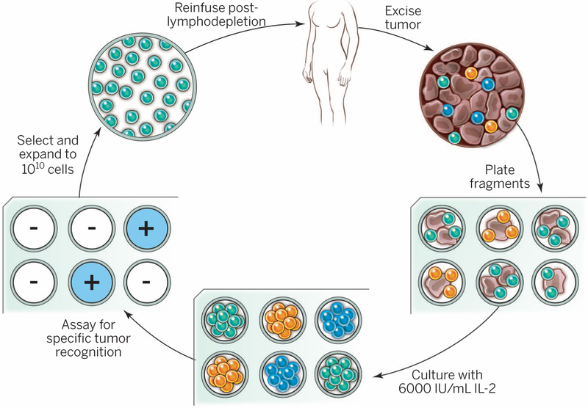
The schema as we know it
What is your schema?
Notes:
The resected melanoma specimen is digested into a single-cell suspension or divided into multiple tumor fragments that are individually grown in IL-2. Lymphocytes overgrow, destroy tumors within 2 to 3 weeks, and generate pure cultures of lymphocytes that can be tested for reactivity in coculture assays. Individual cultures are then rapidly expanded in the presence of excess irradiated feeder lymphocytes, OKT3, and IL-2. By approximately 5 to 6 weeks after resecting the tumor, up to 10¹¹ lymphocytes can be obtained for infusion into patients.
Lymphodepletion first for persistence.

Slide 3
Our data
4 responders & 4 non responders from Ella institute
Melanoma
History of immunotherapy – No
Site of TIL harvest ?

Slide 4
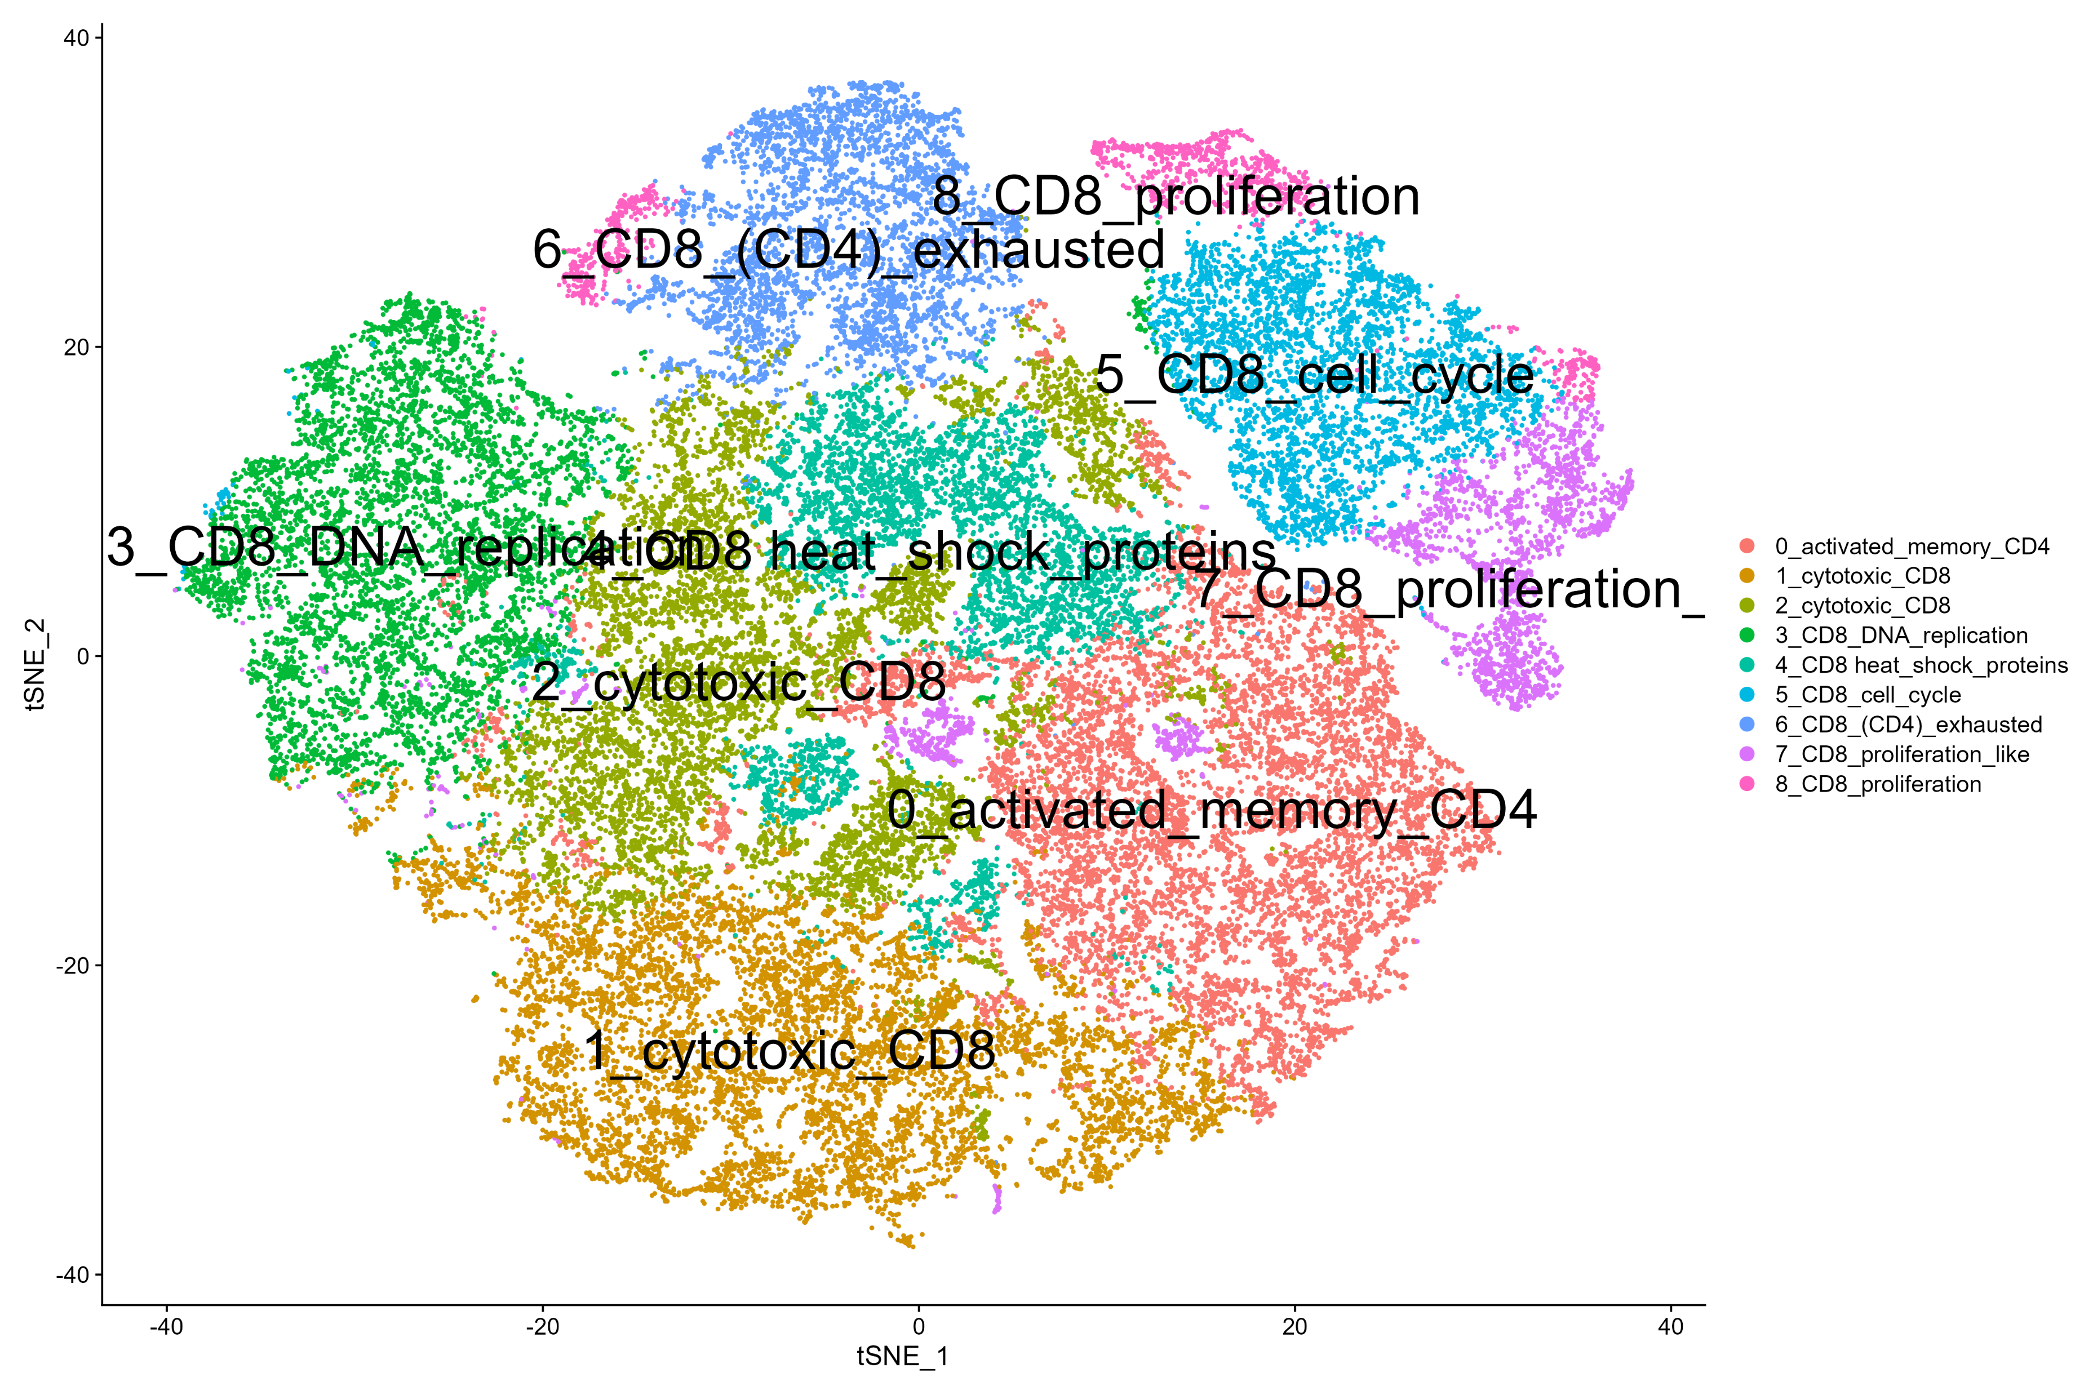
tSNE

Slide 5
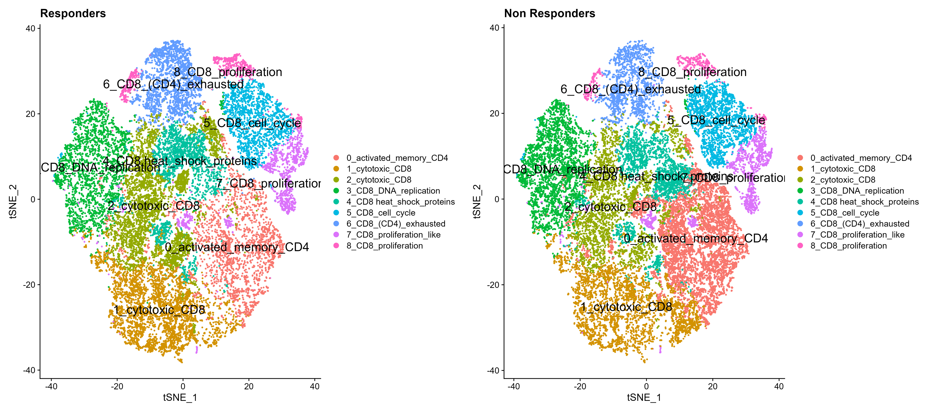
tSNE by response

Slide 6
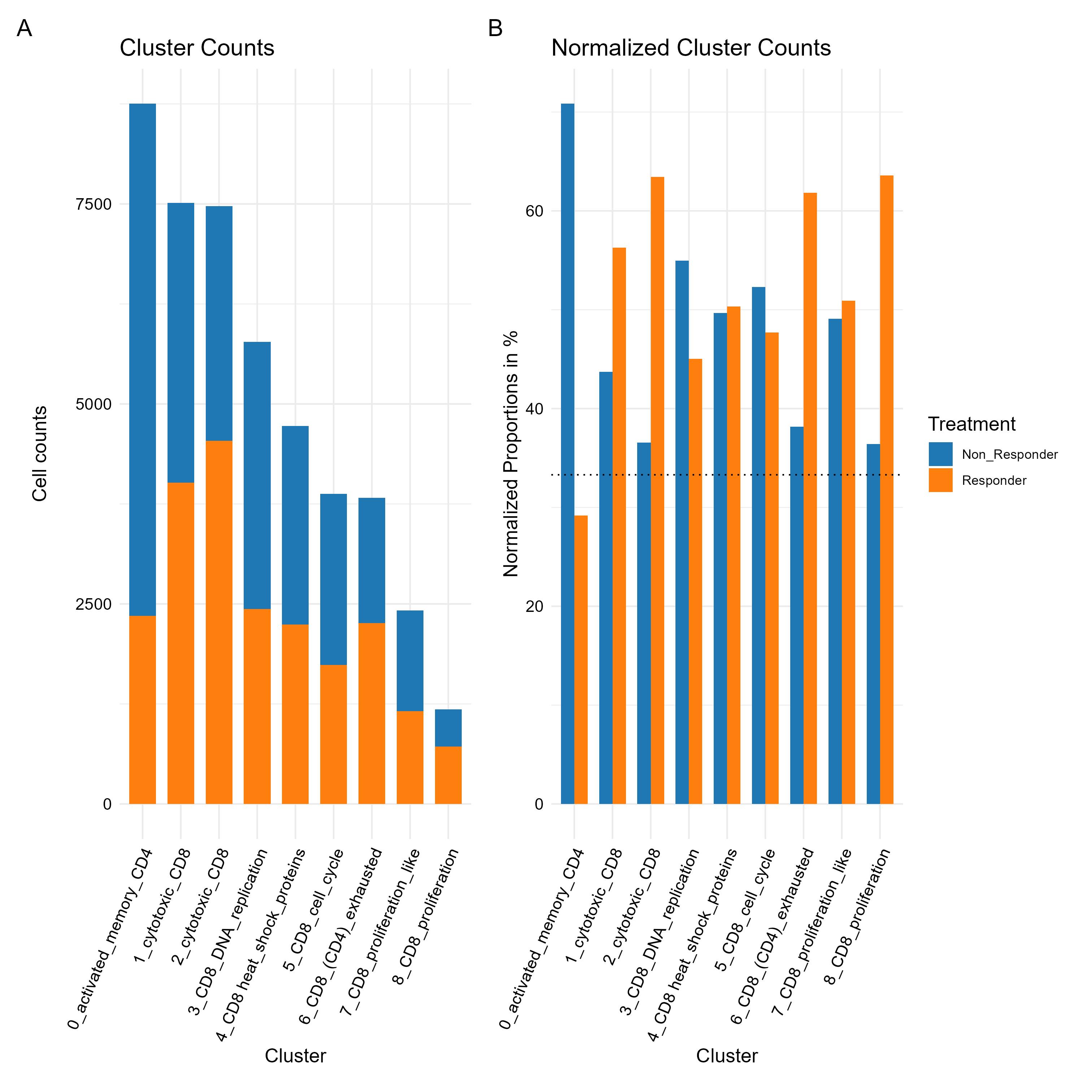
All cells unnormalized + normalized contribution of each sample to each cluster

Slide 7
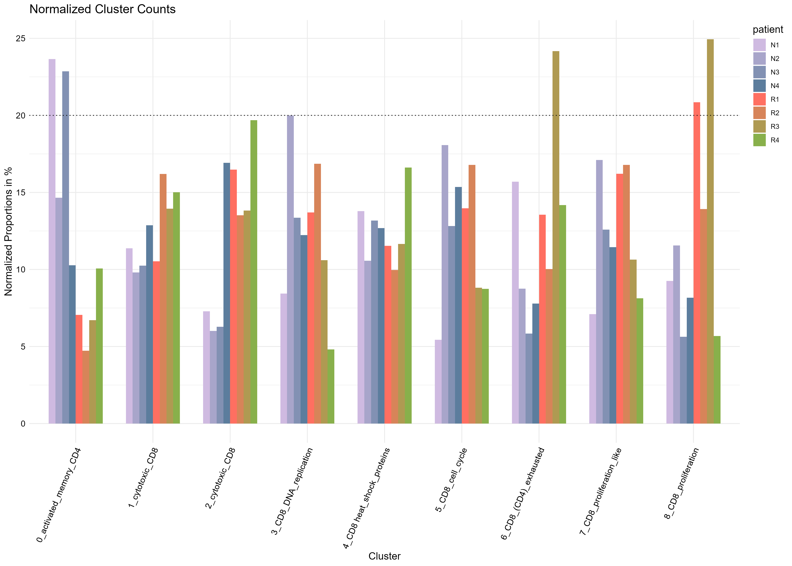
contribution per patient

Slide 8
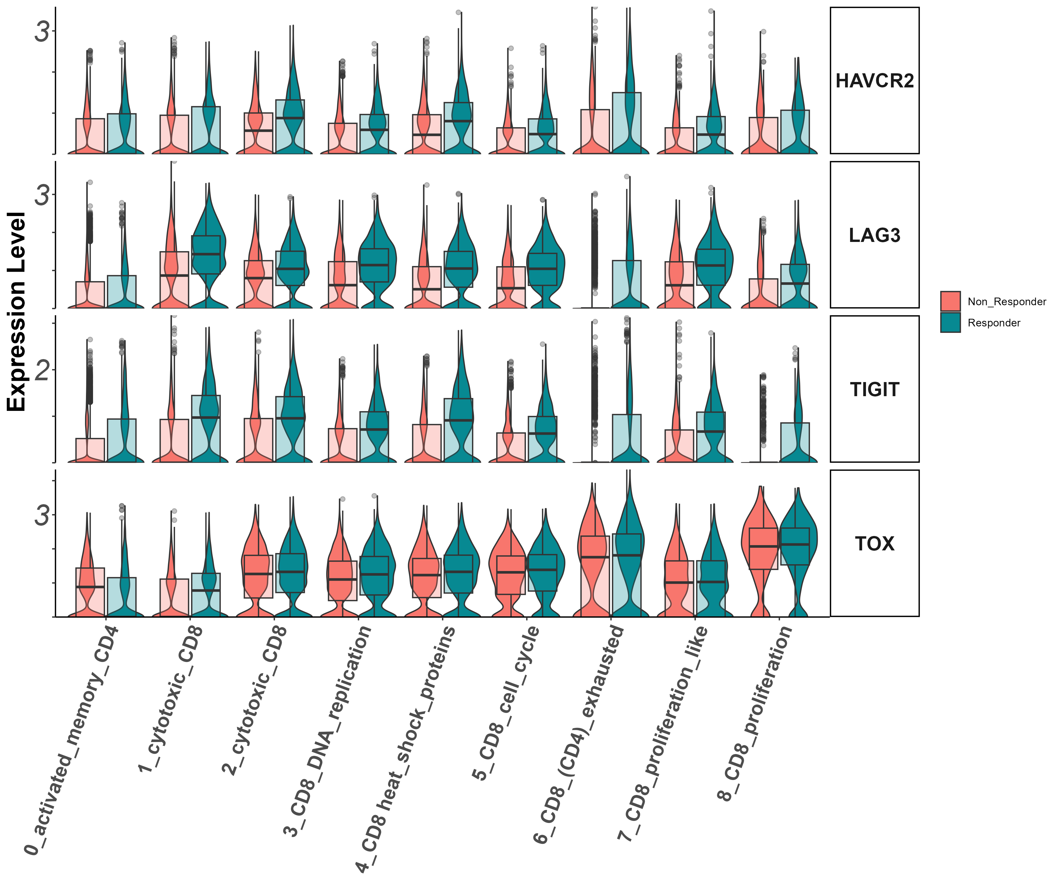
activation/exhaustion markers Tigit, Lag3, Havcr2, Tox (vln)

Slide 9
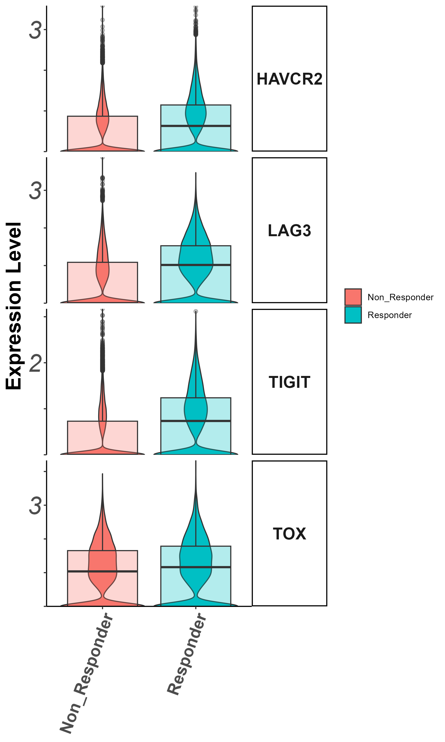
exhaustion markers Tigit, Lag3, Havcr2, Tox
(groupby_treatment)

Slide 10
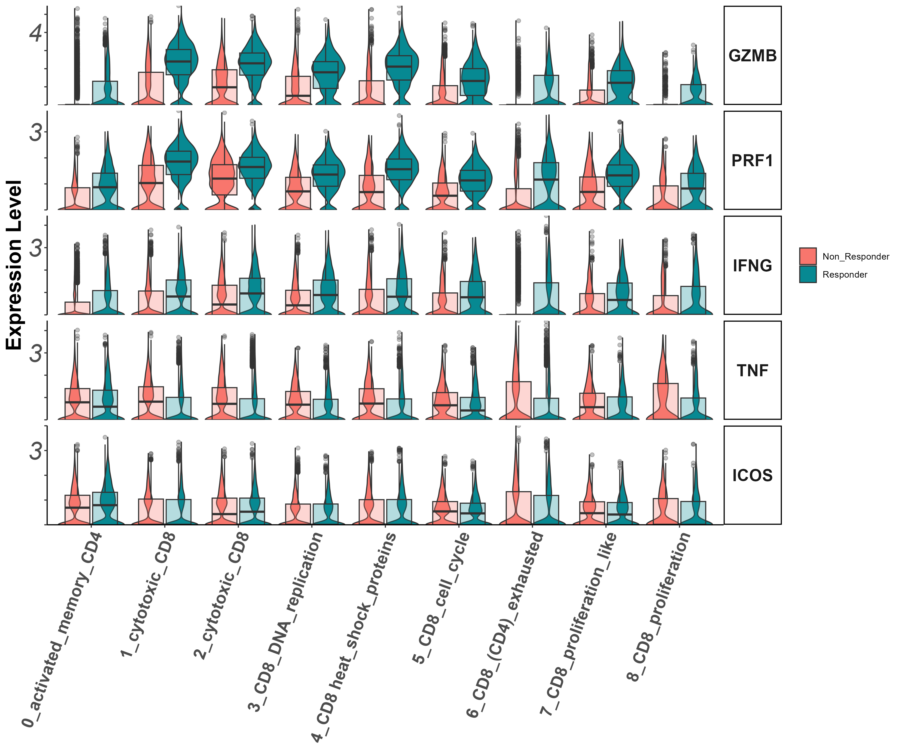
Effector markers
Gzmb, Prf1, Ifng, Il7r (vln)

Slide 11
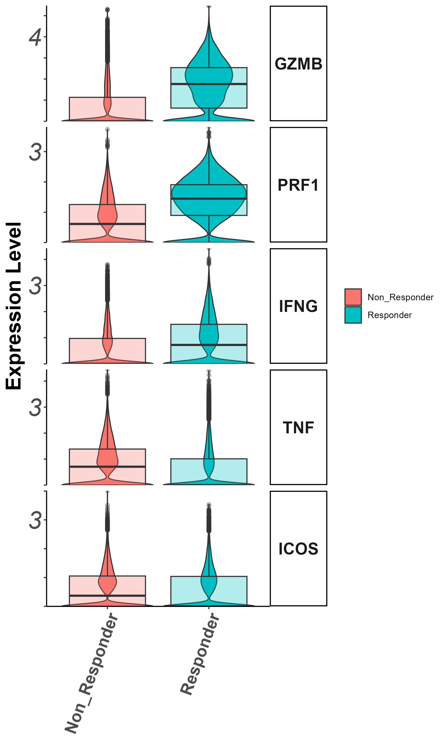
Effector markers
Gzmb, Prf1, Ifng, Tnf, Icos (groupby_treatment)

Slide 12
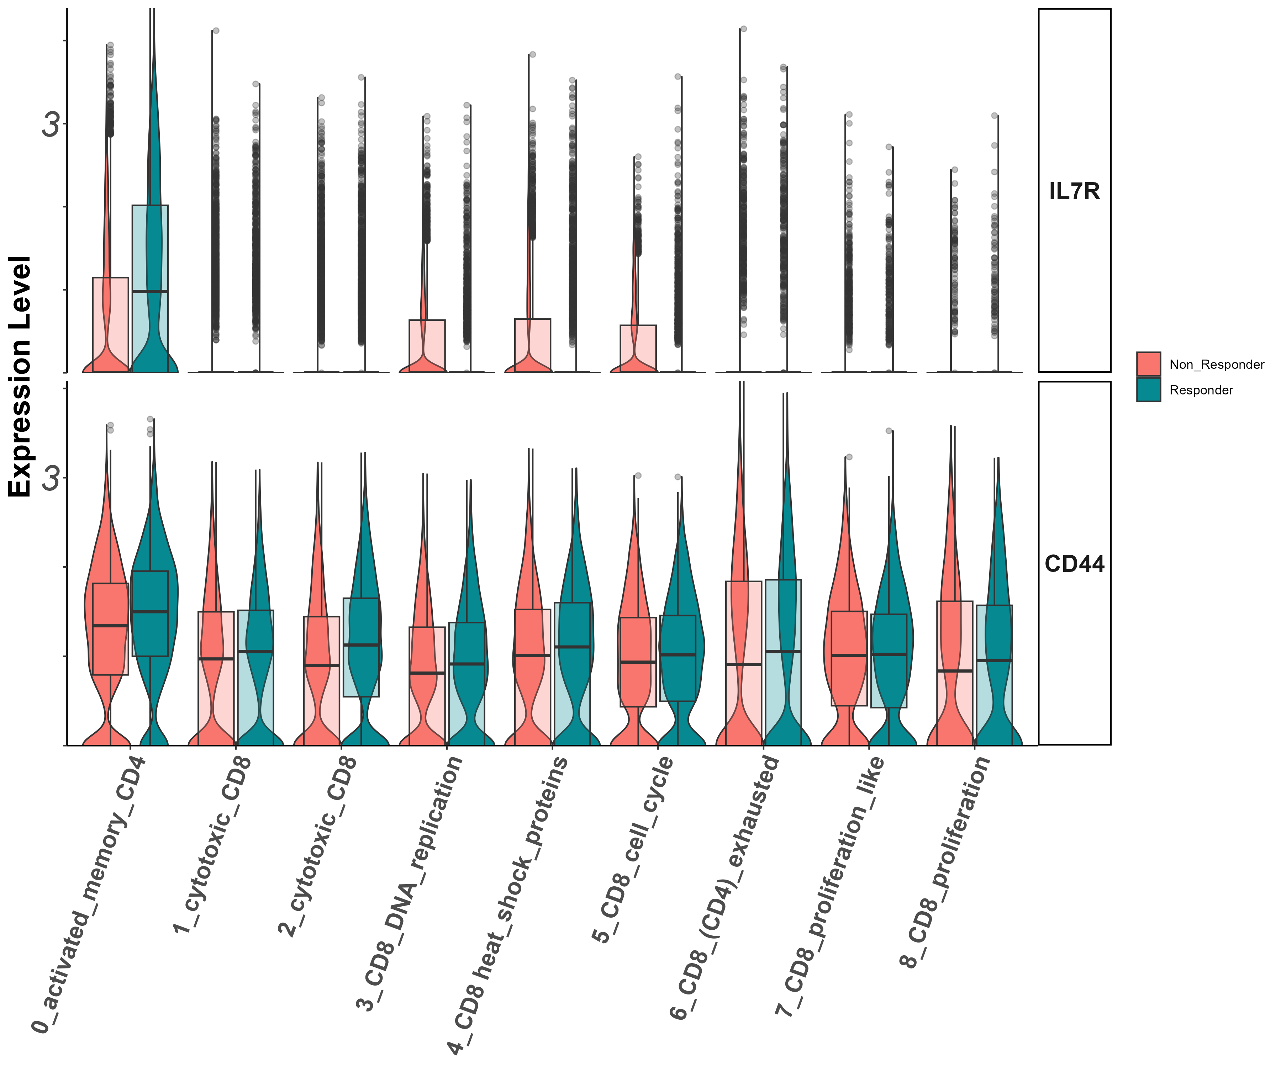
Stem/persister/naïve markers
Il7r, CD44
(vln)

Slide 13
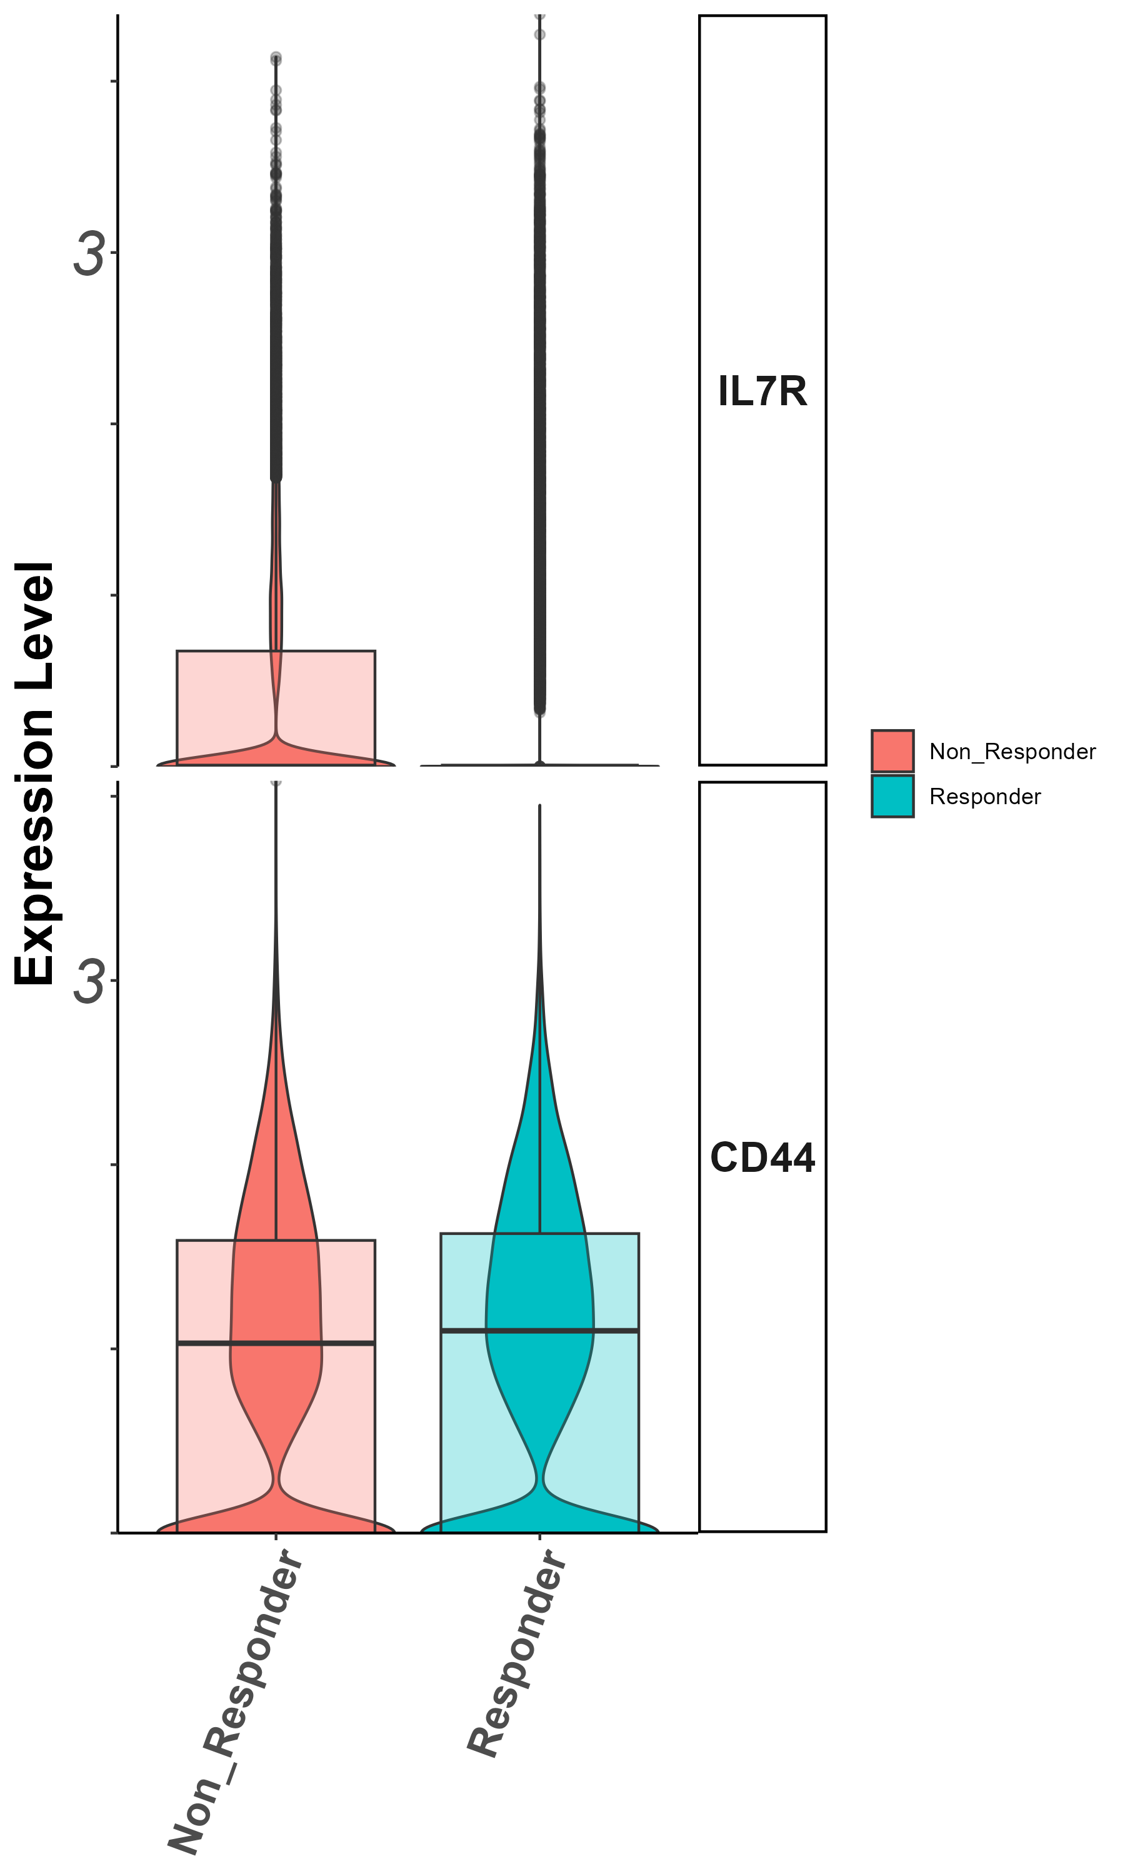
Stem/persister/naïve markers
Il7r, CD44
(groupby_treatment)

Slide 14
Summary – all cells
Patients are coherent in response groups in large clusters.
Non responders show lower CD8/CD4 ratio.
Higher expression of activation and effector markers in responders vs. non-responders.

Slide 15
Cluster 0 (CD4/non responders) zoom in analysis
Notes:
להוסיף ריבוע מדגיש לקלאסטר אפס

Slide 16
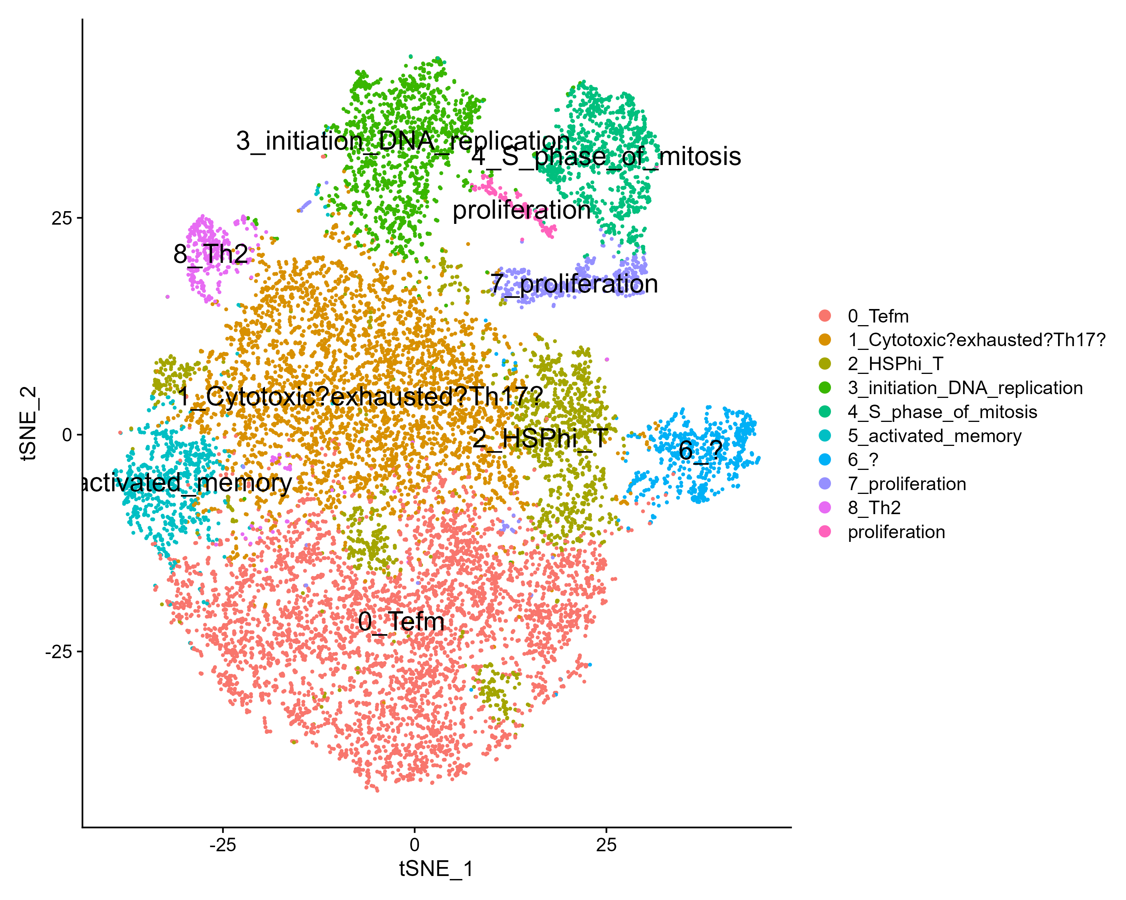
tSNE

Slide 17
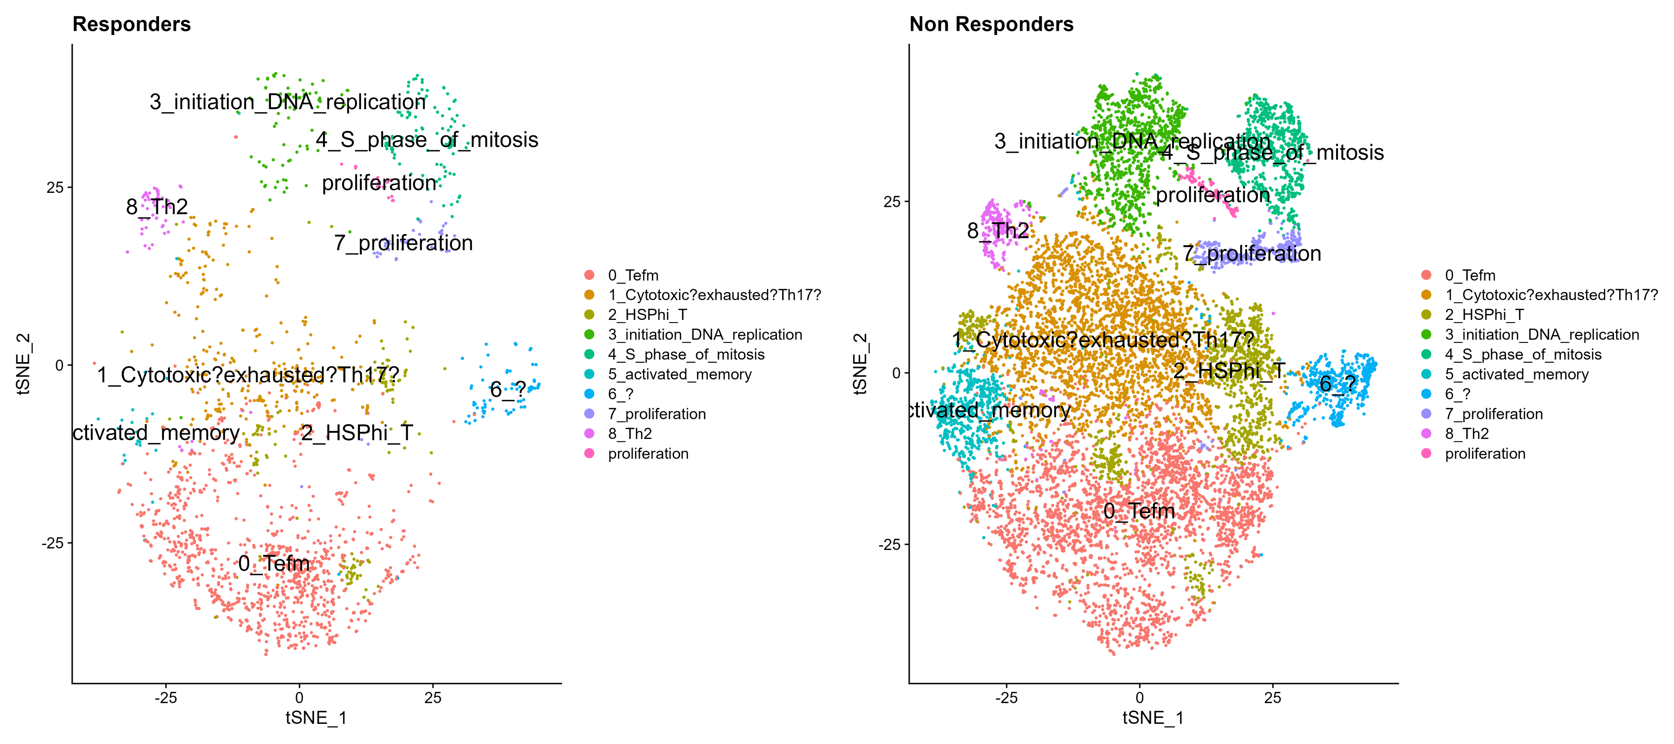
tSNE by response

Slide 18
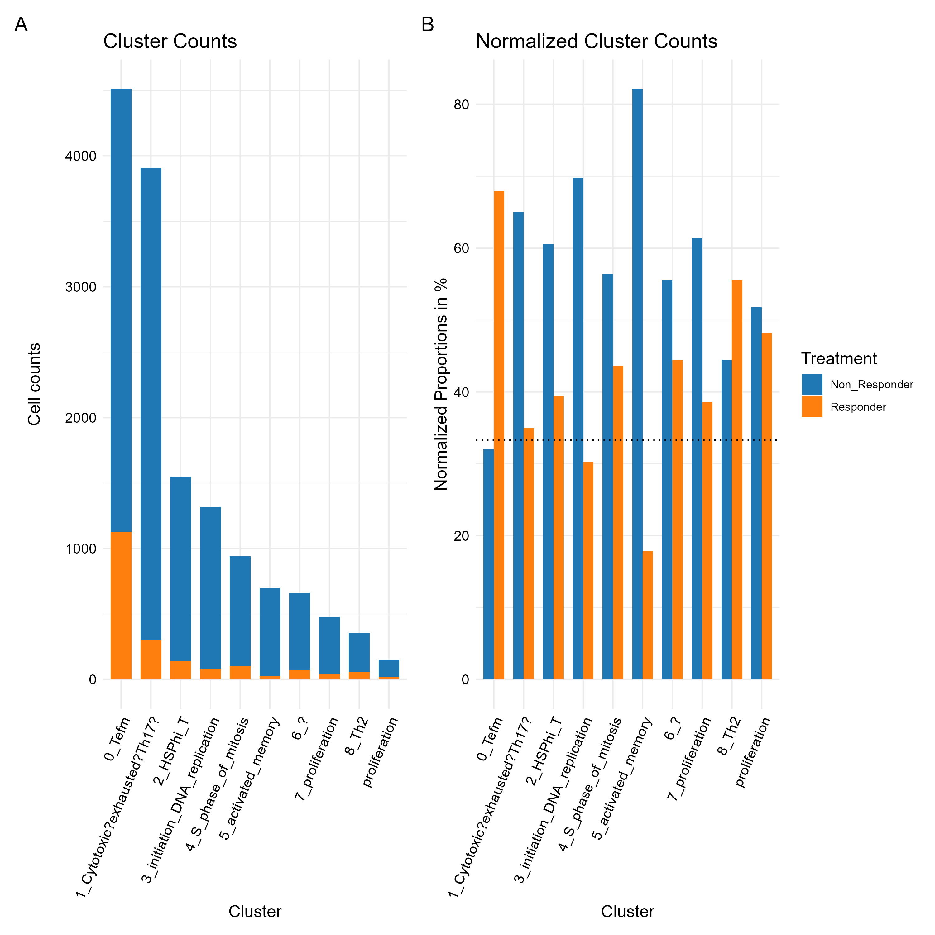
Cluster 0 zoom in analysis contribution per response

Slide 19
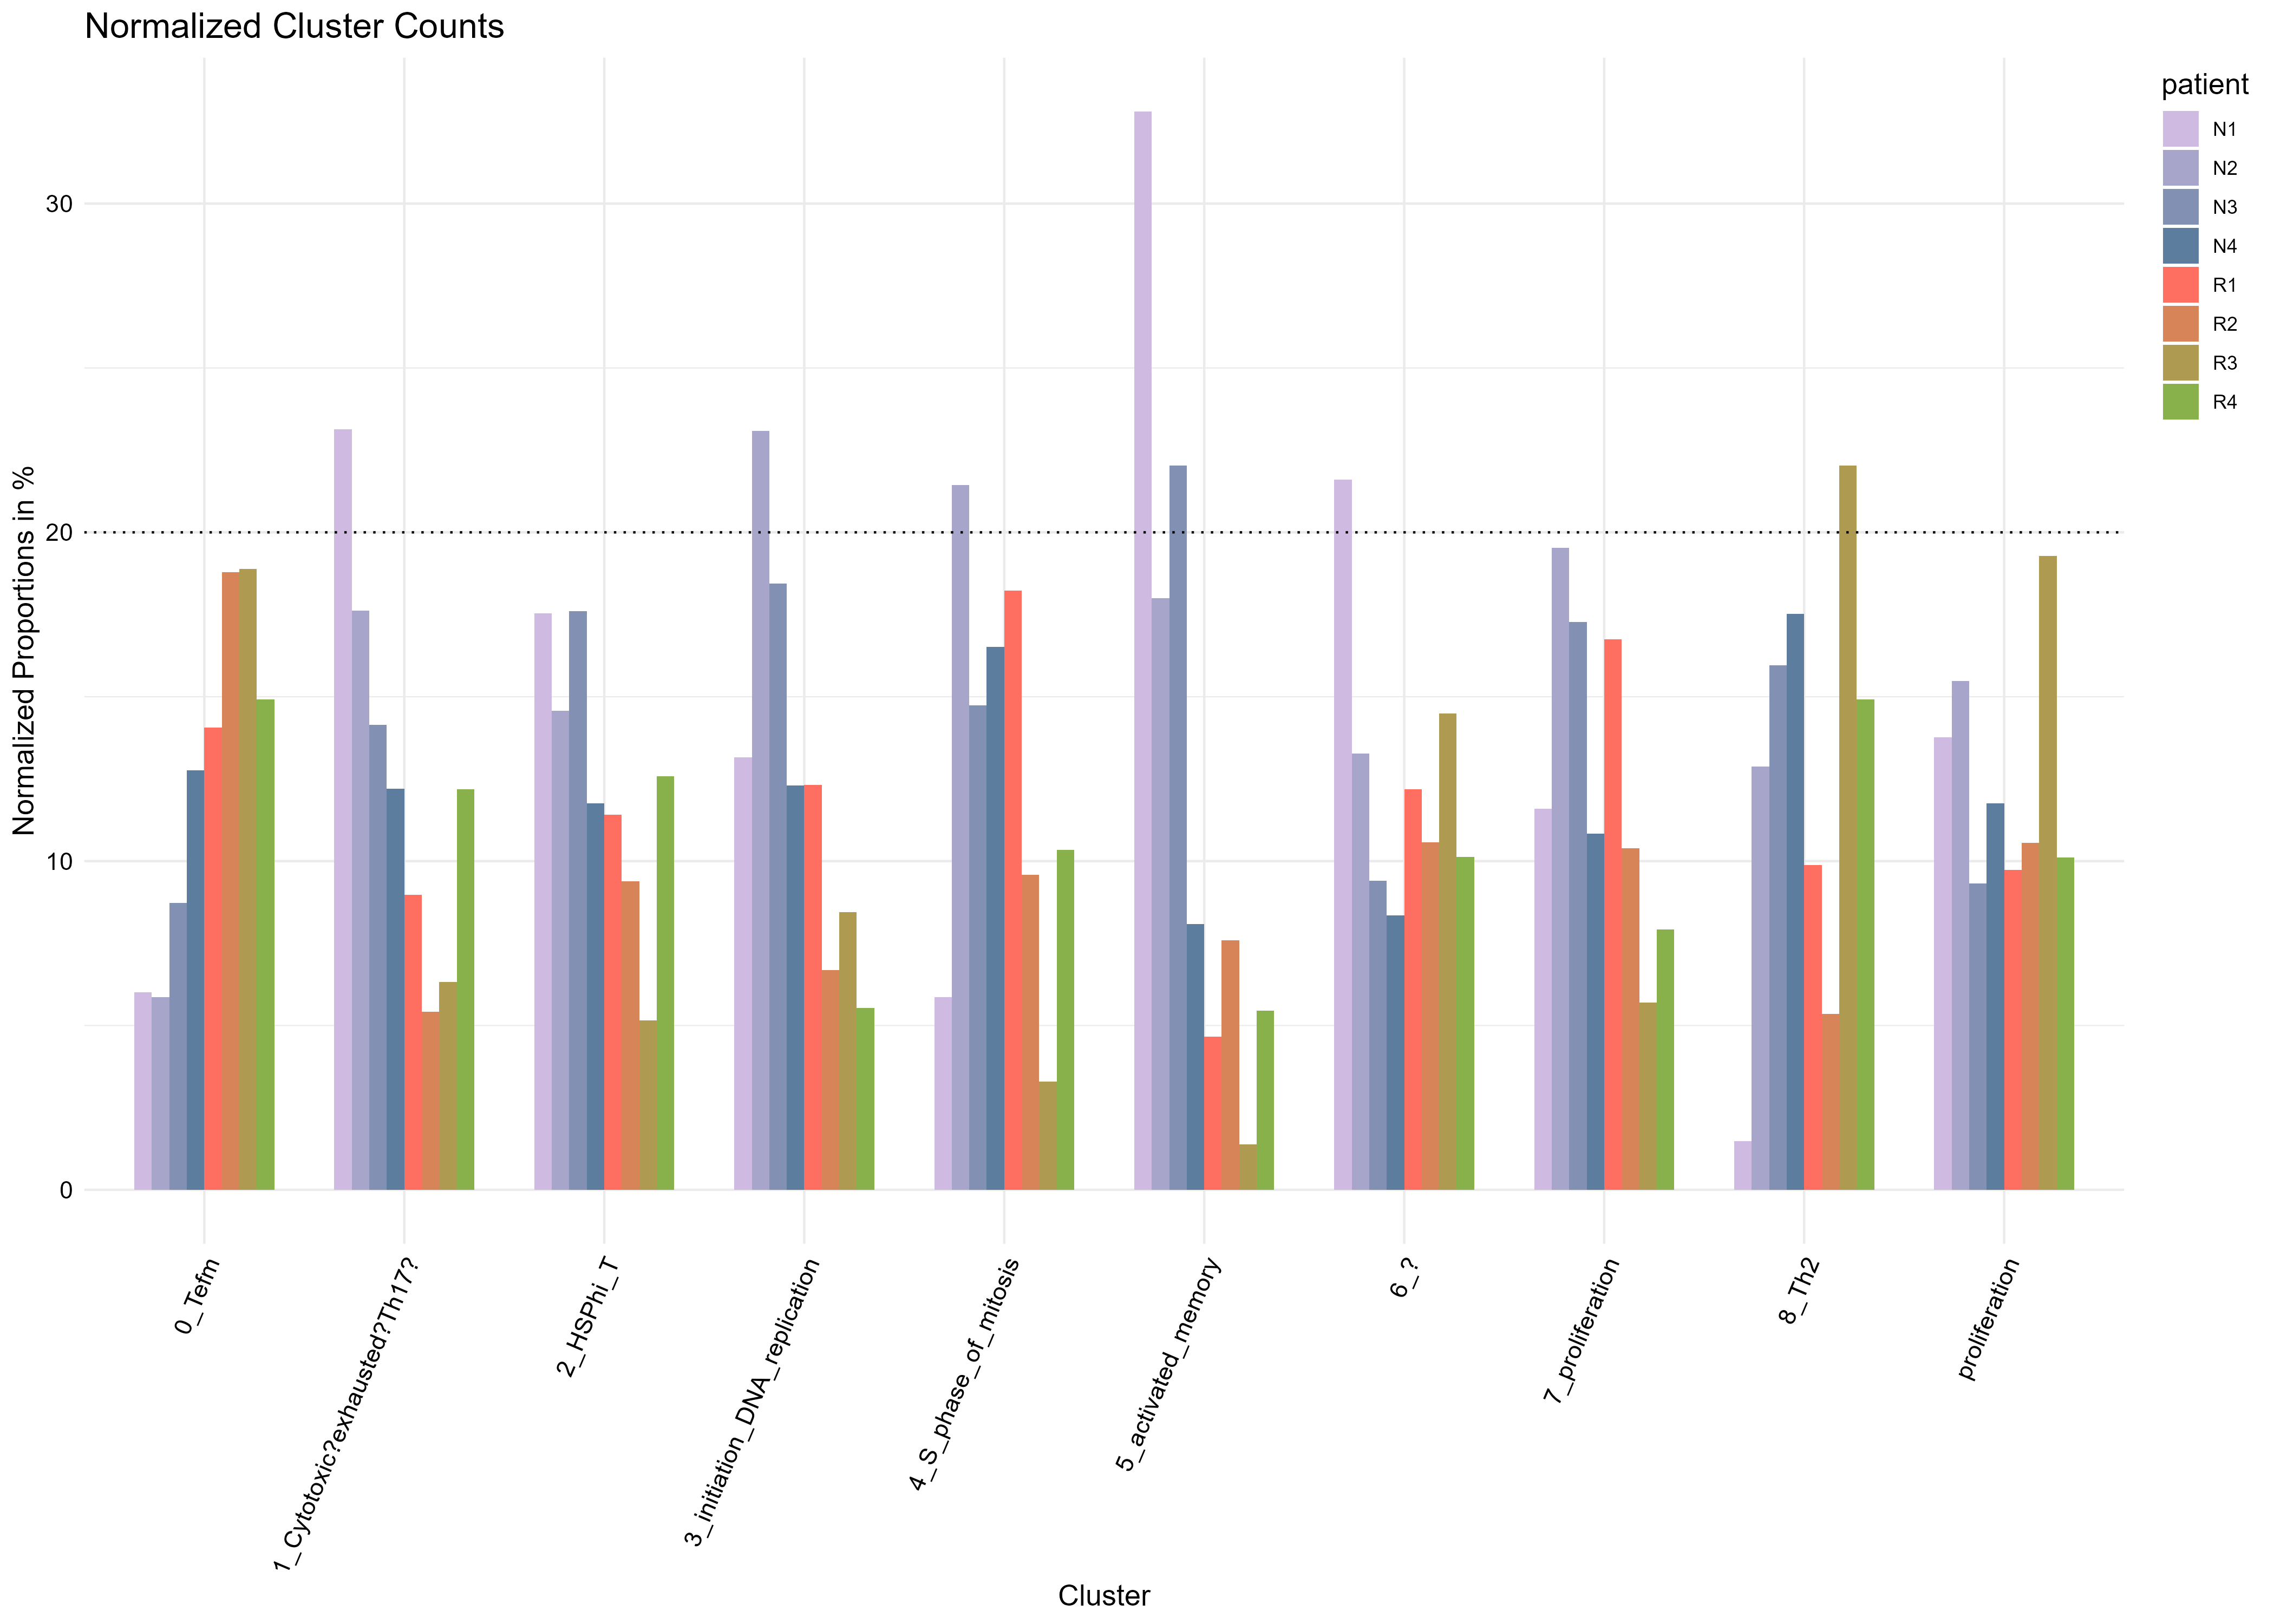
contribution per patient

Slide 20
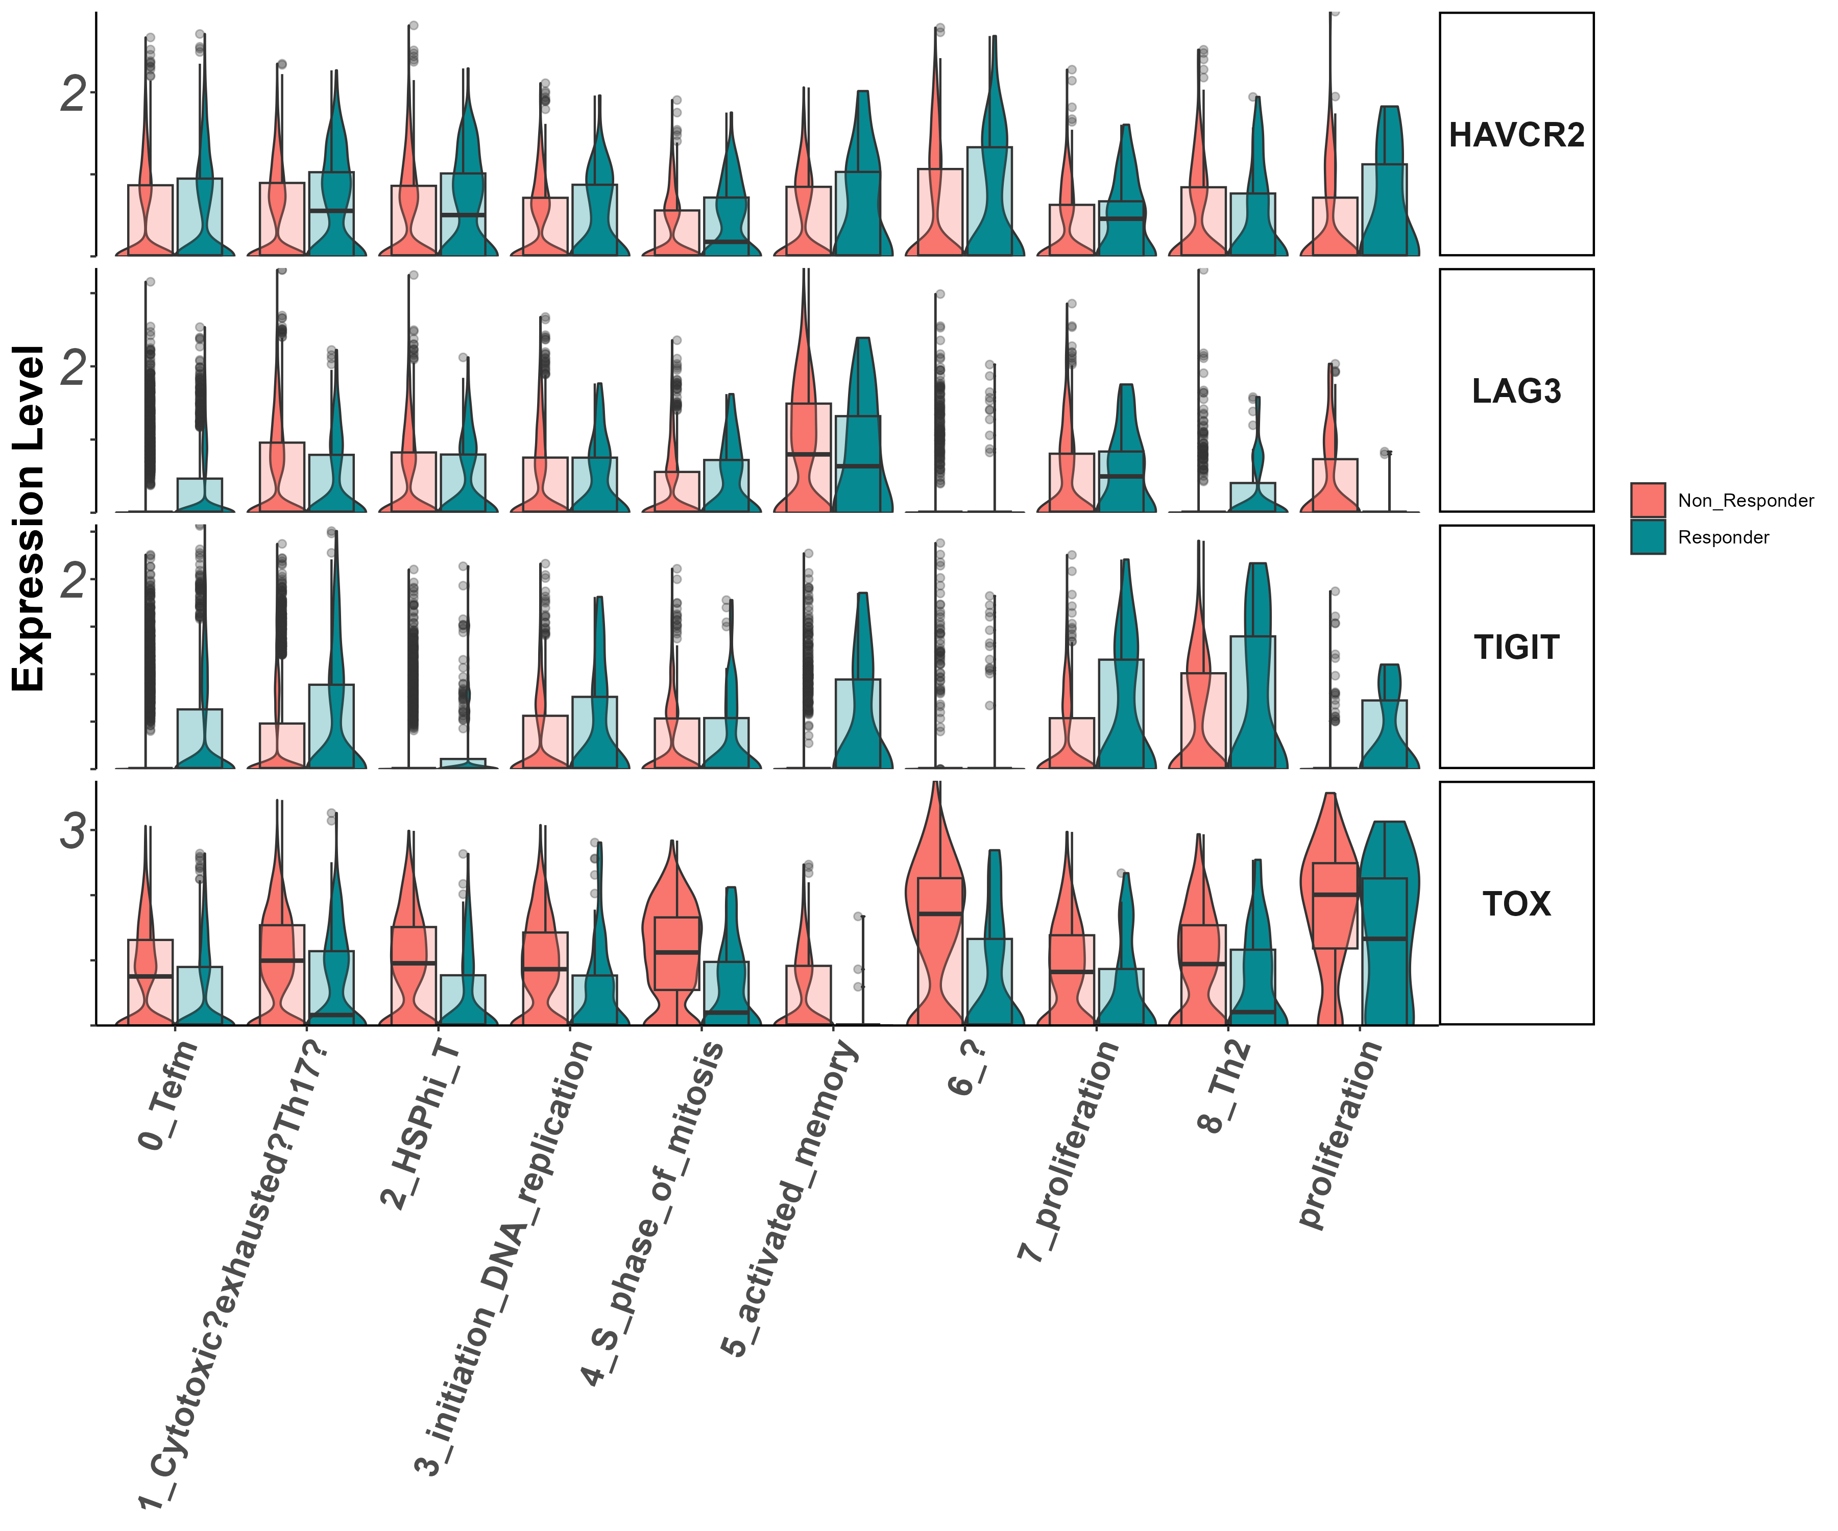
activation/exhaustion markers Tigit, Lag3, Havcr2, Tox (vln)

Slide 21
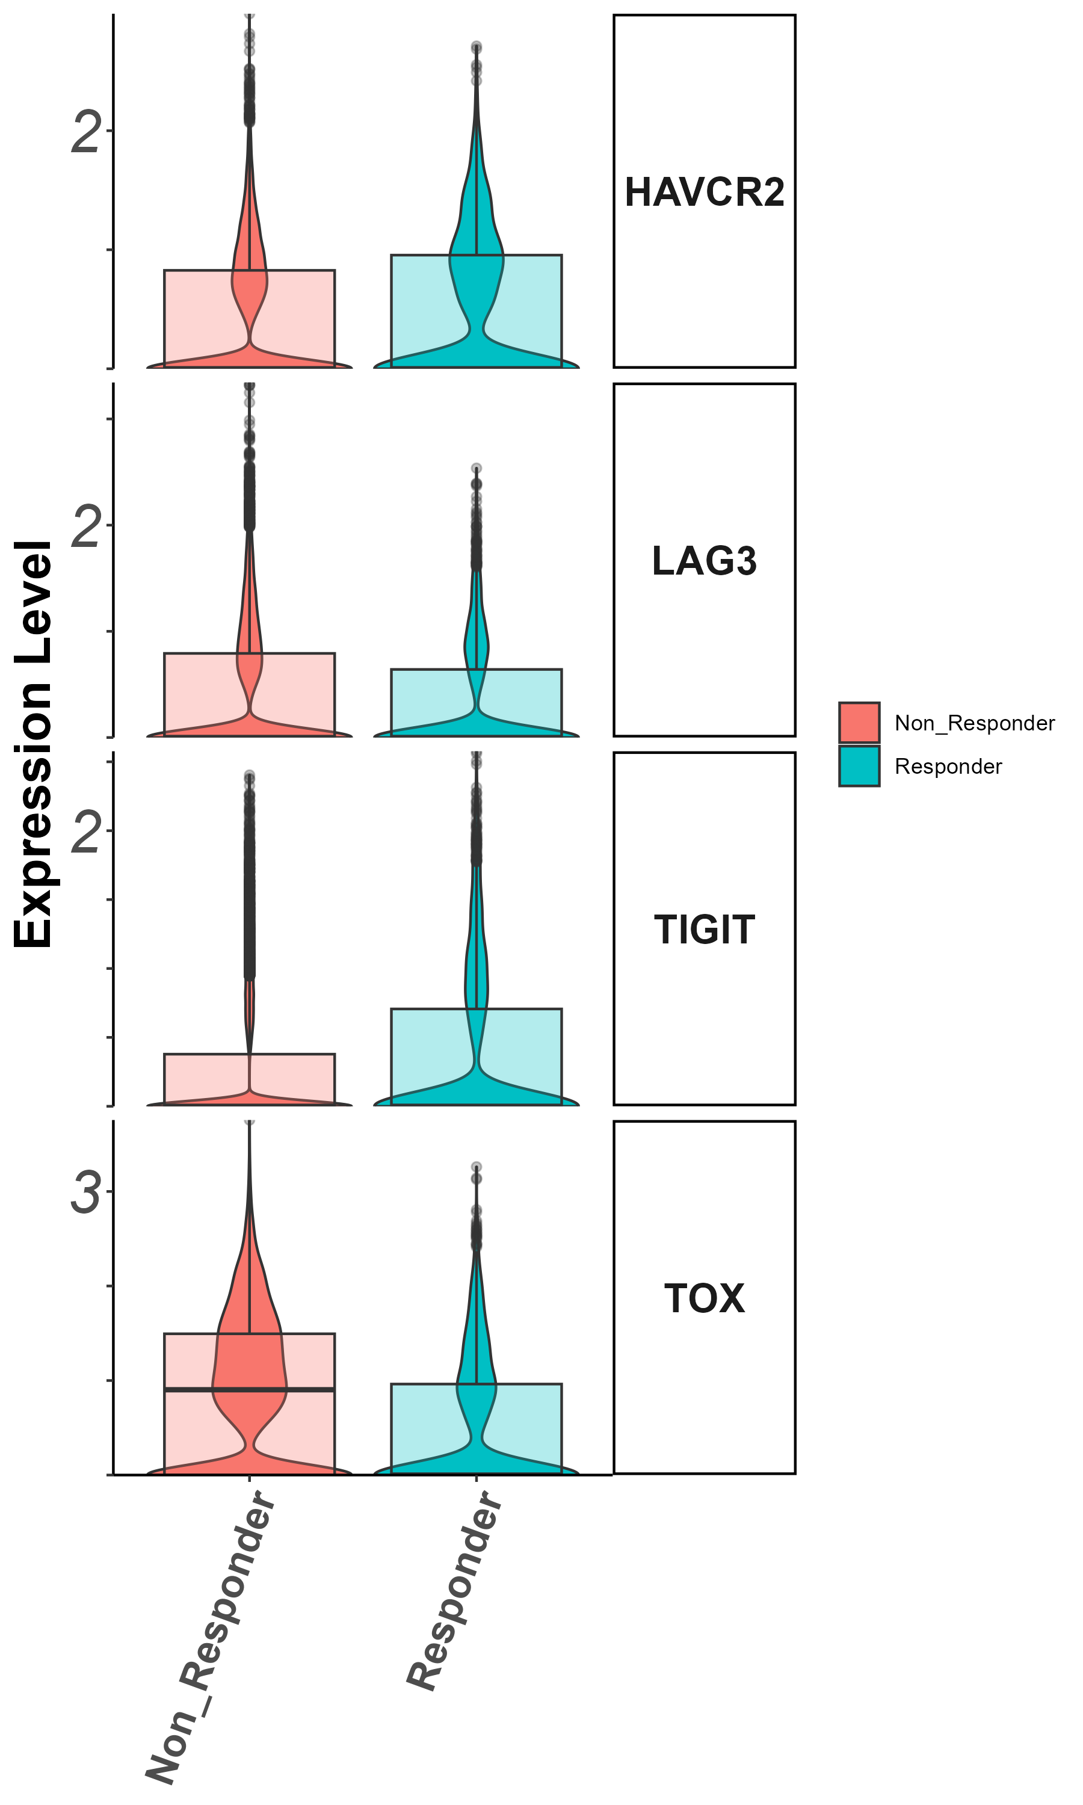
activation/exhaustion markers Tigit, Lag3, Havcr2, Tox
(groupby_treatment)

Slide 22
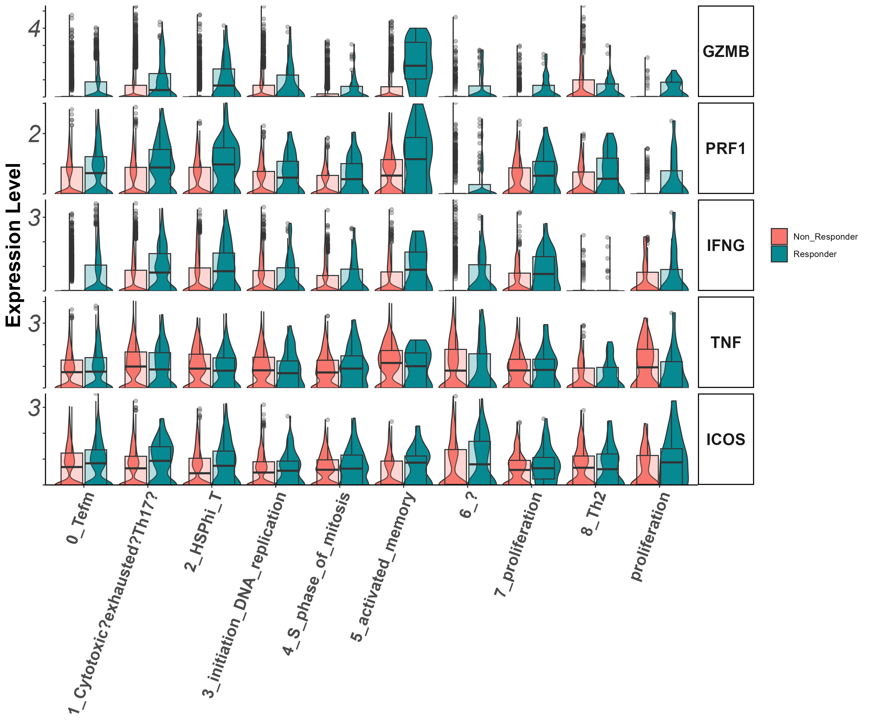
Effector markers
Gzmb, Prf1, Ifng, Tnf, Icos
(vln)

Slide 23
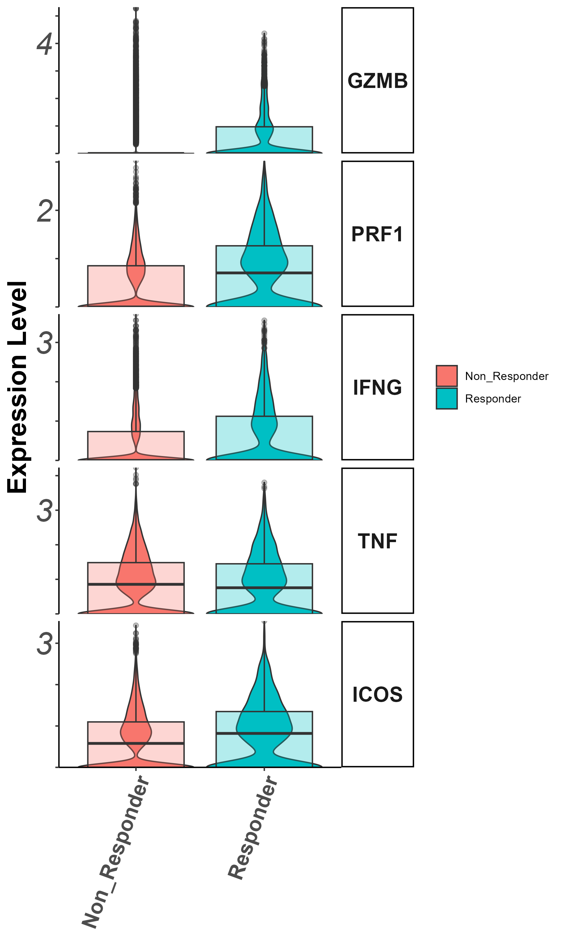
Effector markers
Gzmb, Prf1, Ifng, Il7r (groupby_treatment)

Slide 24
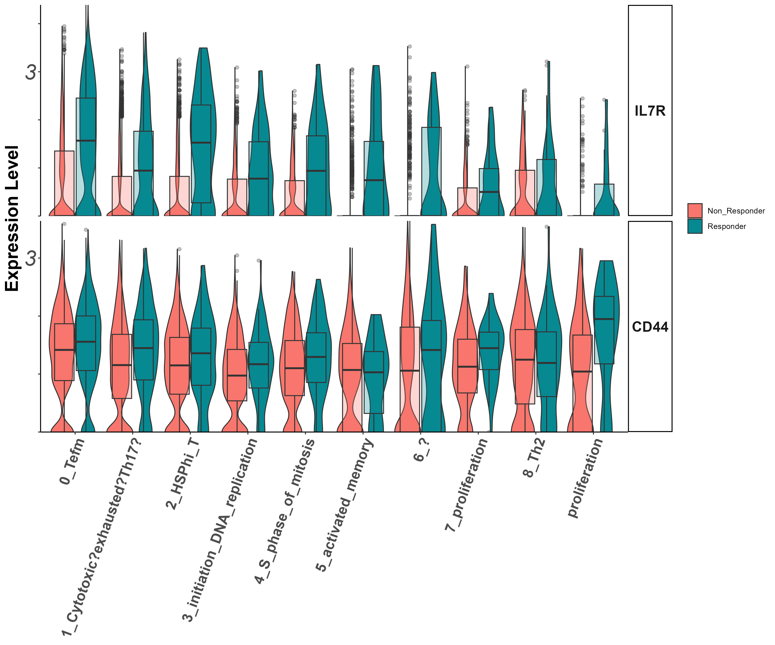
Stem/persister/naïve markers
Il7r, CD44
(vln)

Slide 25
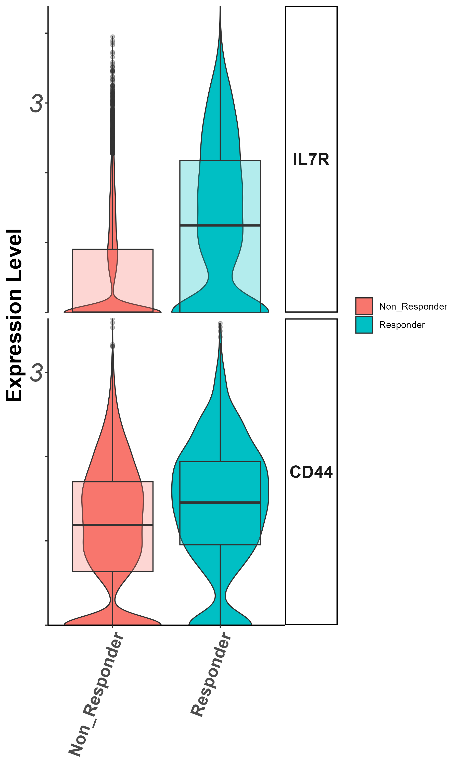
Stem/persister/naïve markers
Il7r, CD44
(groupby_treatment)

Slide 26
Cluster 1 (cytotoxic CD8) zoom in analysis
Notes:
להוסיף ריבוע מדגיש לקלאסטר אפס

Slide 27
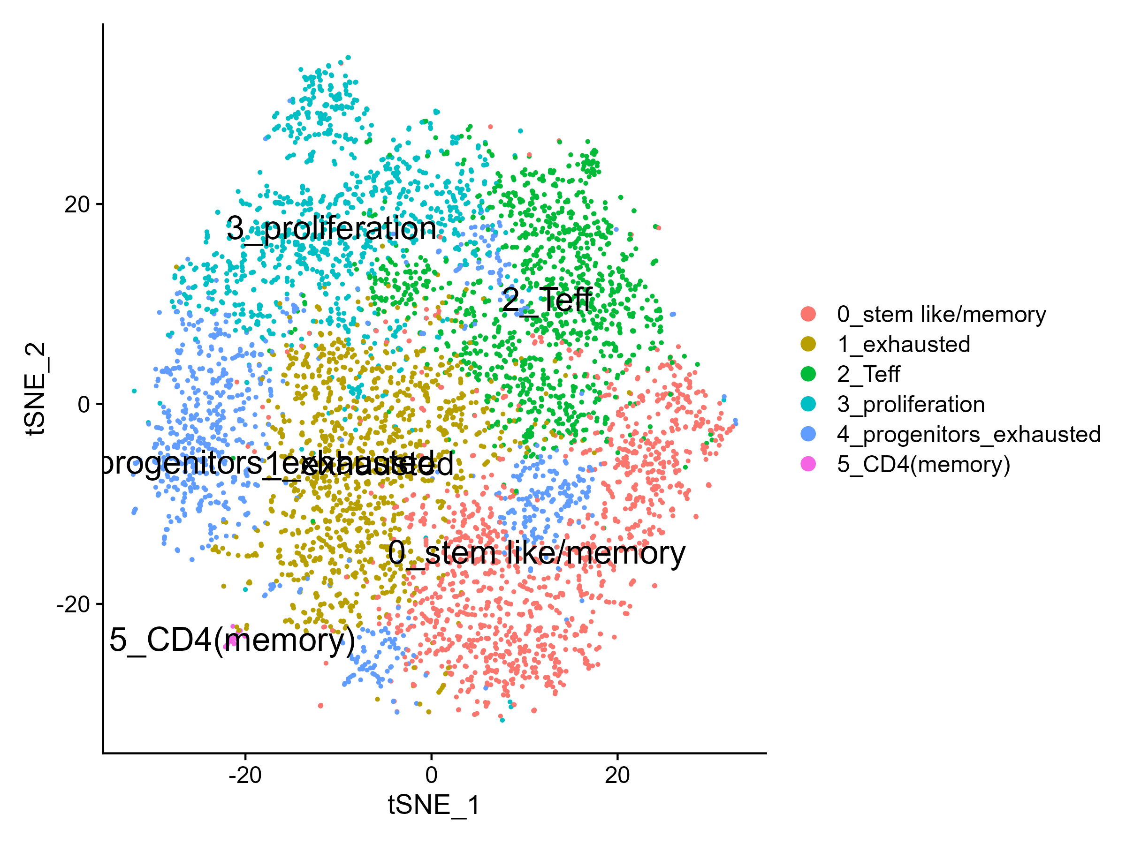
tSNE

Slide 28
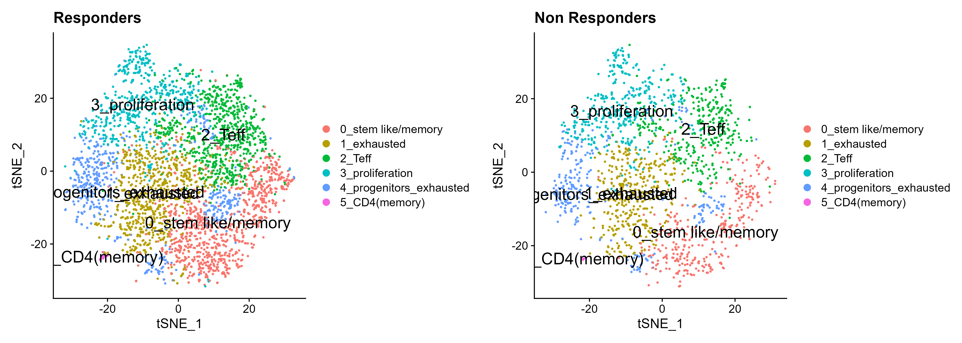
tSNE by response

Slide 29
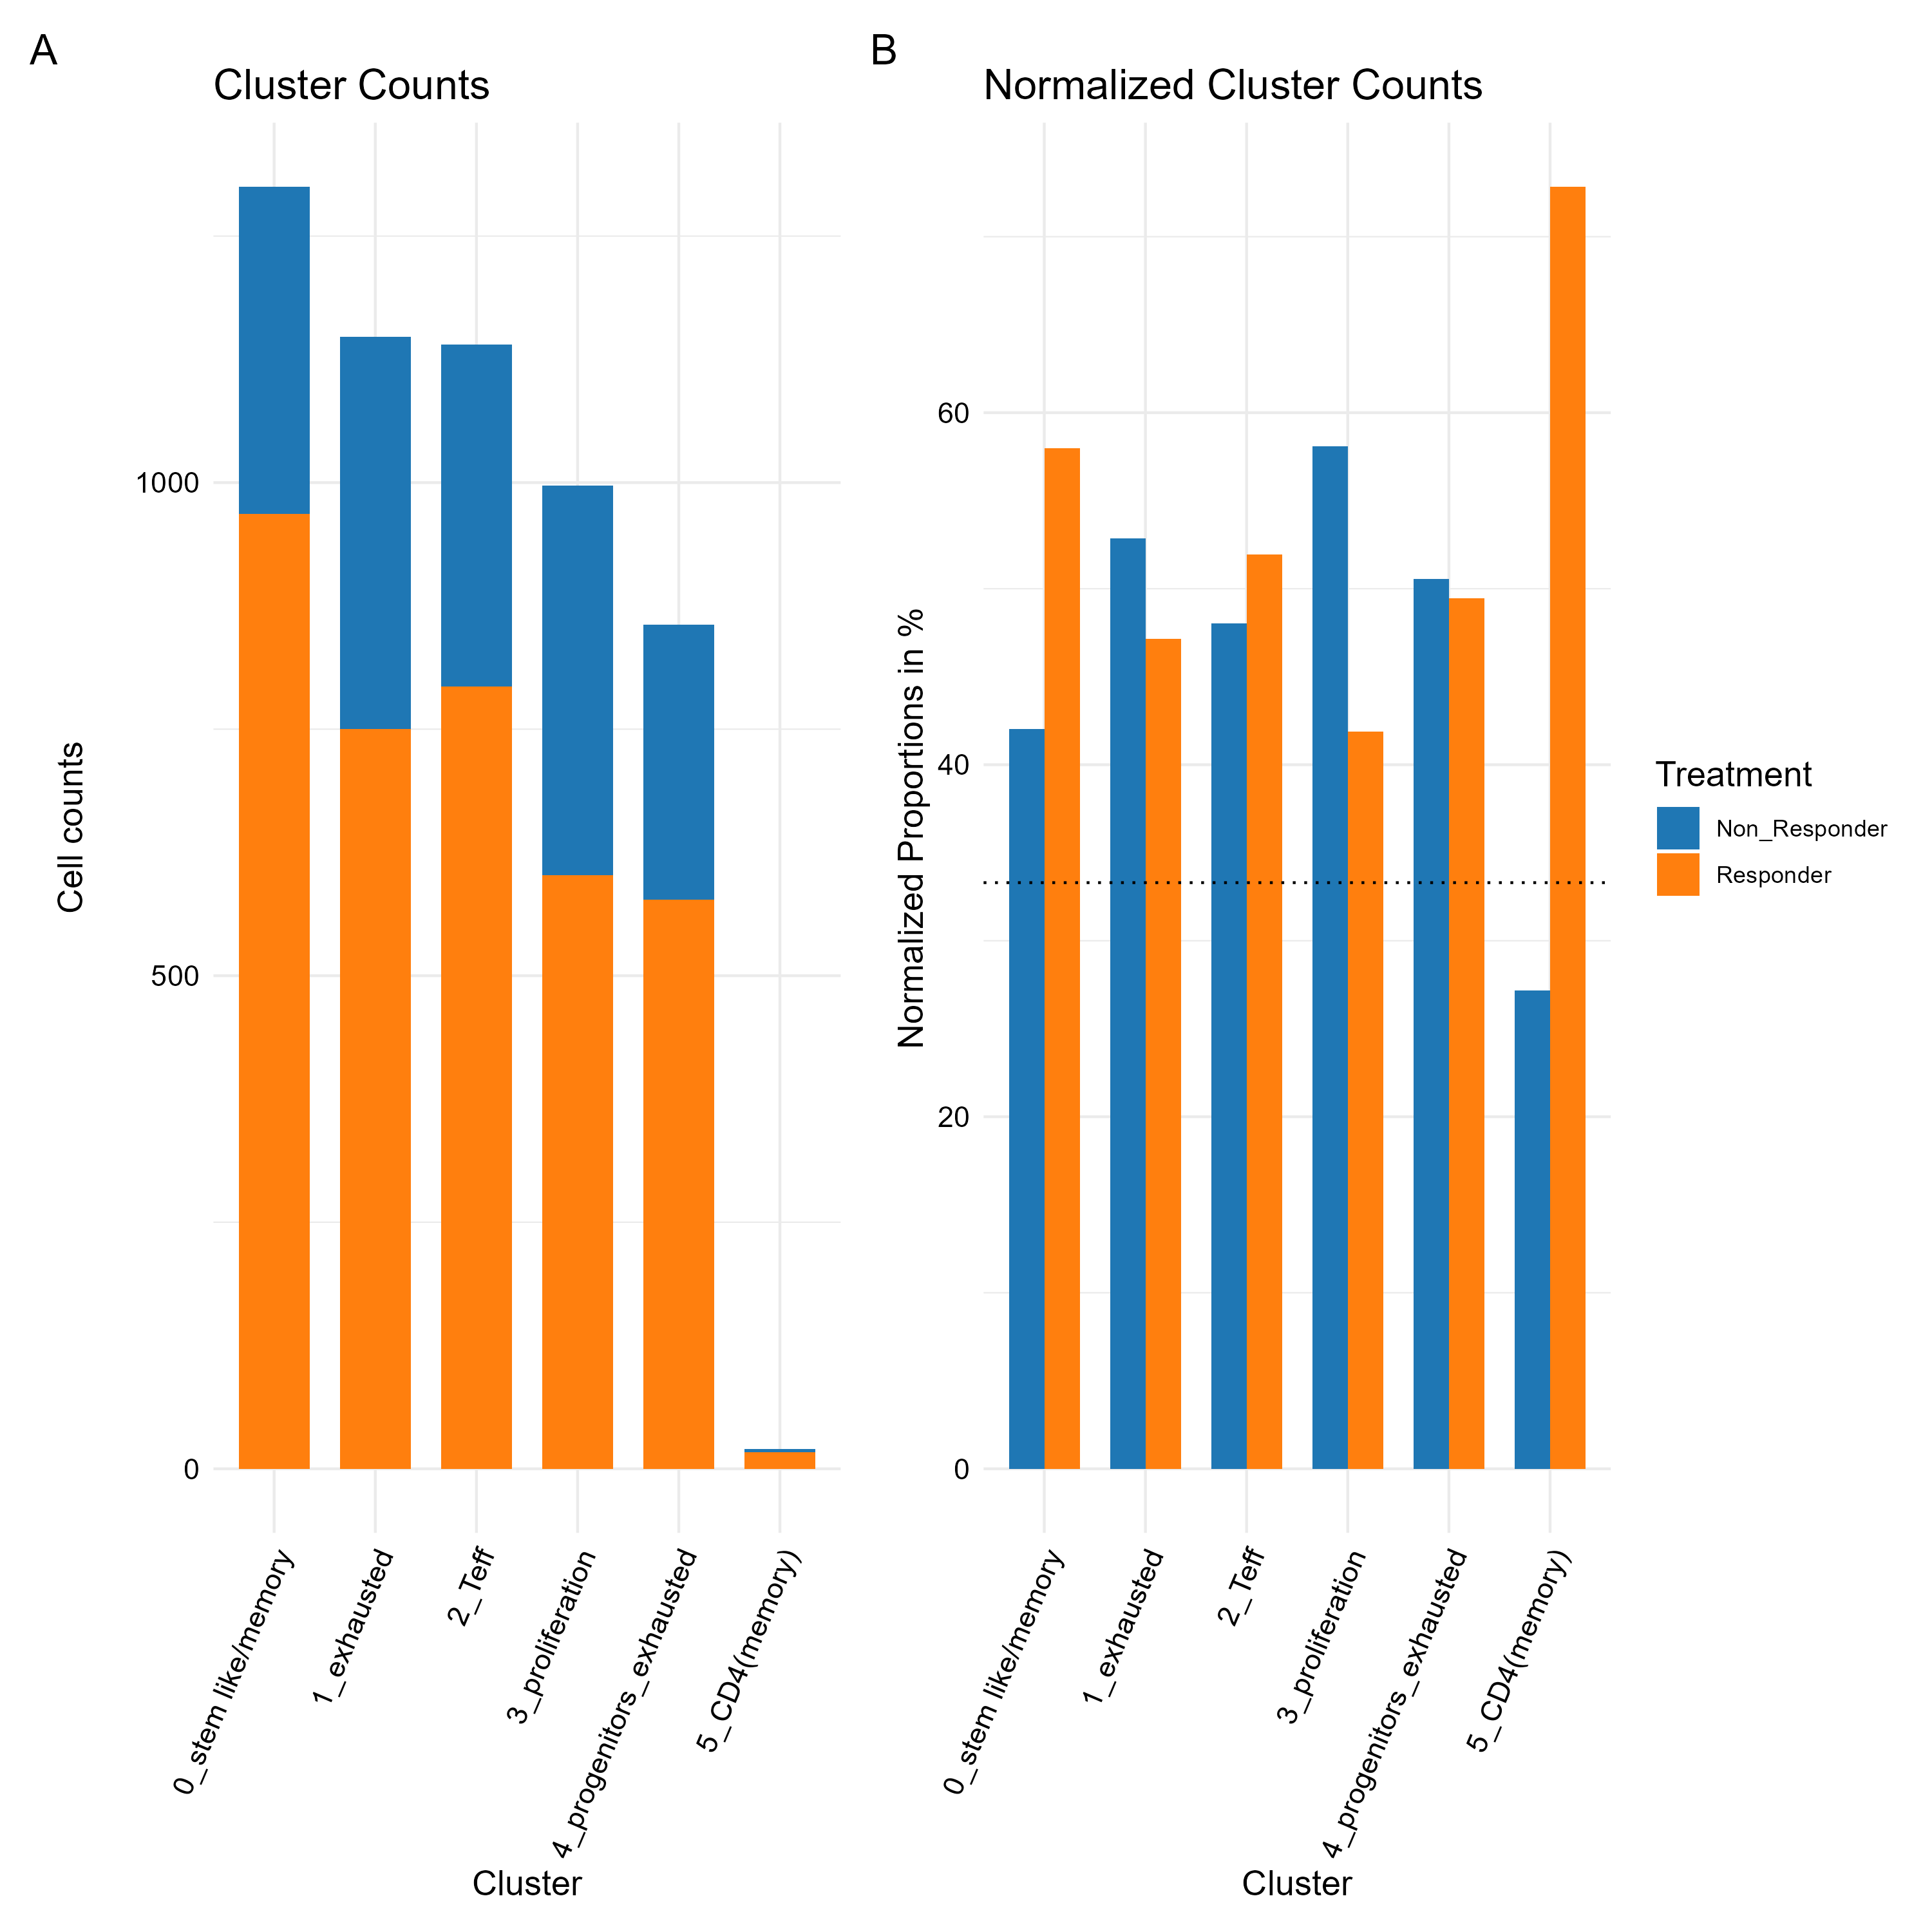
Cluster 1 zoom in analysis contribution per response

Slide 30
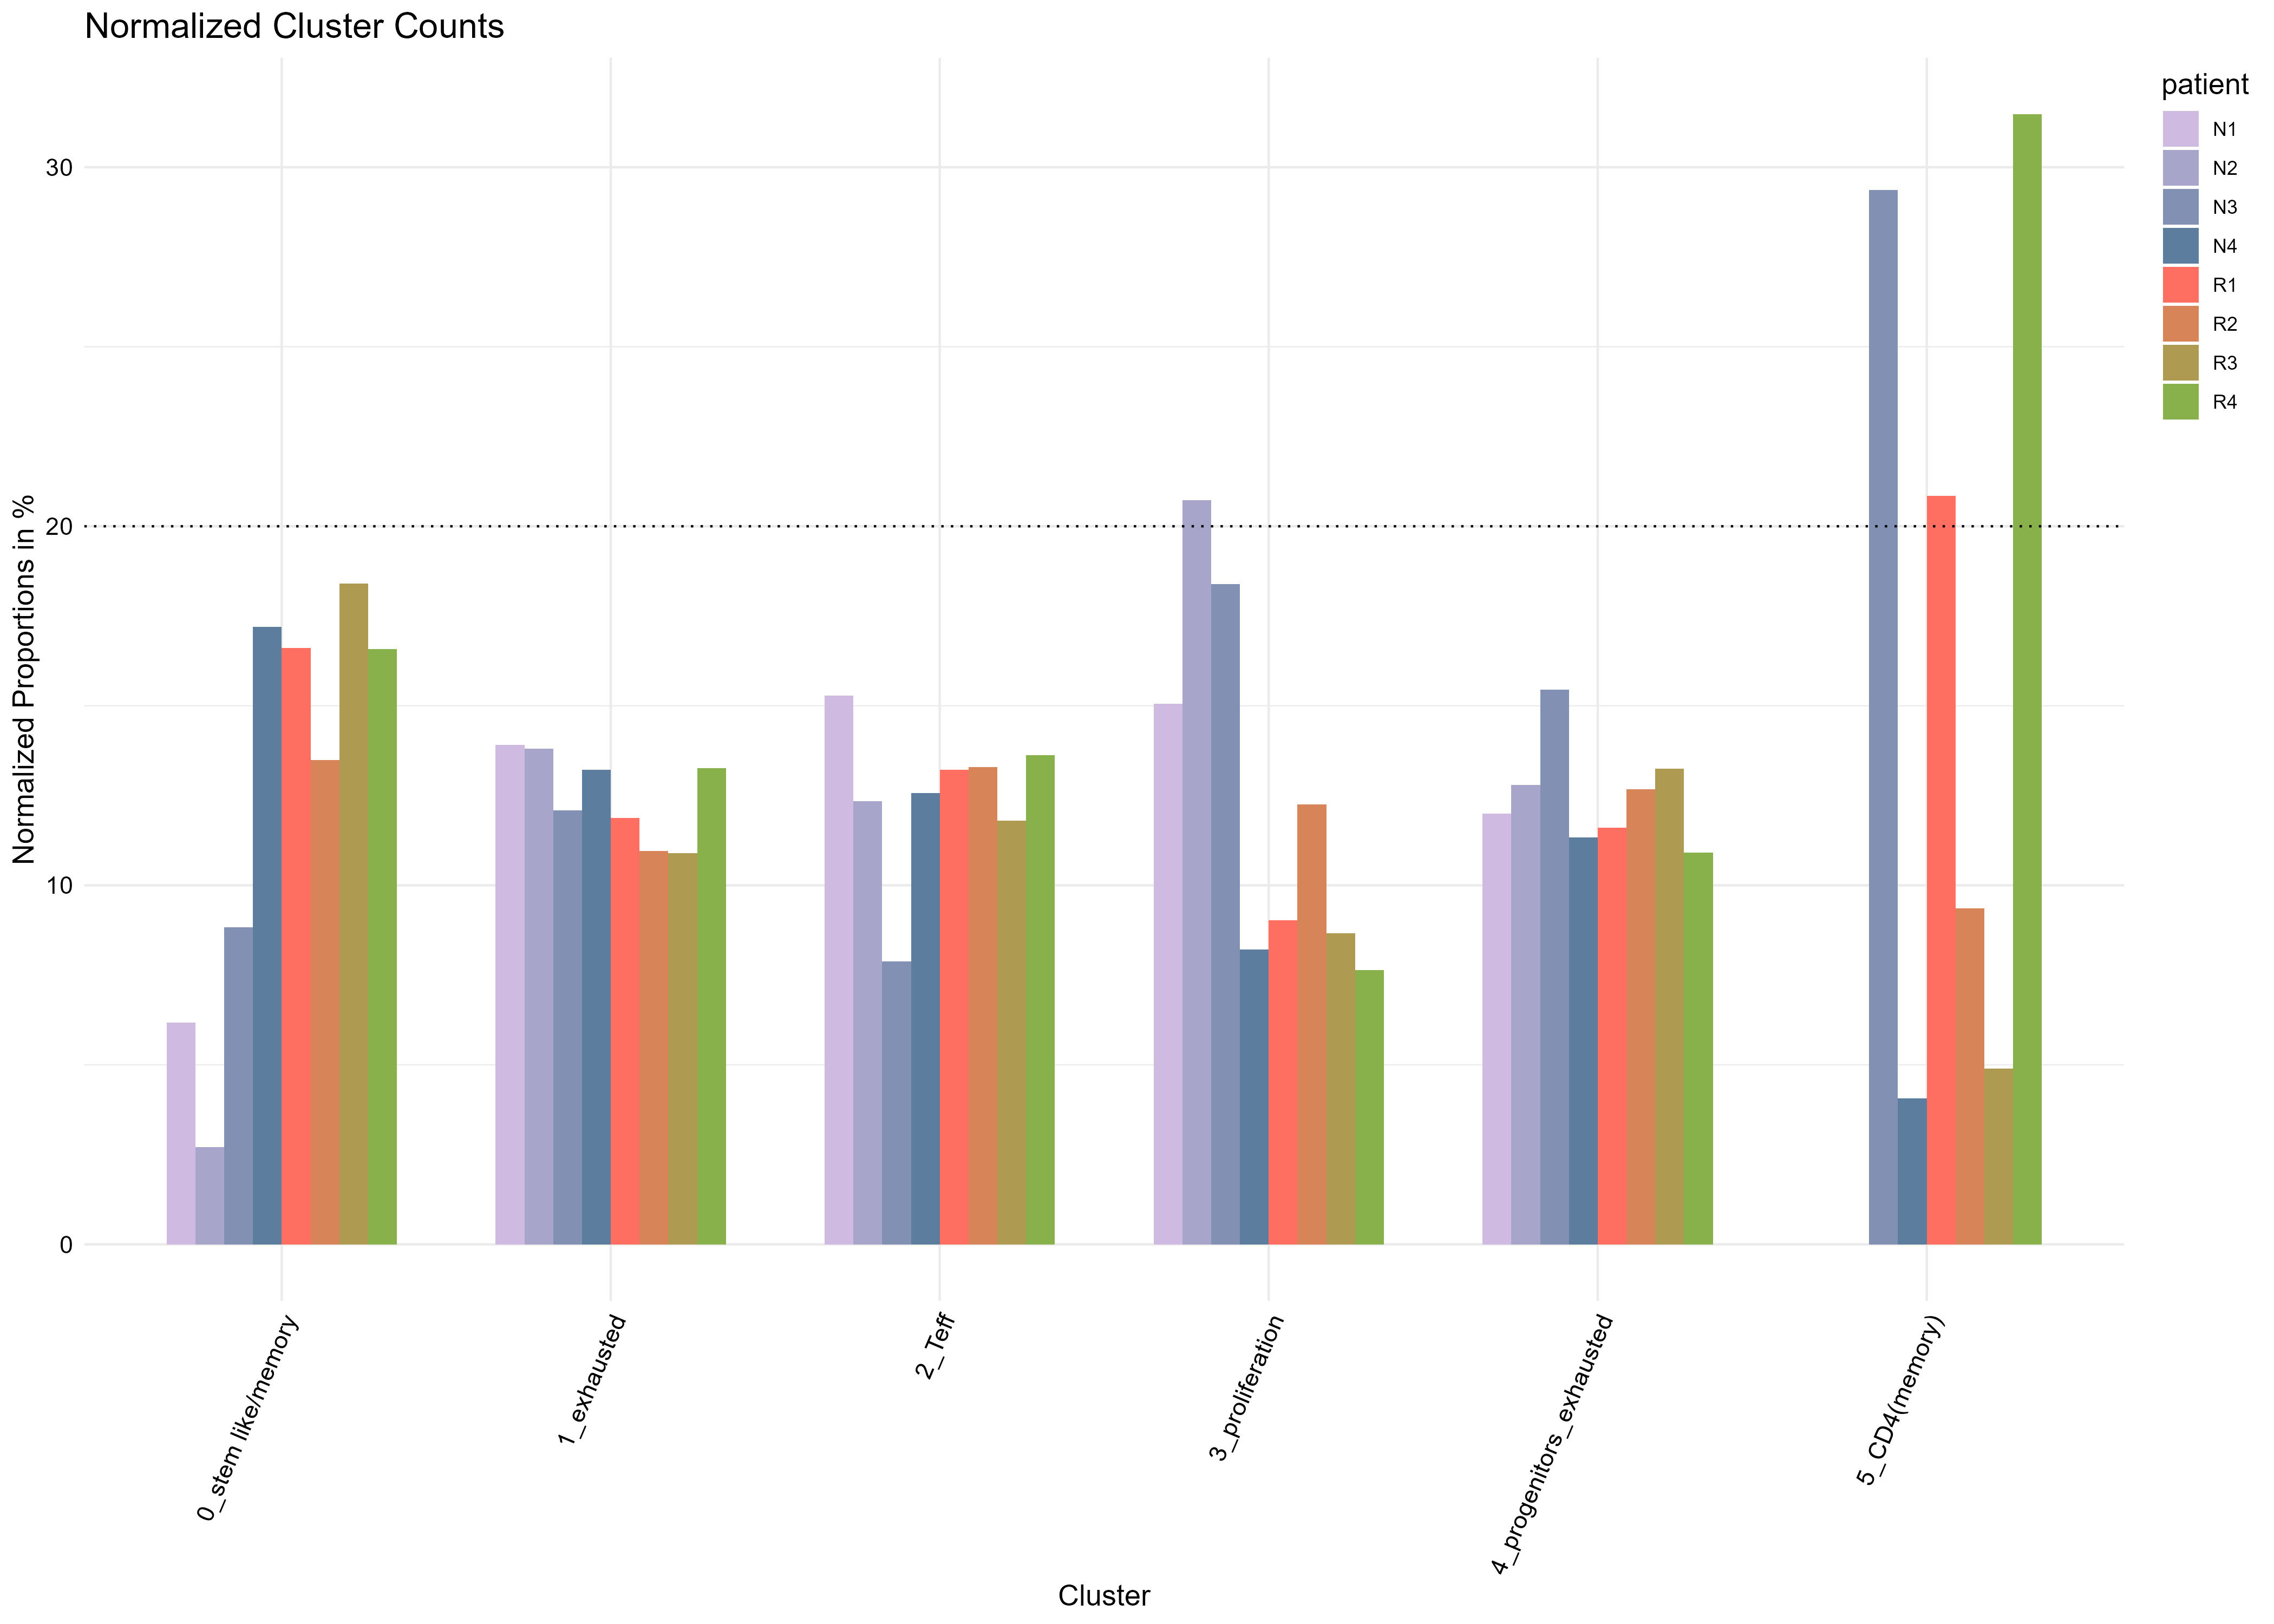
contribution per patient

Slide 31
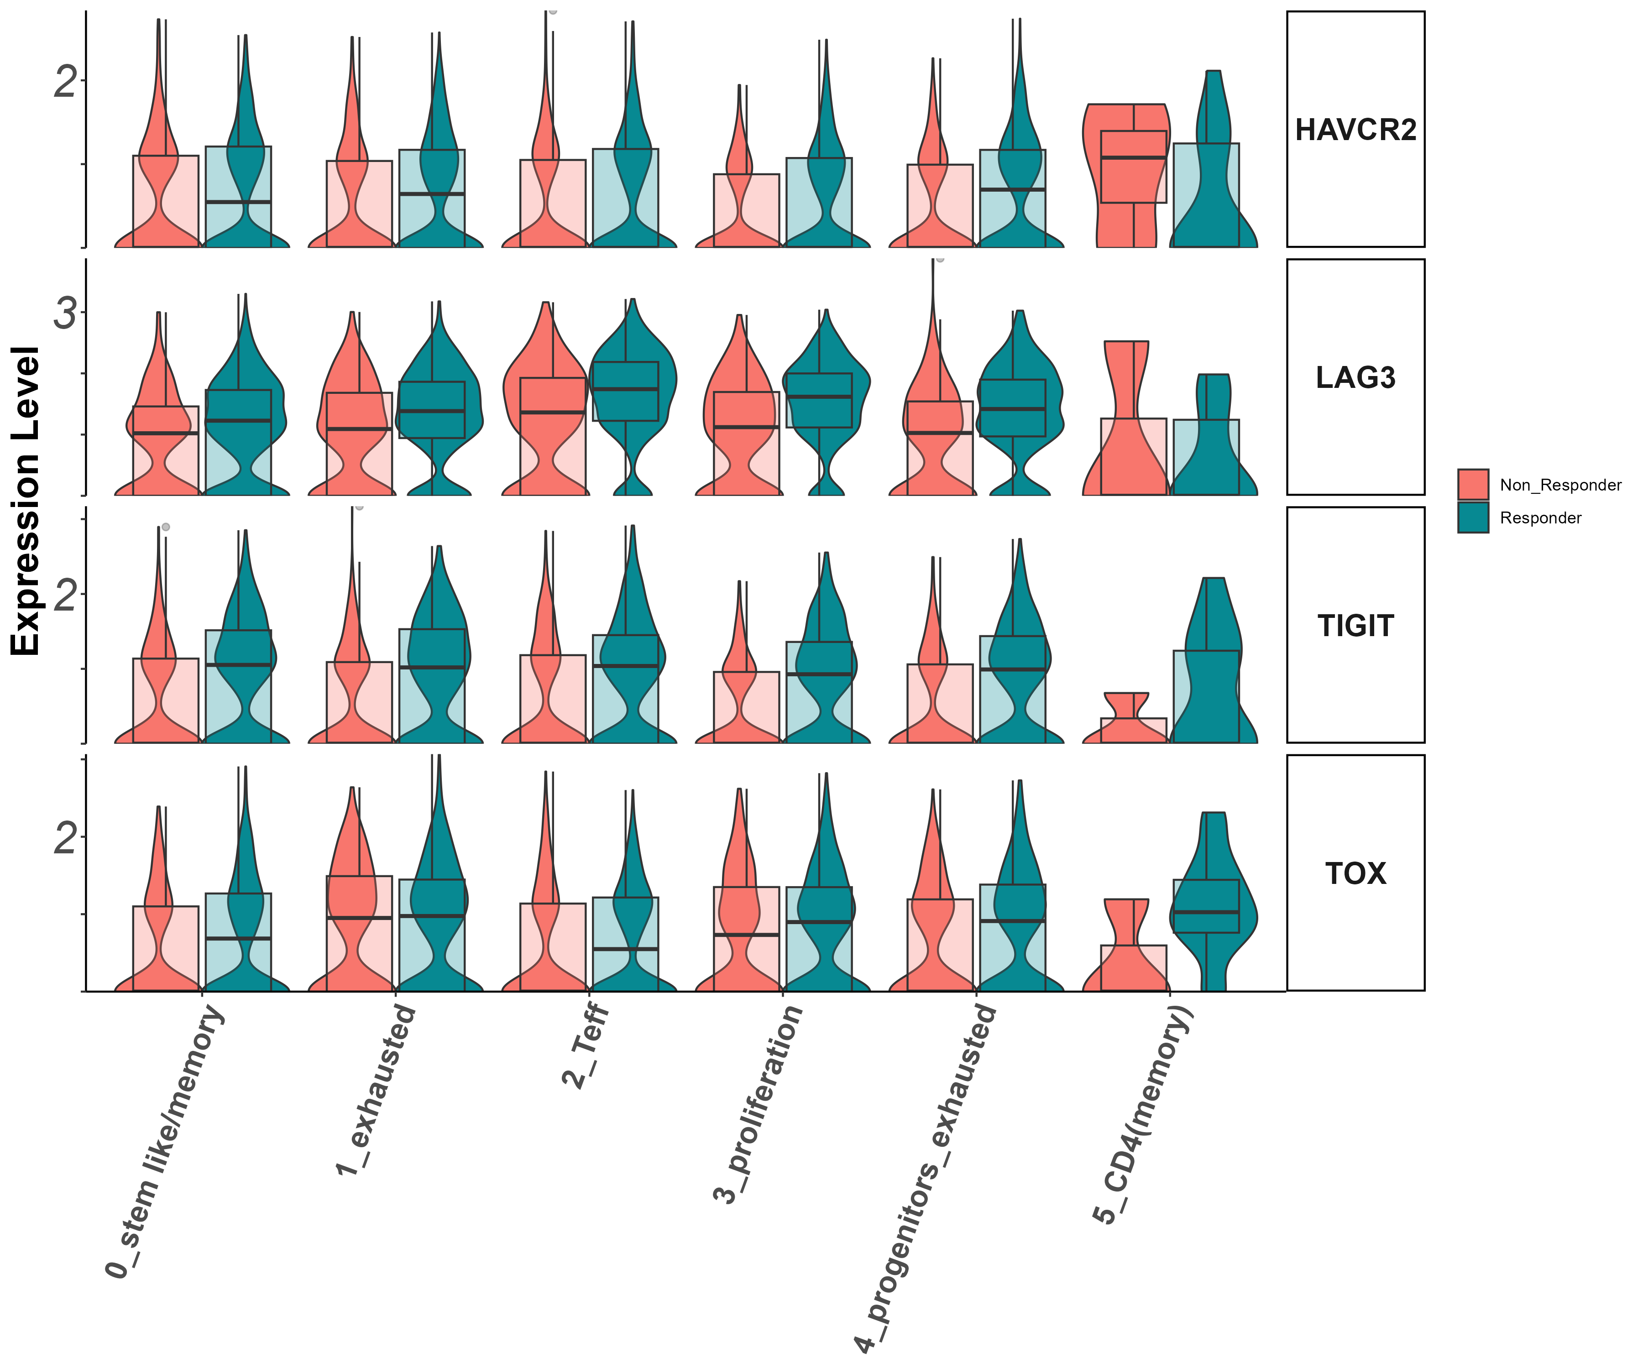
activation/exhaustion markers Tigit, Lag3, Havcr2, Tox (vln)

Slide 32
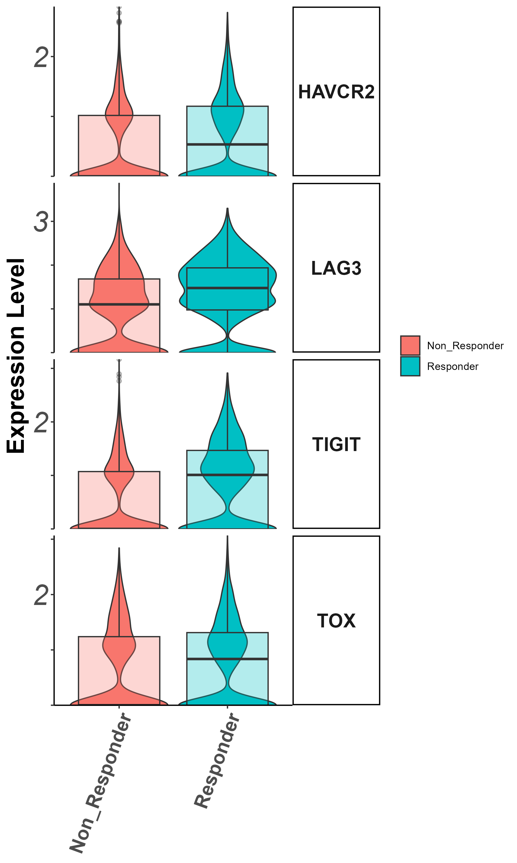
activation/exhaustion markers Tigit, Lag3, Havcr2, Tox
(groupby_treatment)

Slide 33
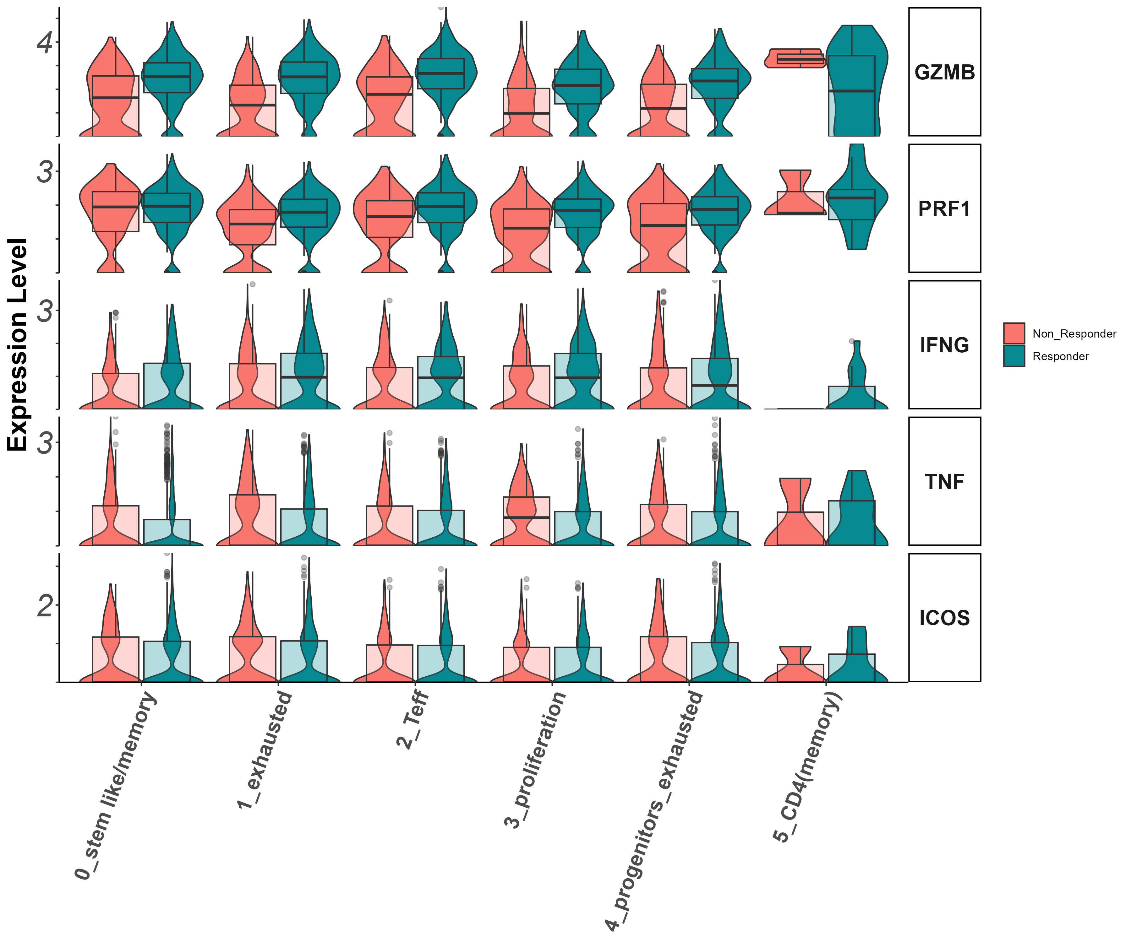
Effector markers
Gzmb, Prf1, Ifng, Il7r (vln)

Slide 34
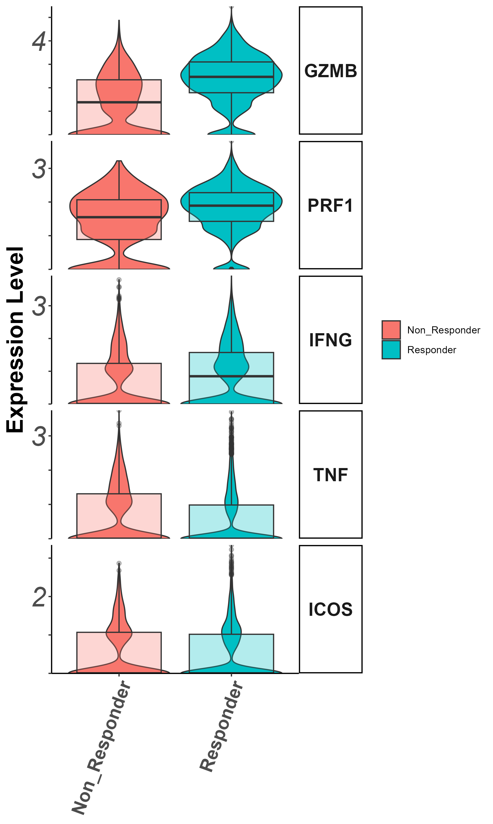
Effector markers
Gzmb, Prf1, Ifng, Il7r (groupby_treatment)

Slide 35
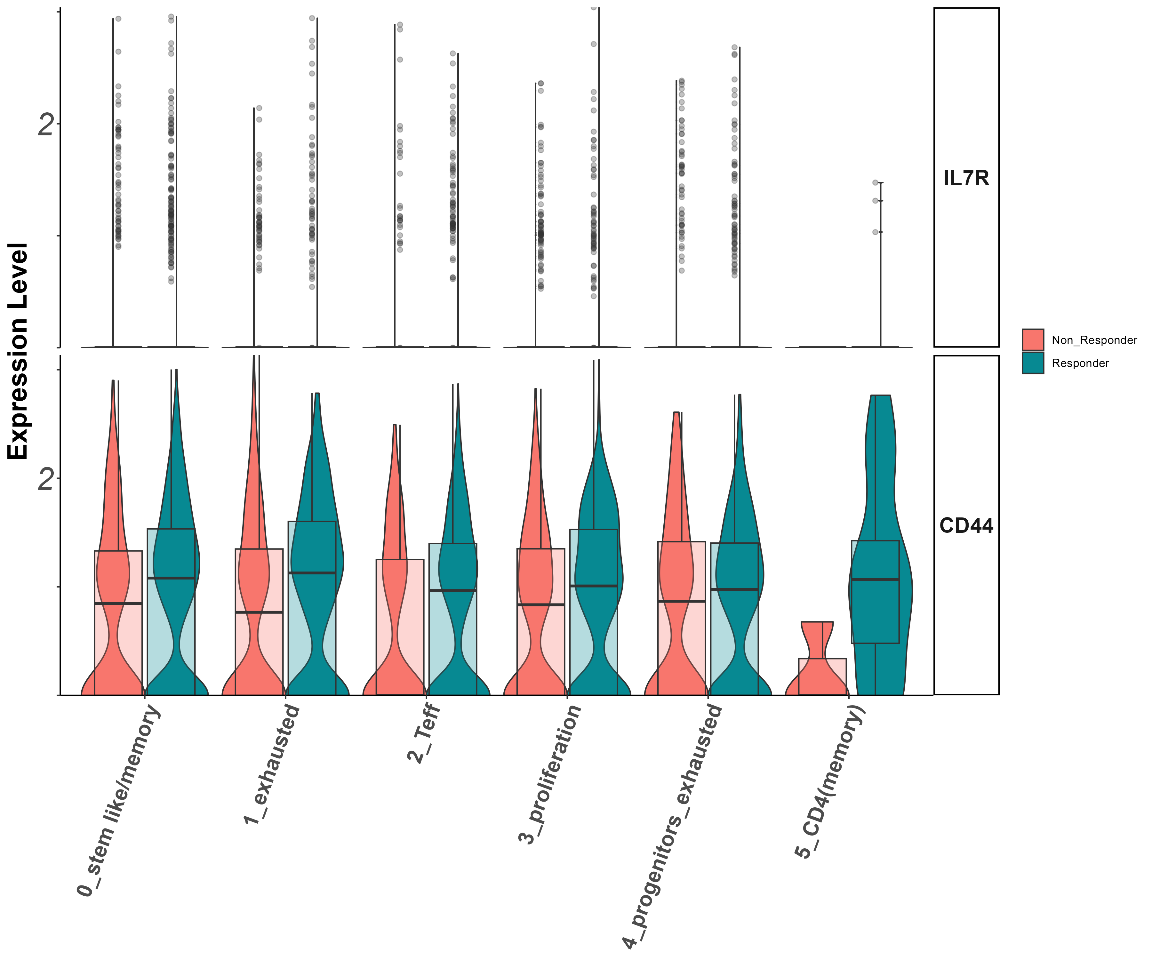
Stem/persister/naïve markers
Il7r, CD44
(vln)

Slide 36
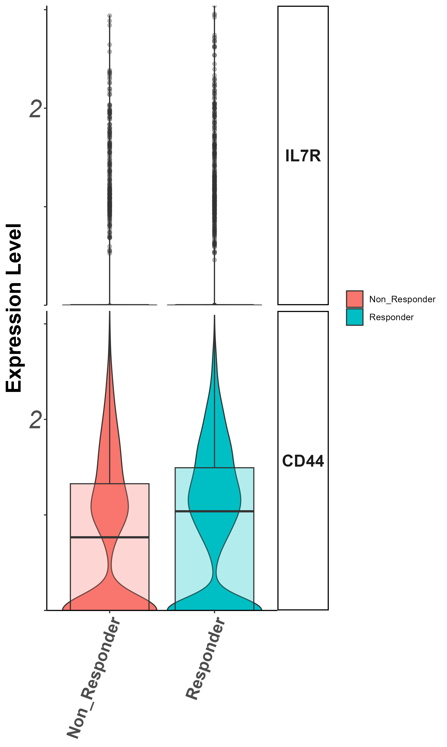
Stem/persister/naïve markers
Il7r, CD44
(groupby_treatment)

Slide 37
Summary cluster 1
CD40LG higher in non responders. what is this?
klf2, bach2, CD27, higher in responders (?)

Slide 38
Cluster 2 (cytotoxic CD8) zoom in analysis
Notes:
להוסיף ריבוע מדגיש לקלאסטר אפס

Slide 39
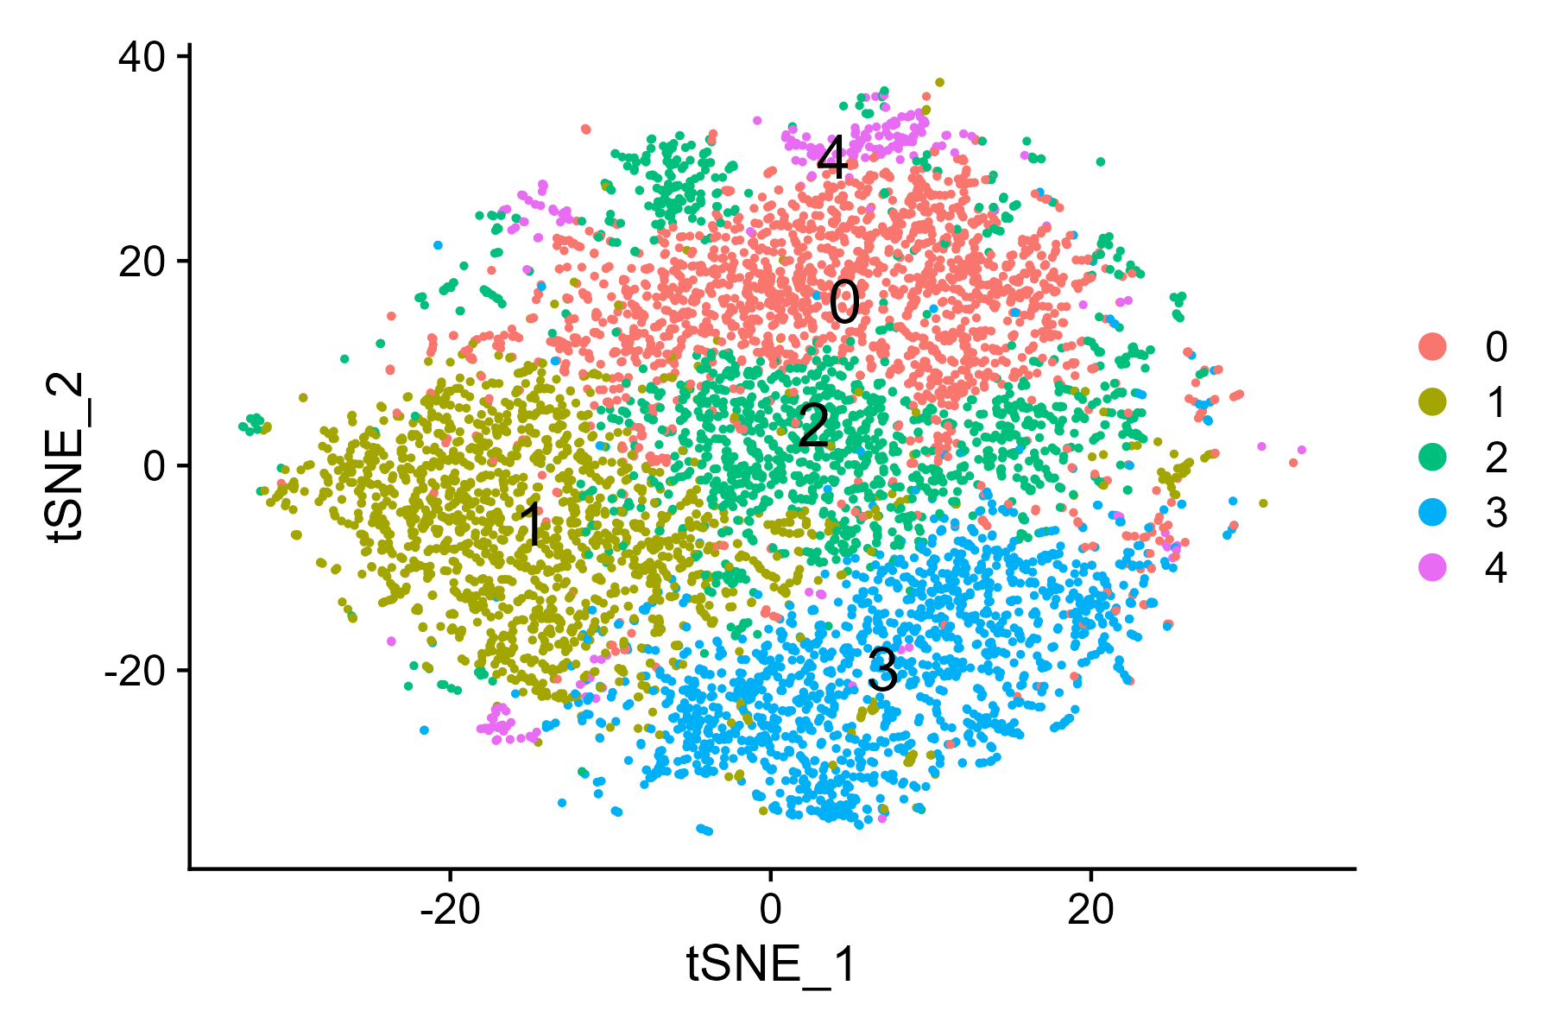
tSNE

Slide 40
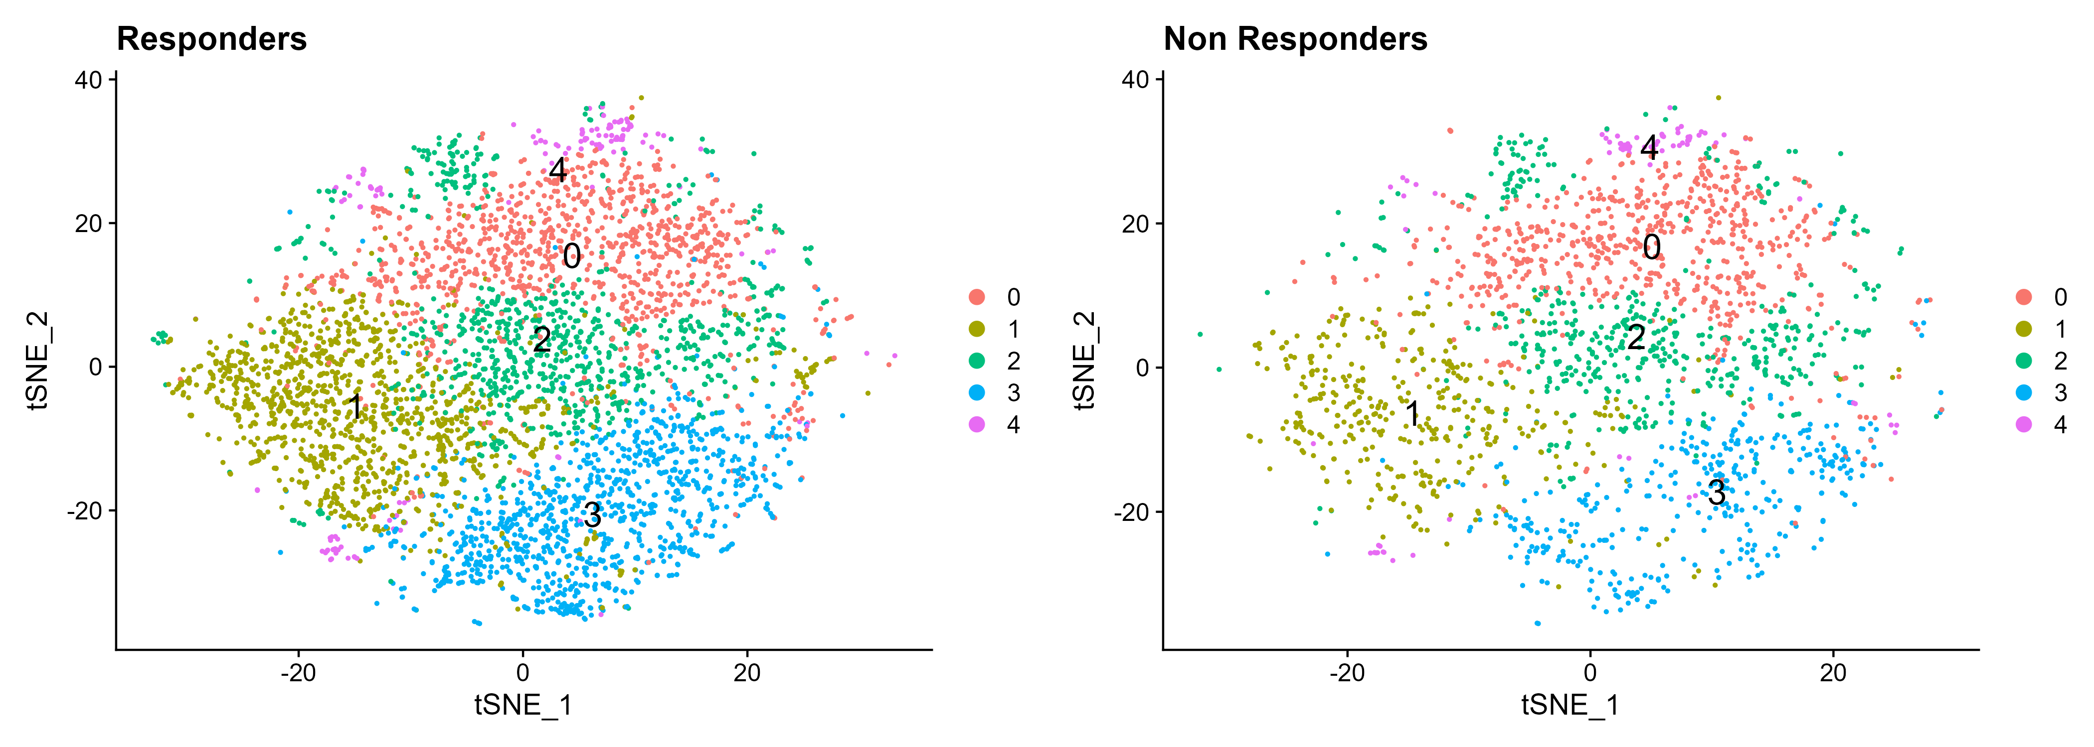
tSNE by response

Slide 41
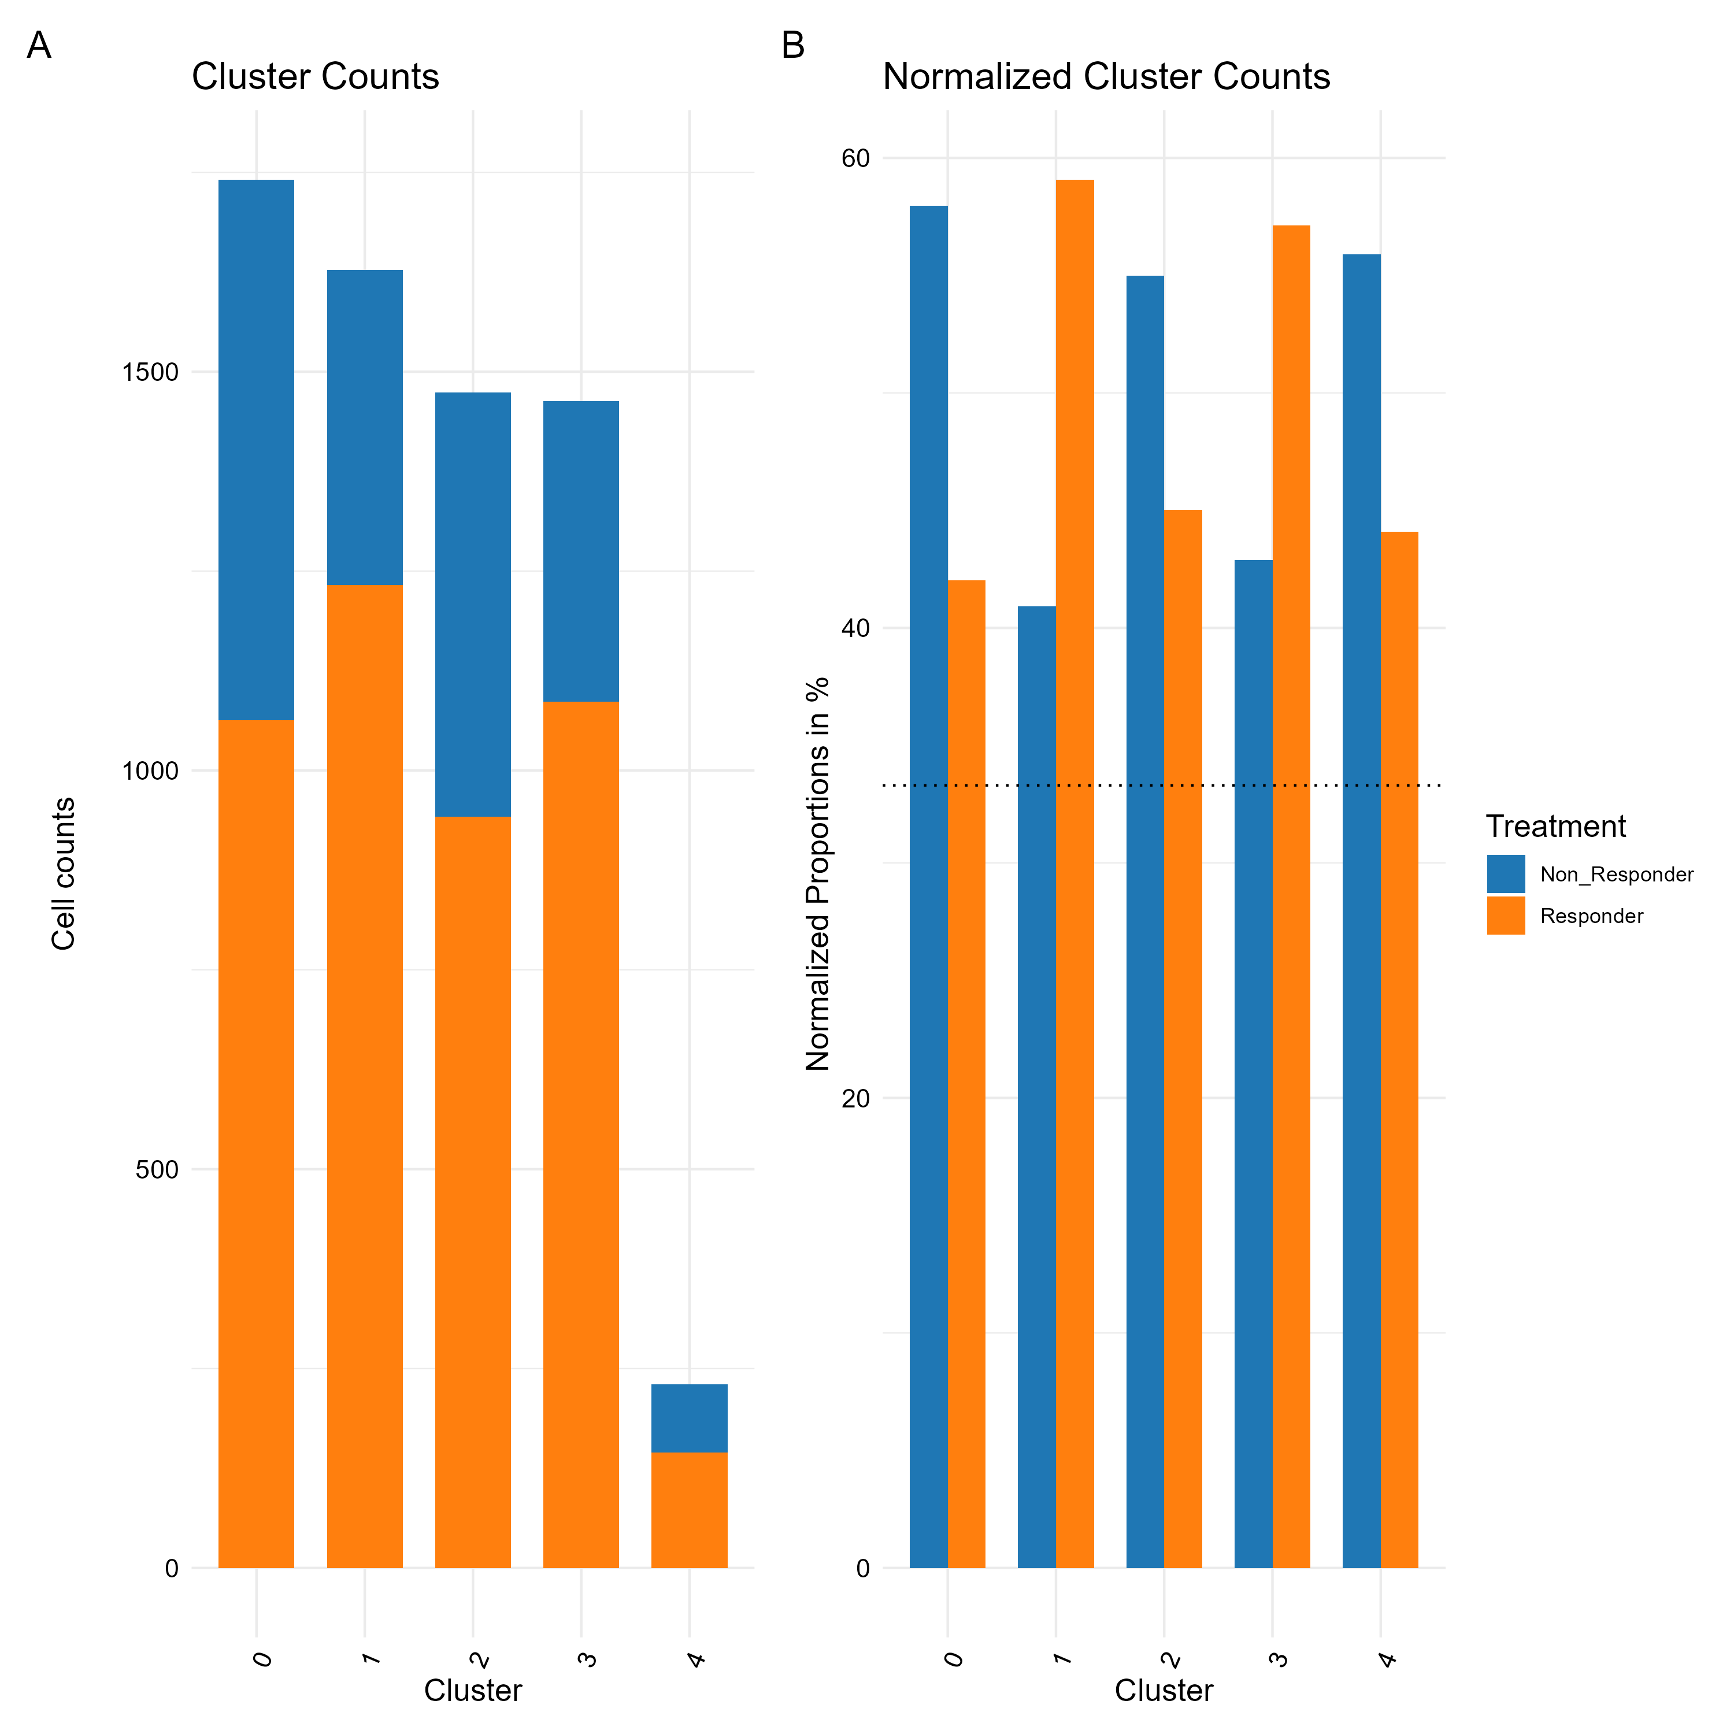
Cluster 2 zoom in analysis contribution per response

Slide 42
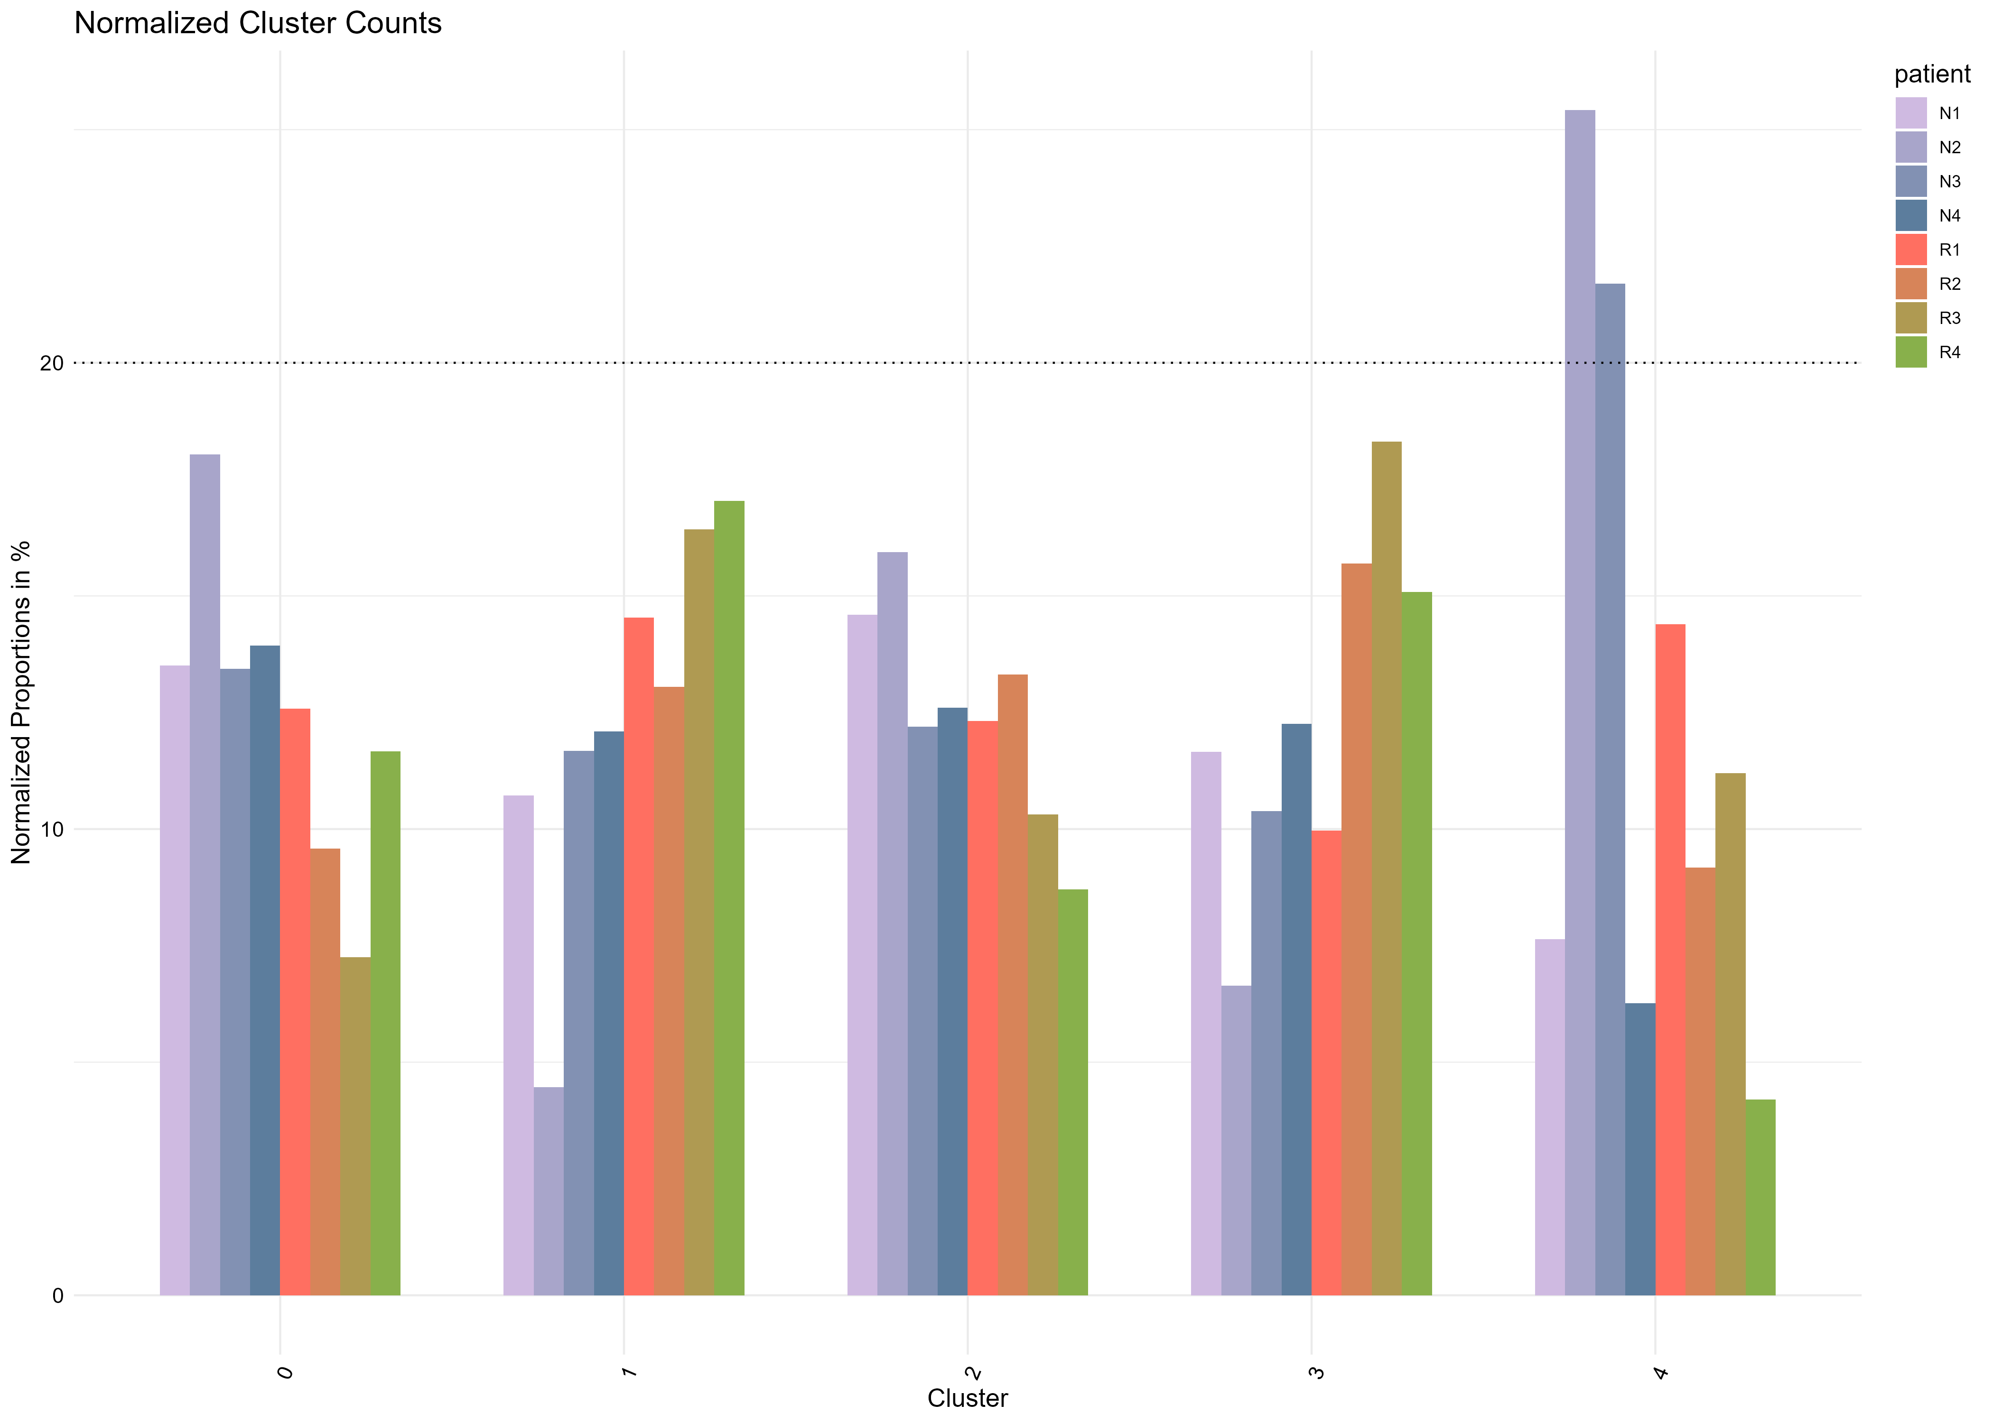
contribution per patient

Slide 43
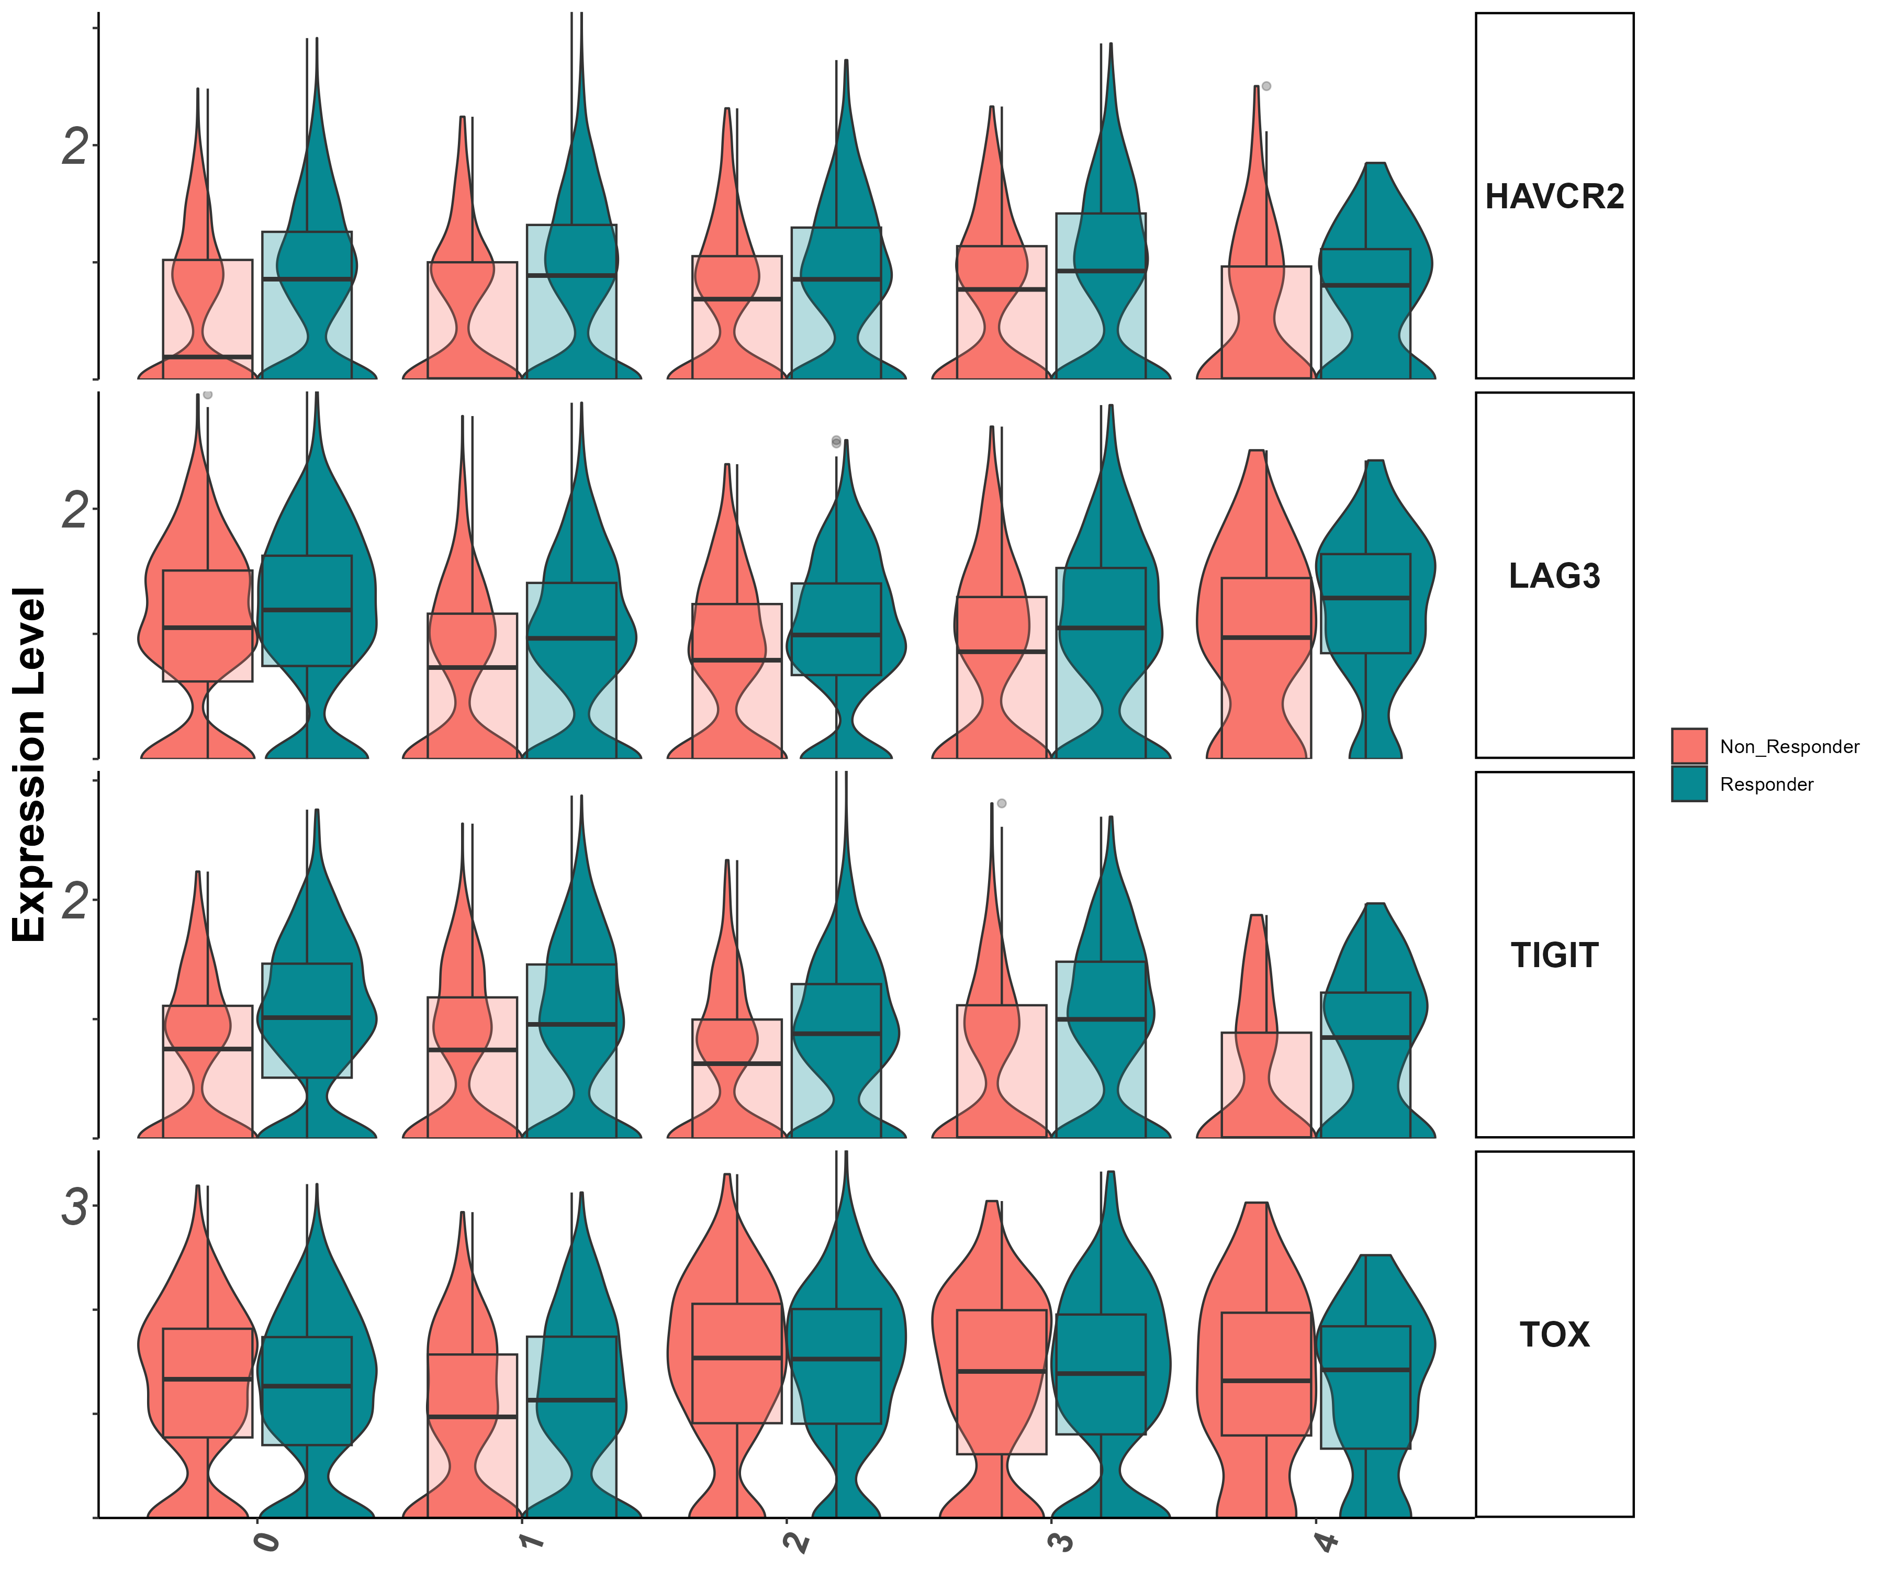
activation/exhaustion markers Tigit, Lag3, Havcr2, Tox (vln)

Slide 44
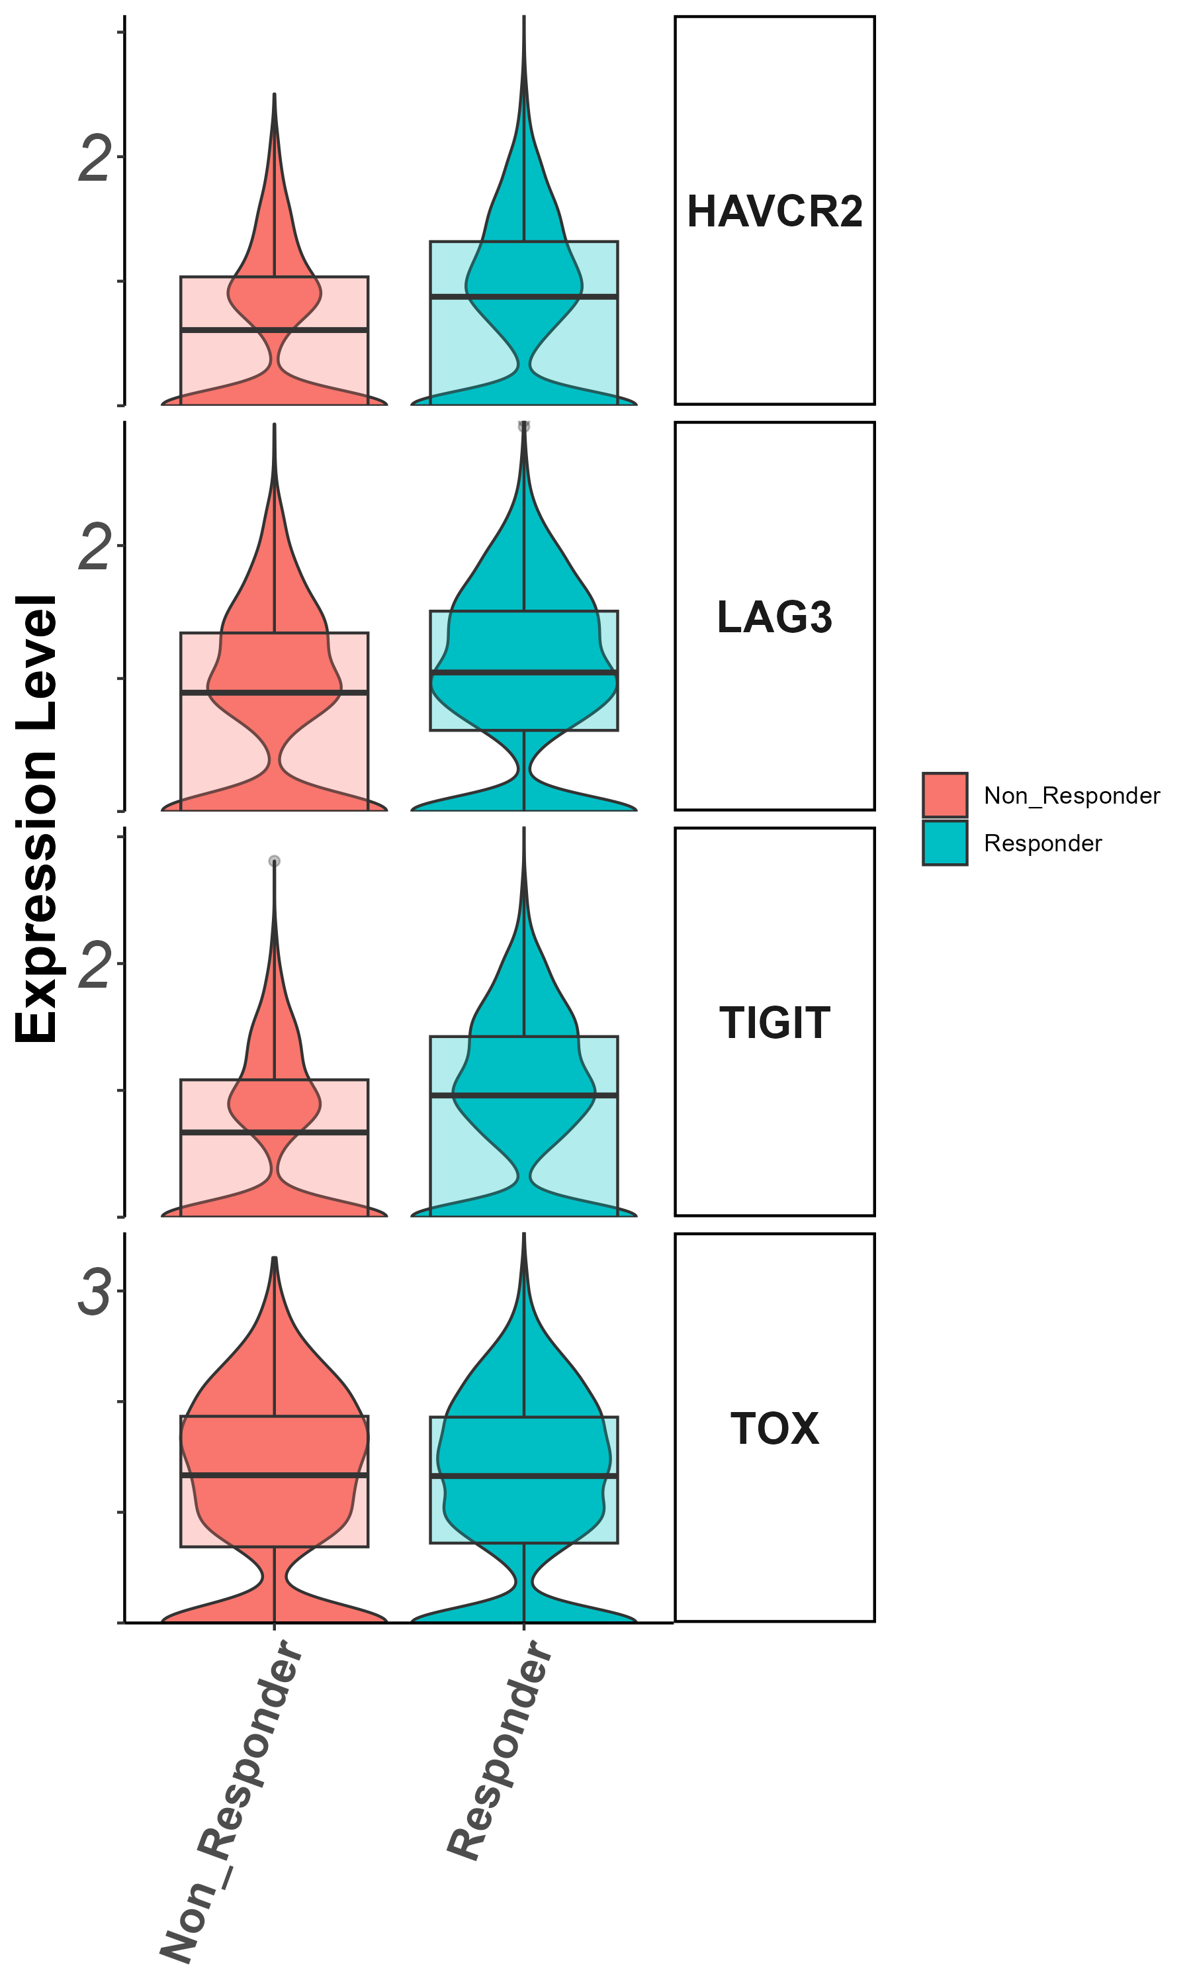
activation/exhaustion markers Tigit, Lag3, Havcr2, Tox
(groupby_treatment)

Slide 45
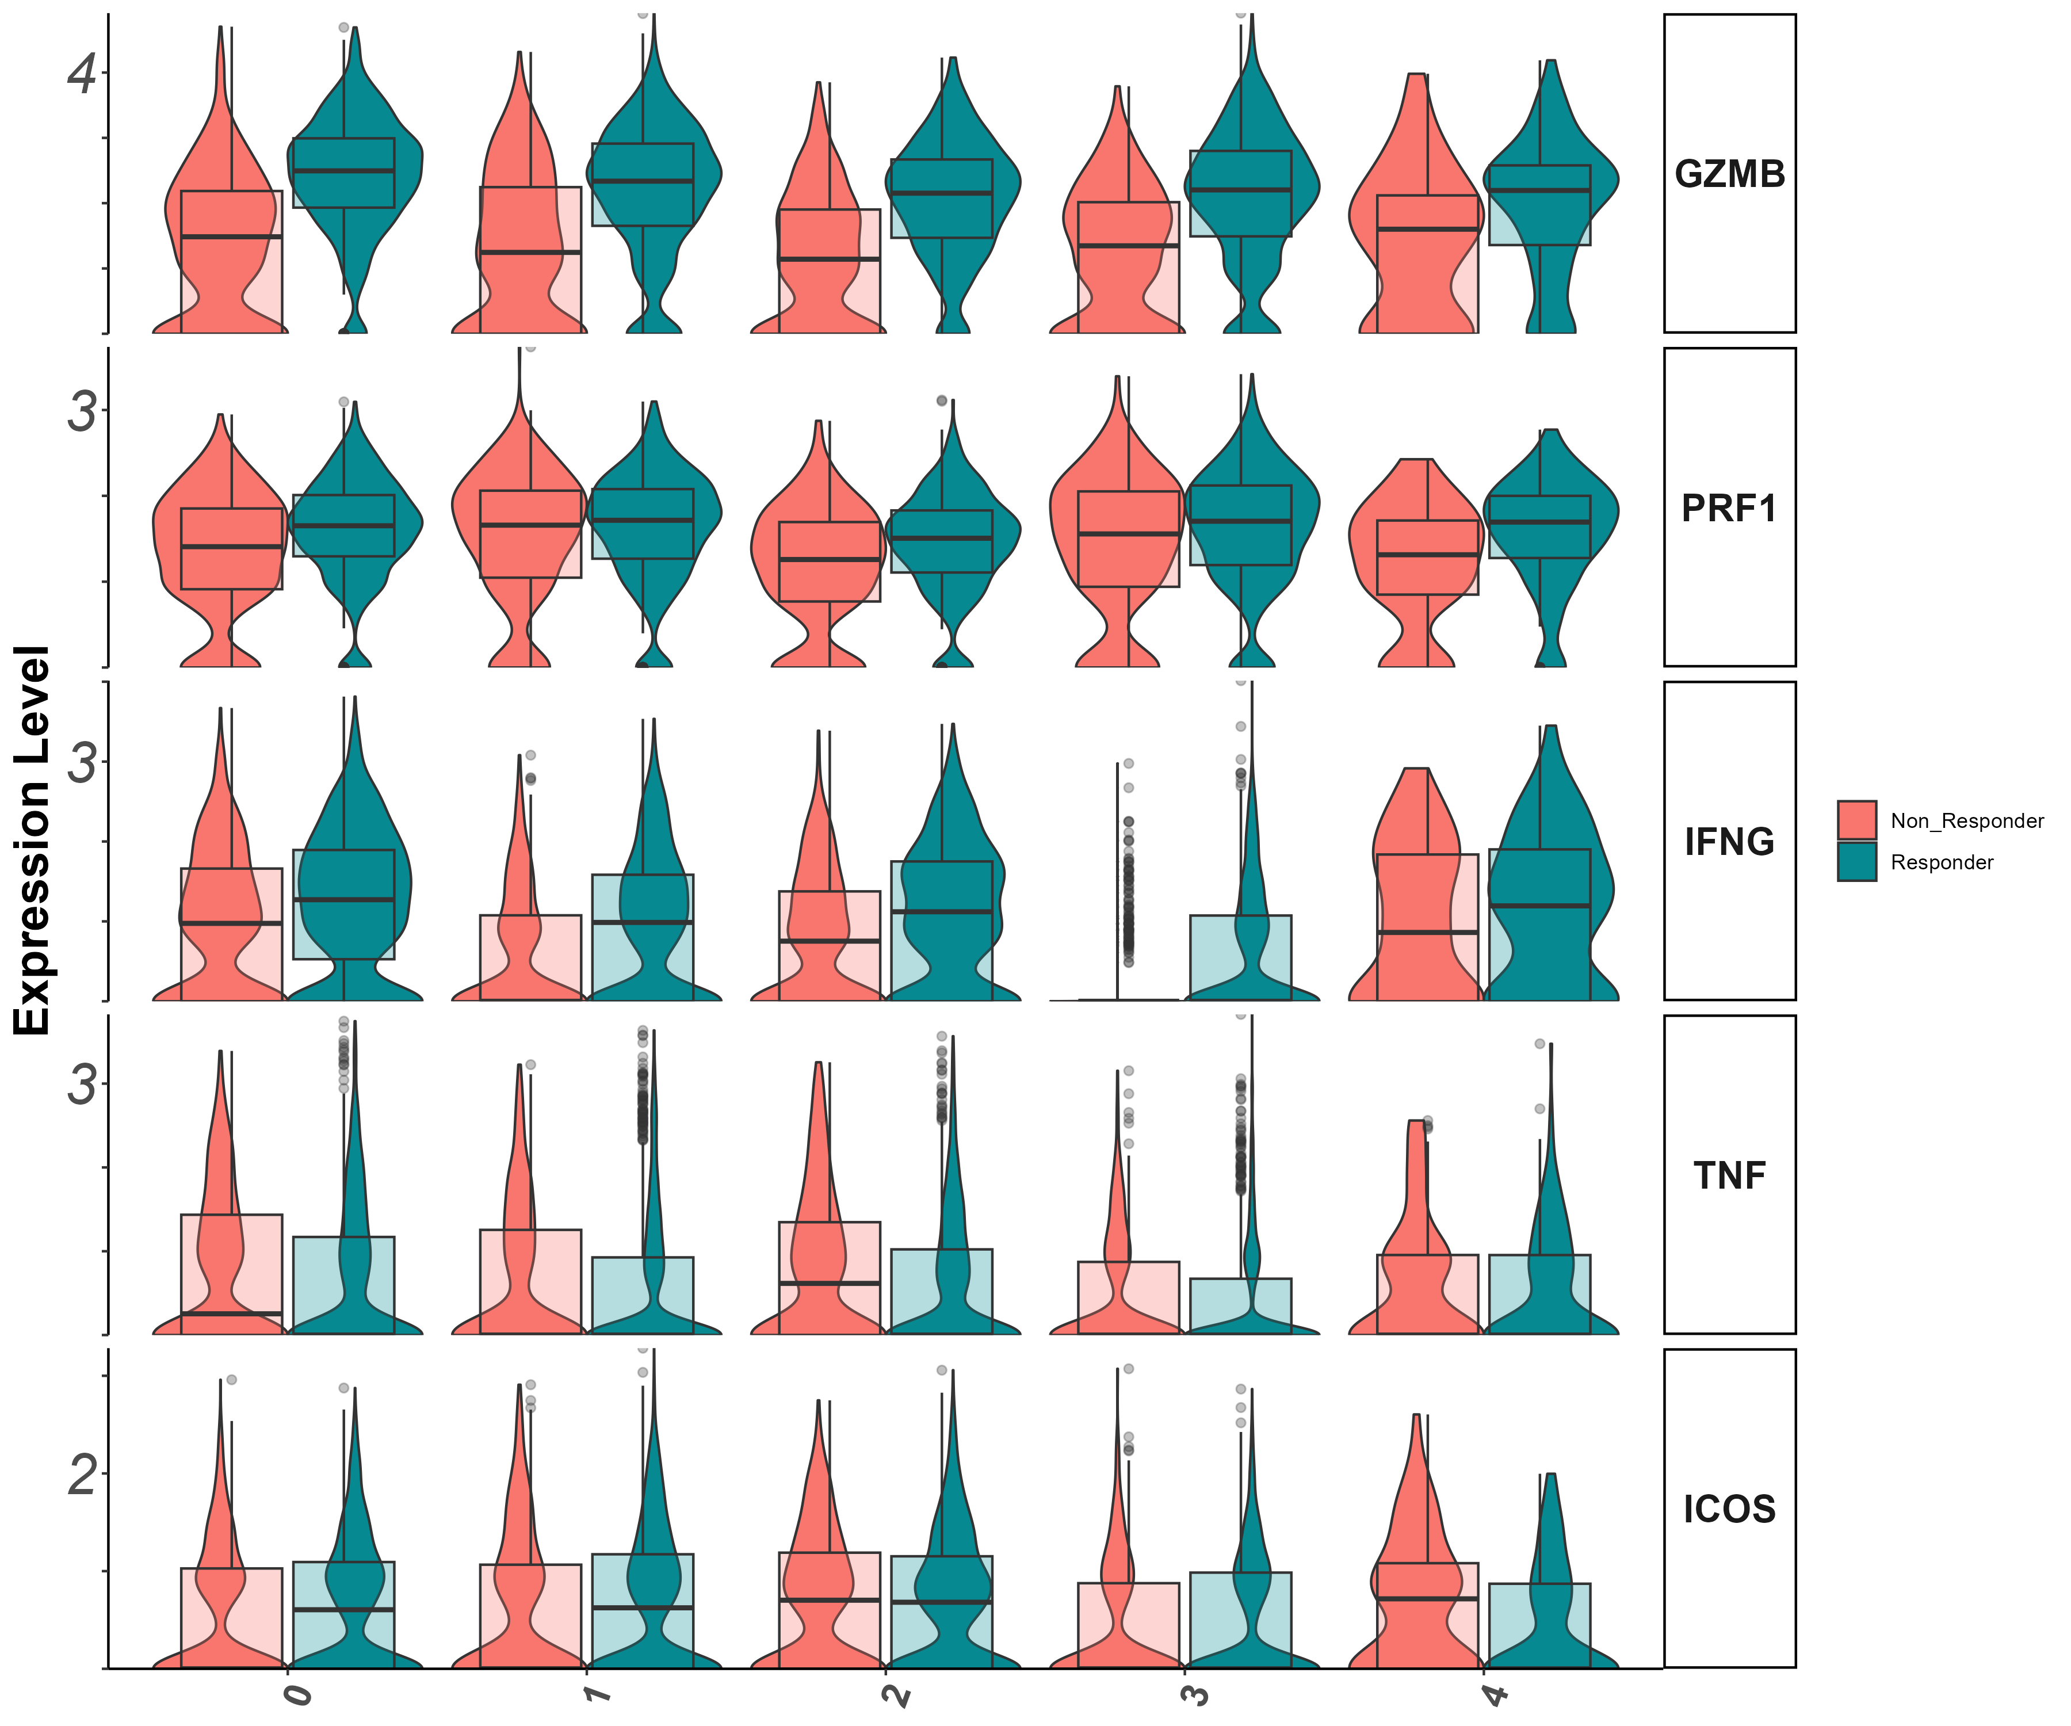
Effector markers
Gzmb, Prf1, Ifng, Il7r (vln)

Slide 46
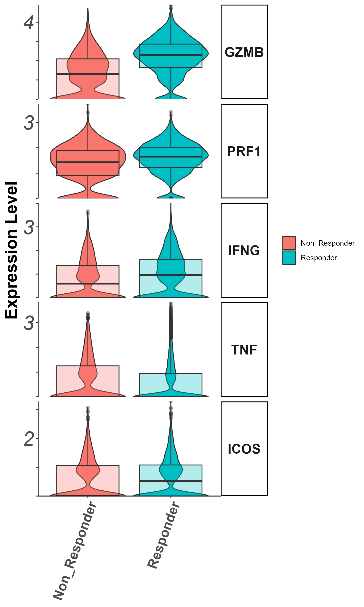
Effector markers
Gzmb, Prf1, Ifng, Il7r (groupby_treatment)

Slide 47
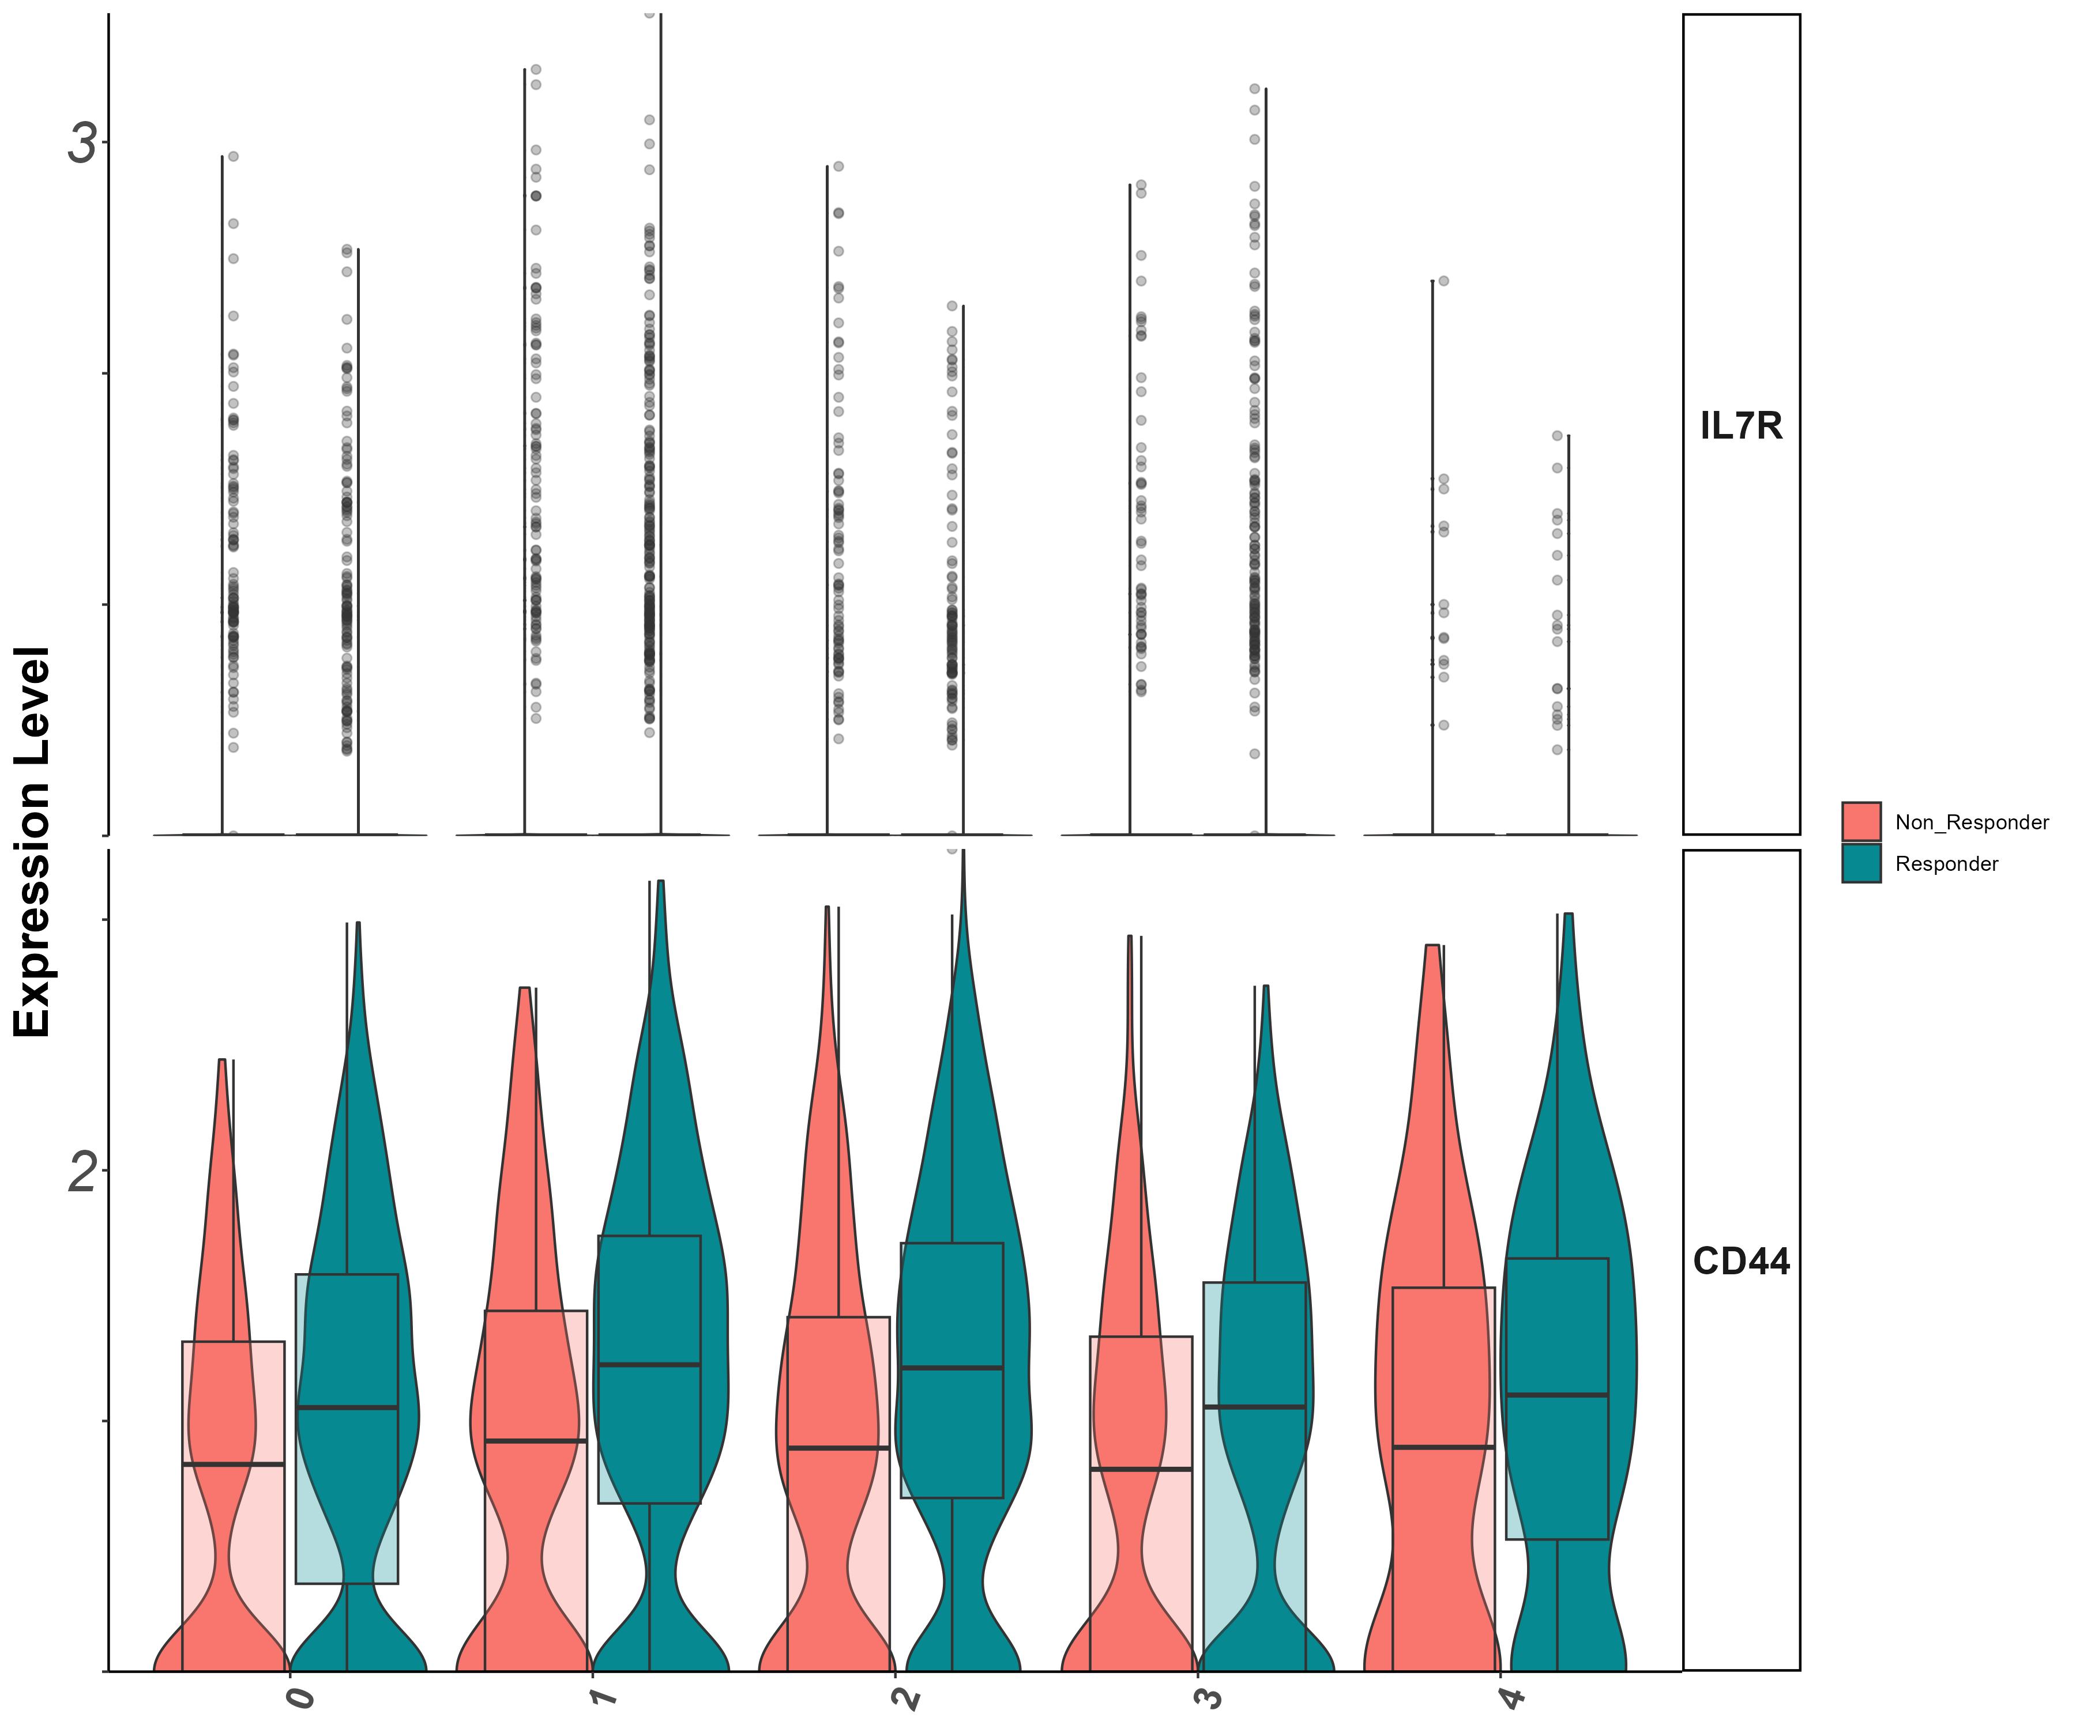
Stem/persister/naïve markers
Il7r, CD44
(vln)

Slide 48
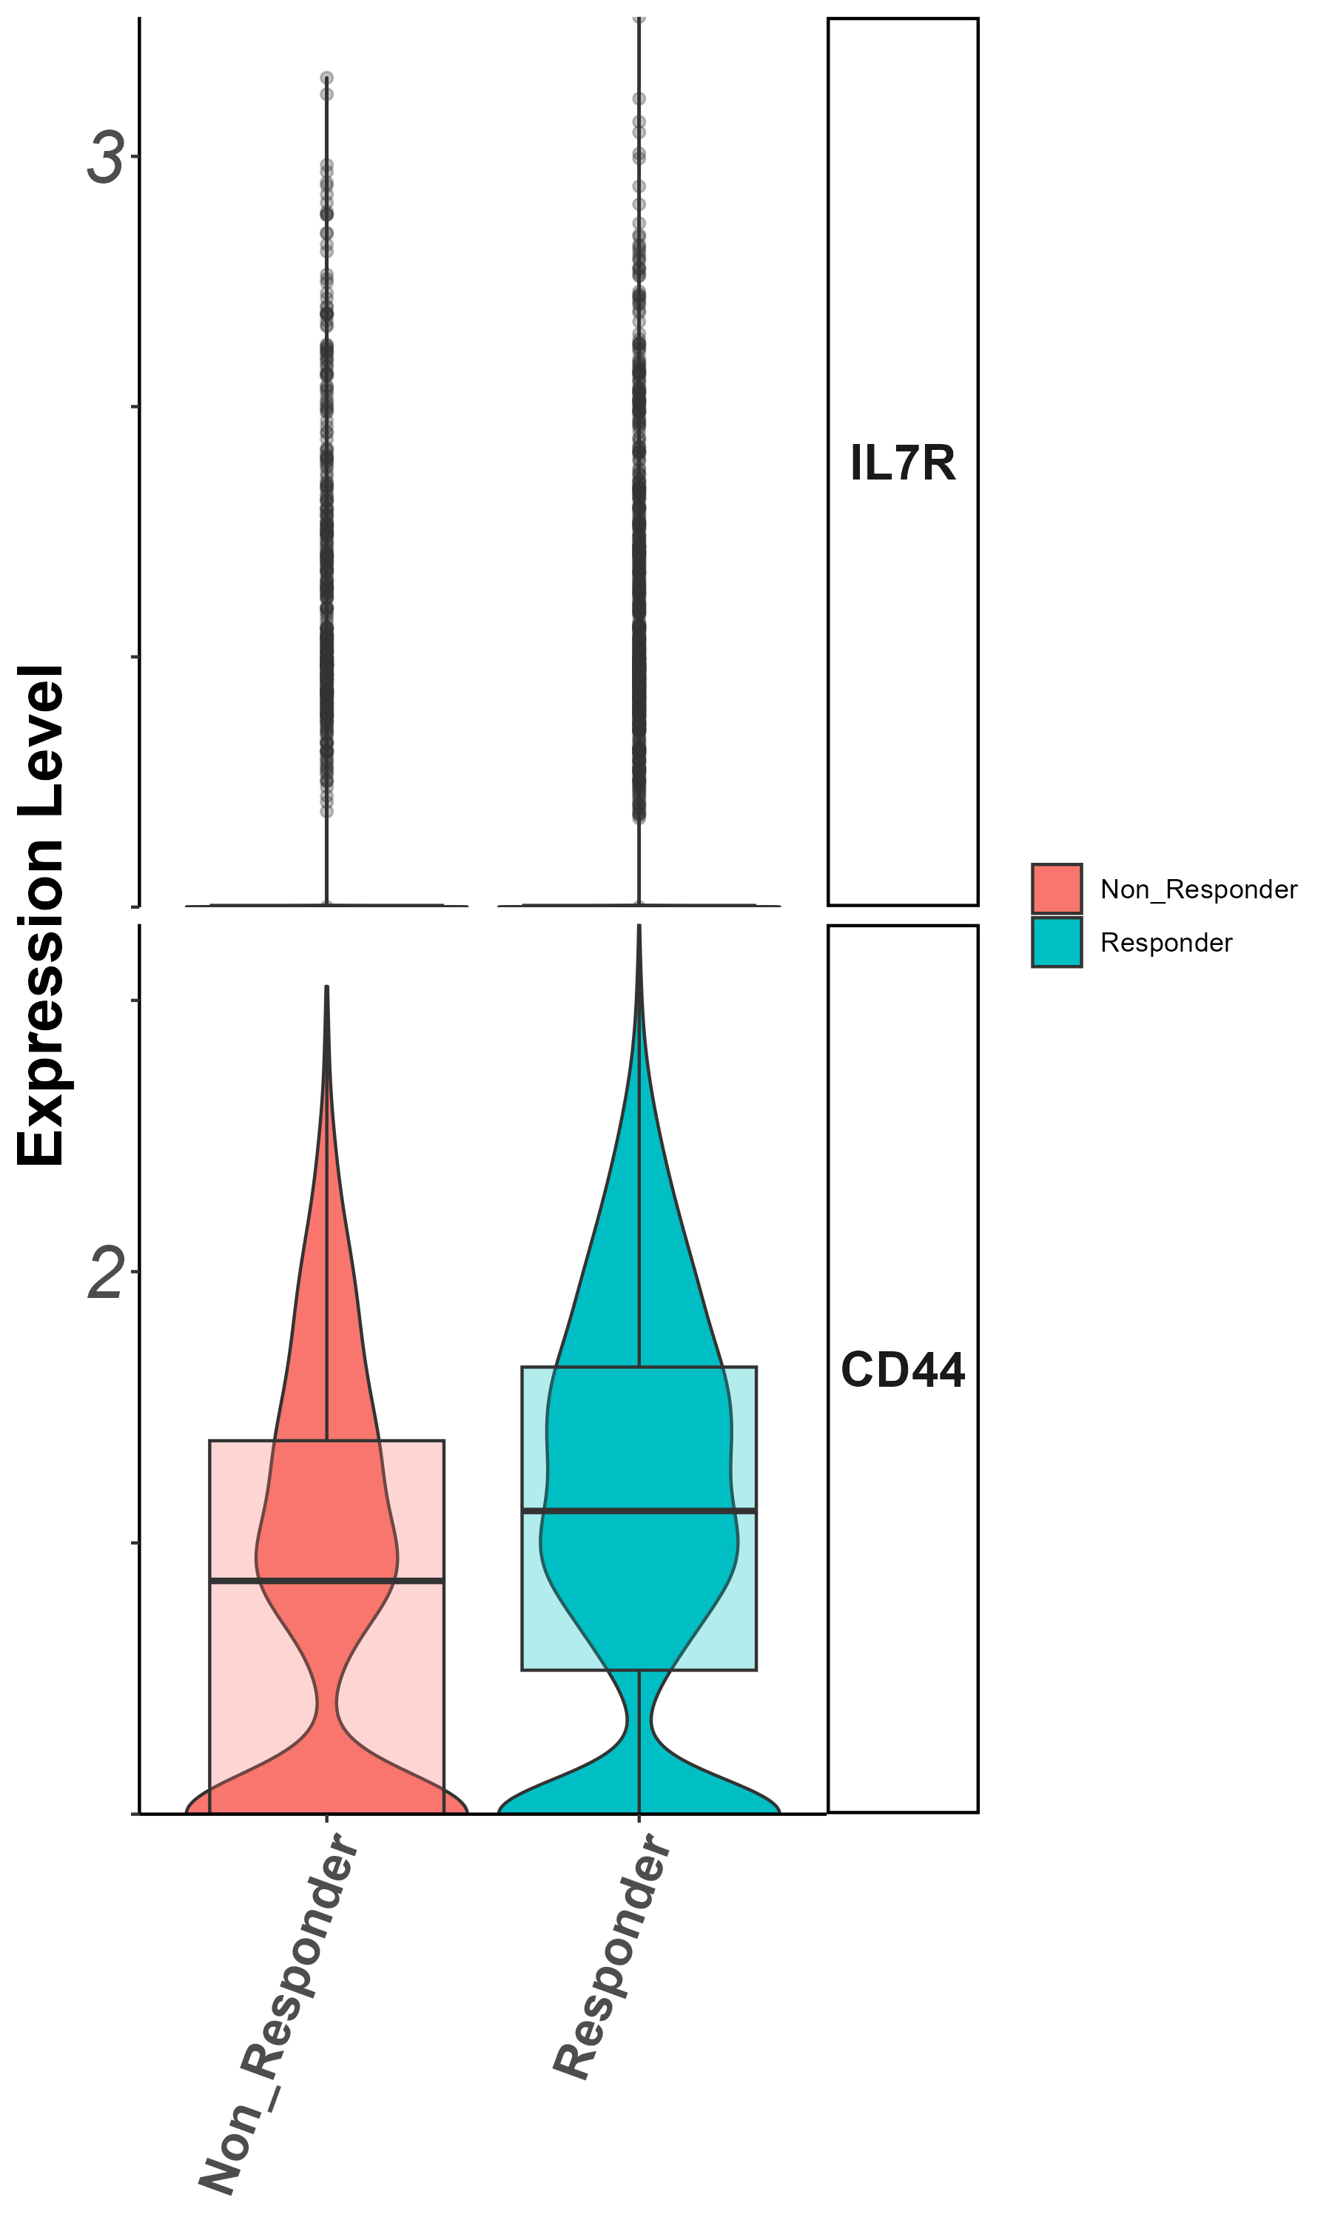
Stem/persister/naïve markers
Il7r, CD44
(groupby_treatment)

Slide 49
Summary cluster 2
- cluster 0,2 (inside clus2 analysis) more non-responders - cluster 1,3 more responders - CD40LG, ENTPD1, : higher in non responders - GZMB, prf1, IFNG, GZMK, CD27, : higher in responders - exhaustion : TIM3, TIGIT, TNF higher in respondesr - naive-like/memory : CD44, higher in responders - effector/memory : KLF2, higher in responders

Slide 50
Observations - detailed
general : - lower expression of ENTPD1 in responders (both in cd8 &cd4) (TIM3 and ENTPD1 mark the exhausted-like state of CD8+ T cells) https://www.ncbi.nlm.nih.gov/pmc/articles/PMC6641984/ - N4 acts like responders in cluster 0, 1(a bit in 2 aswell) of all_cells(maybe interesting that he is not a responder ? ) - il2 signature significant between responders & non in cluster 2 sub analysis, but not in cluster 1 - il2r not significant between responders & non in coth clusters 1&2 - All_cells : - DE between responders and non-respondesr in all_cells : SELL, CD27, GZMK, TRAV5 - cluster0 + cd4 : - ILR7 higher in responders cluster 1 : - CD40LG higher in non responders. what is this? - klf2, bach2, CD27, higher in responders (?) cluster 2 : - cluster 0,2 (inside clus2 analysis) more non-responders - cluster 1,3 more responders - cluster 4 not significant - CD40LG, ENTPD1, : higher in nonresponders - GZMB, prf1, IFNG, GZMK, CD27, : higher in responders - activation\exhaustion : TIM3, TIGIT, TNF higher in respondesr - naive-like/memory : CD44, higher in responders - effector/memory : KLF2, higher in responders

Slide 51
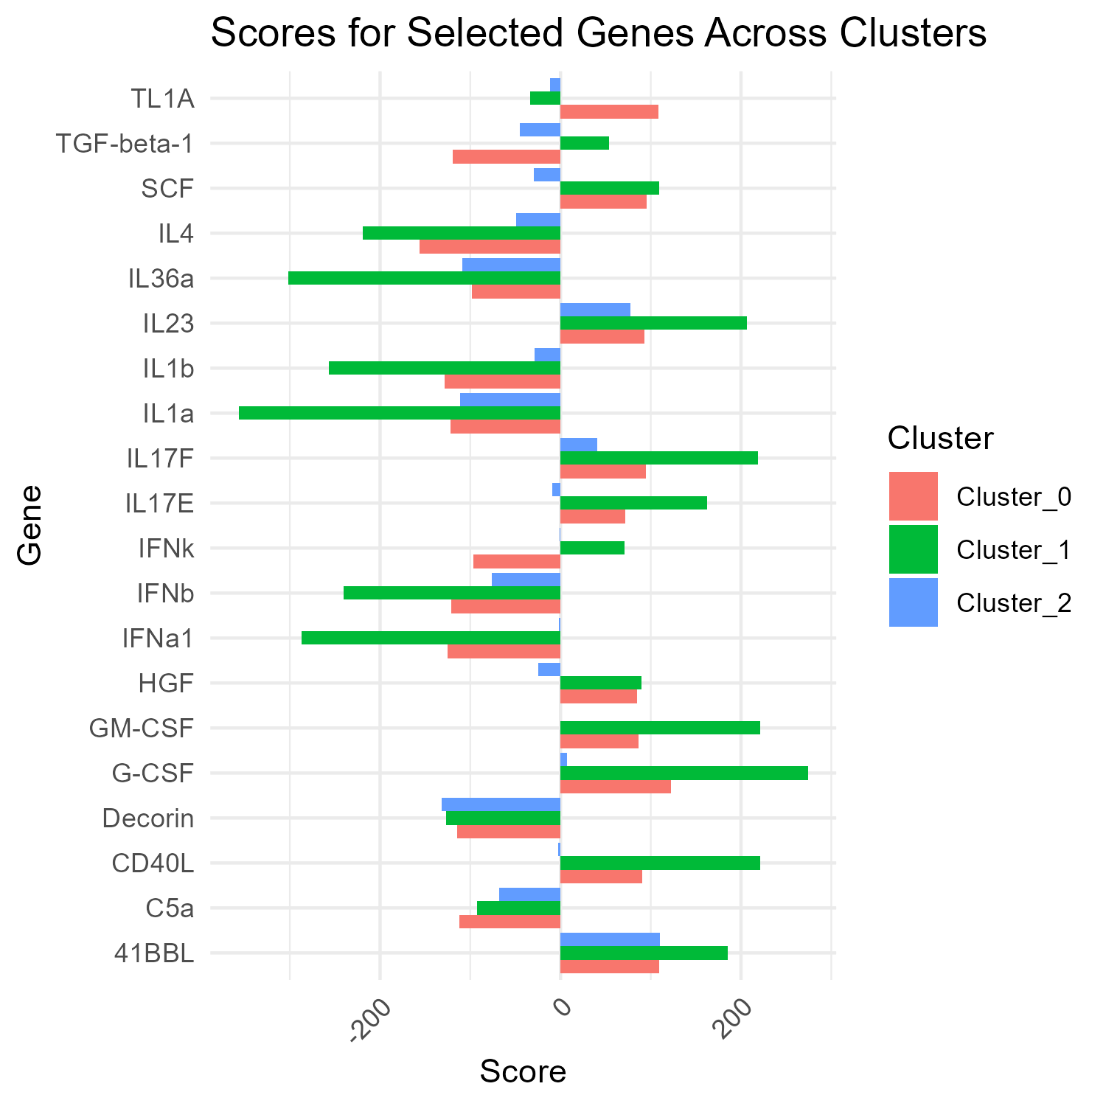
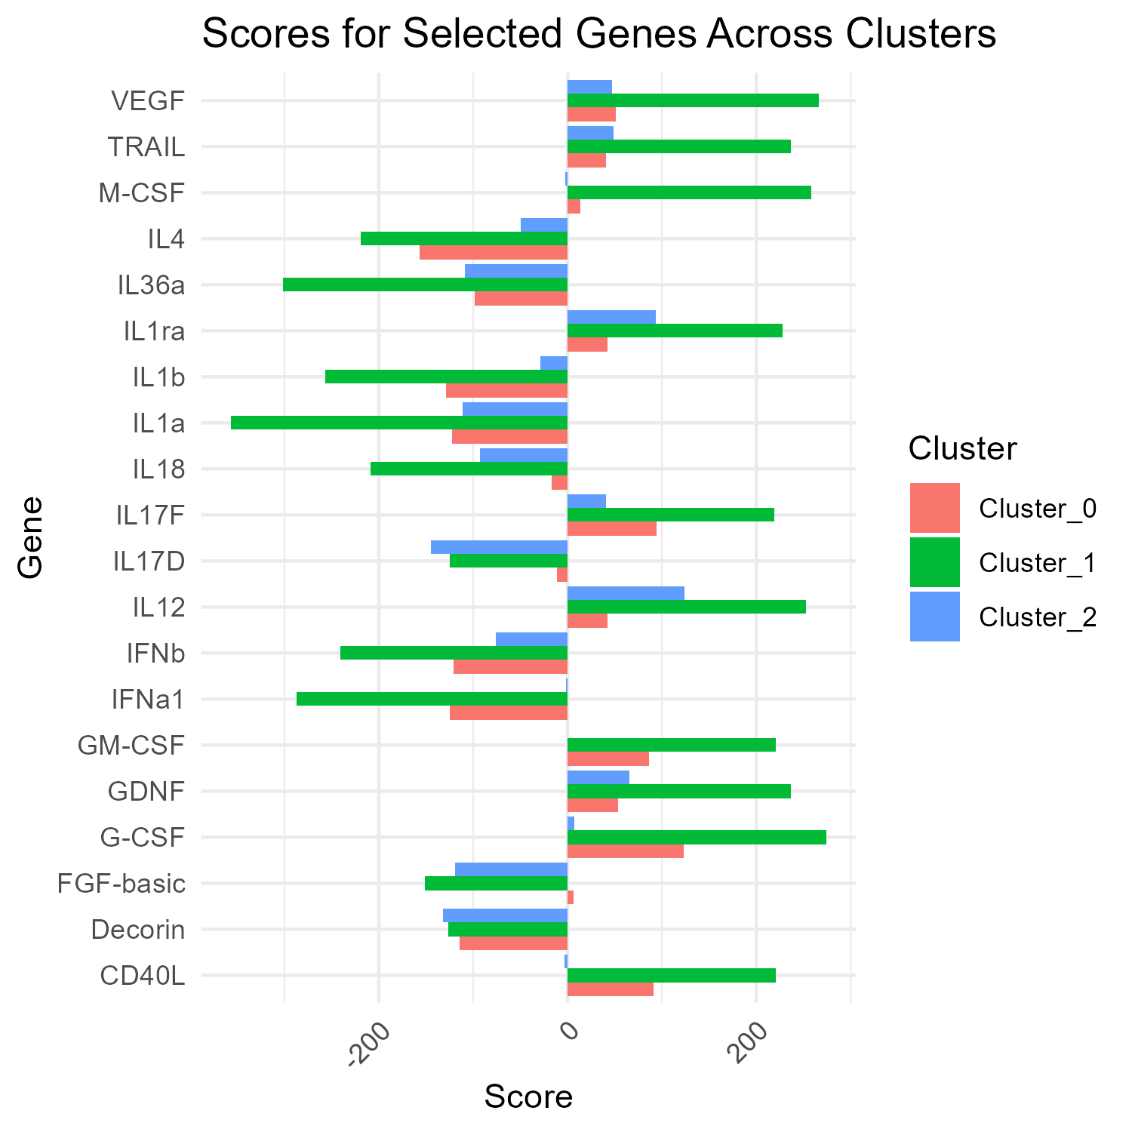
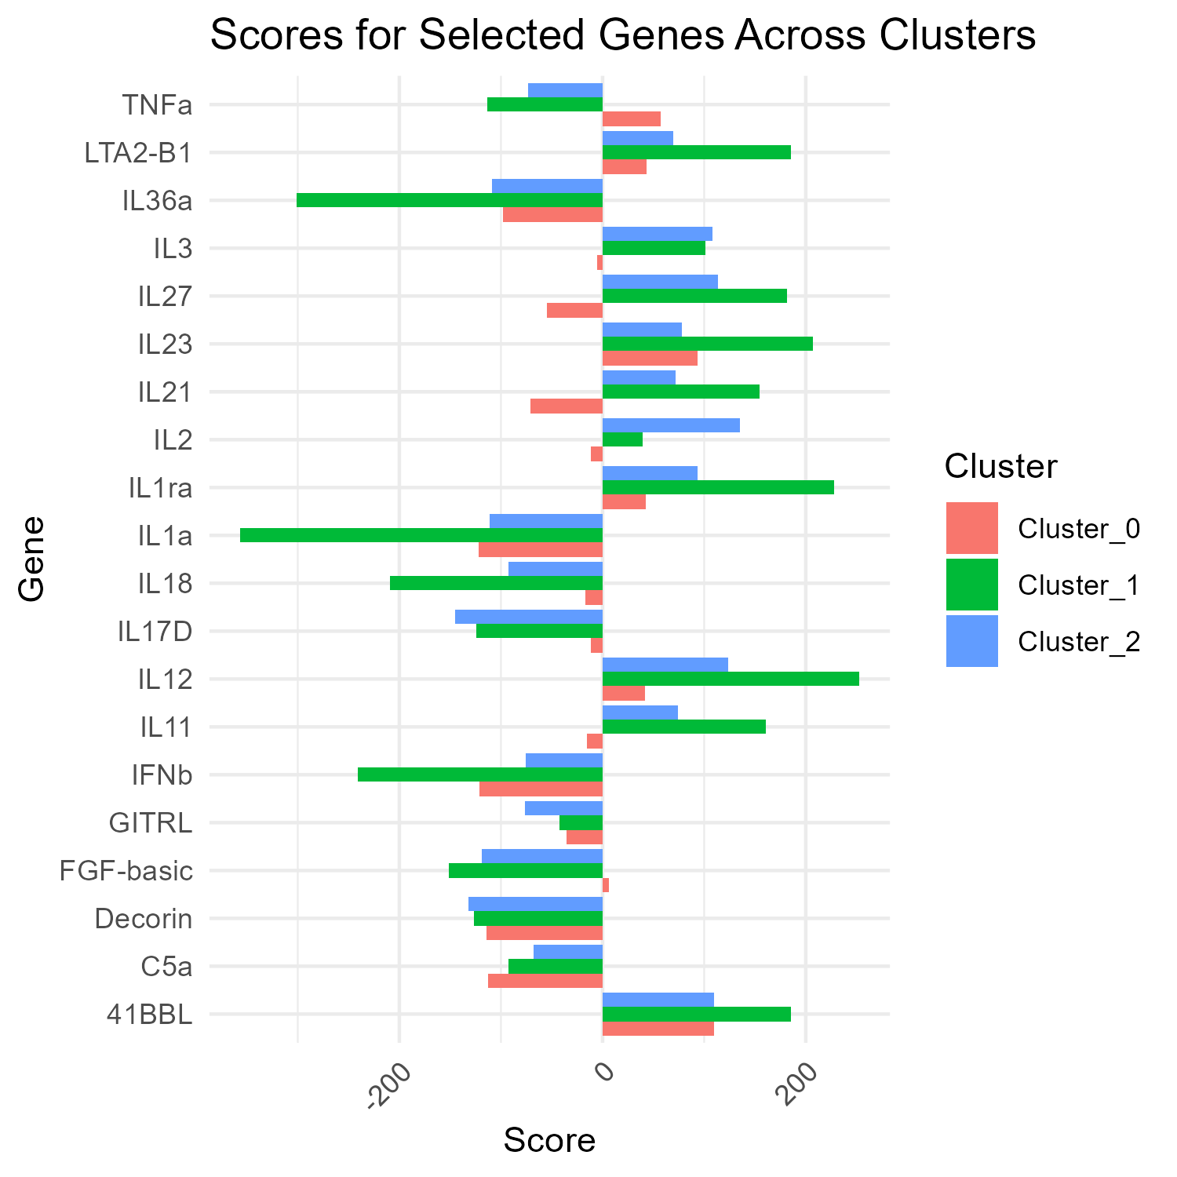
cytokine analysis
Cluster 0
Cluster 1
Cluster 2

Slide 52
cytokine analysis
- il-2 high only in cluster 2, not in cluster 1 - CD40L high in both cluster 0 & 1. seemed like not responder trait, but cluster 1 seemed as responder cluster. maybe cluster 1 is less "responsive" than cluster 2 - some cytokines show linkage of cluster 0,1, and 2 is different. may tell some more about cluster identities

Slide 53
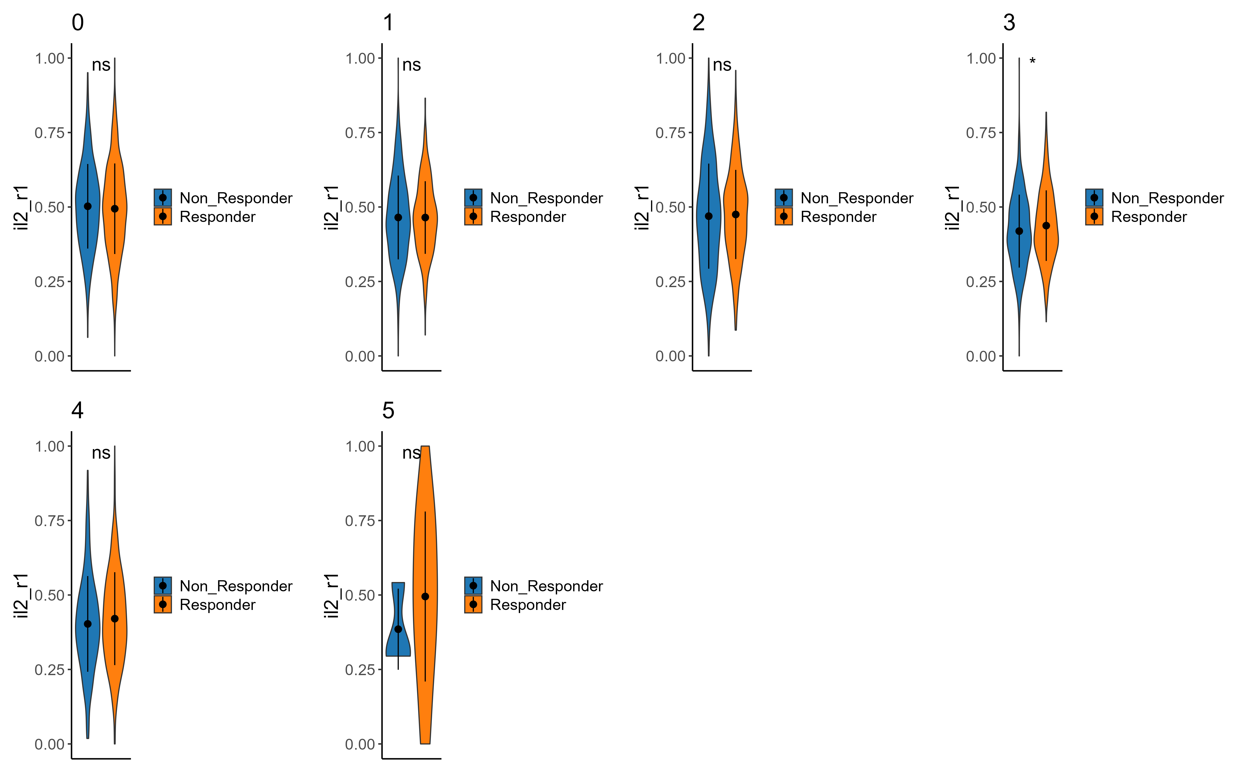
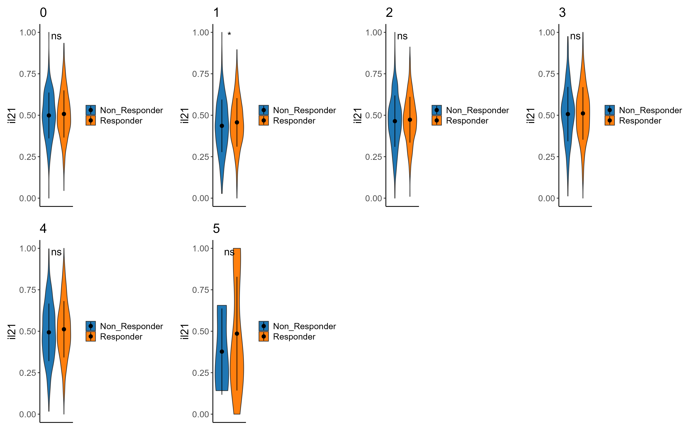
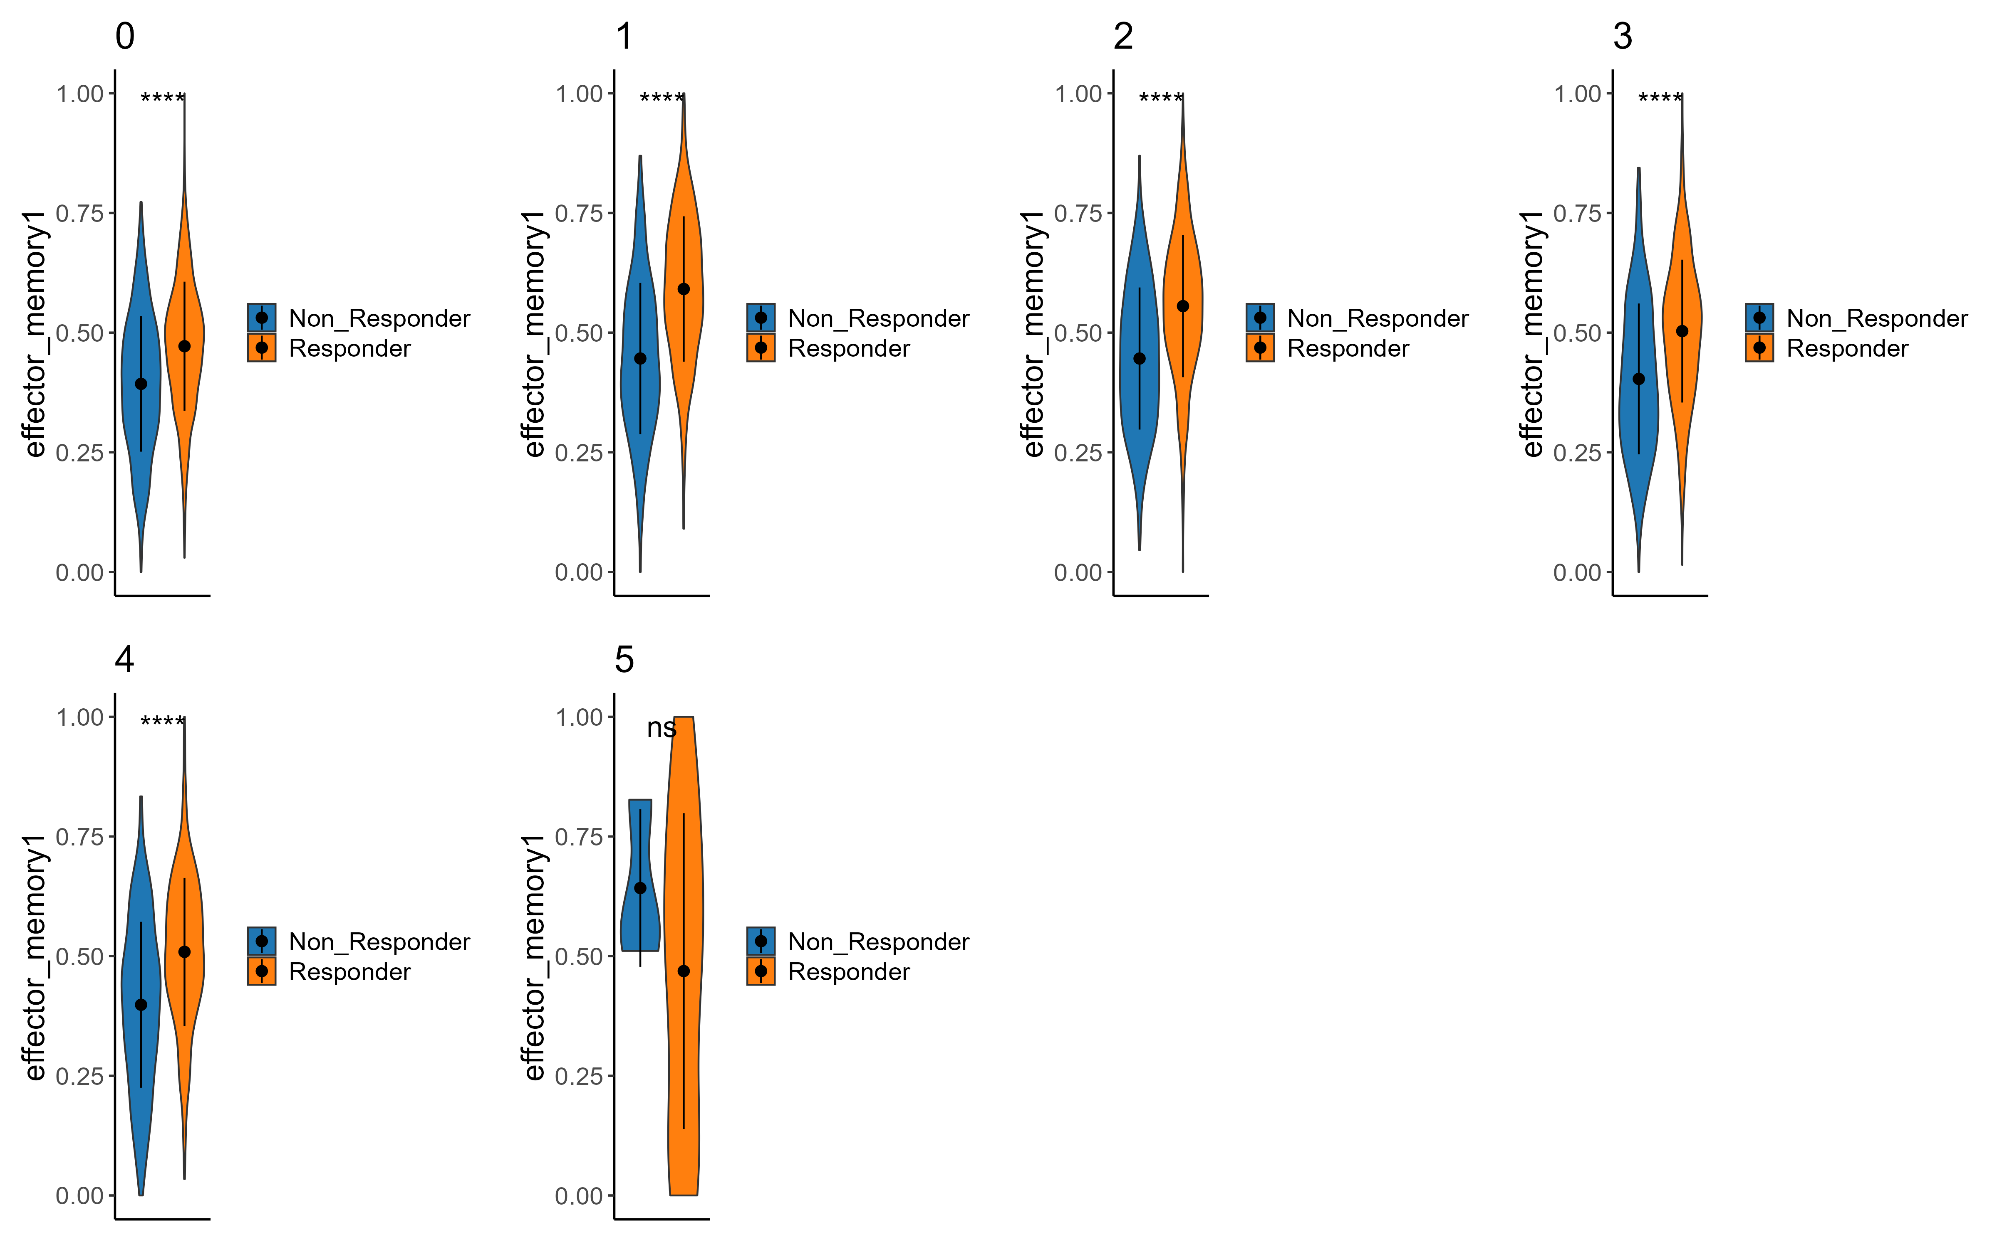
Signatures – cluster 1
il2
il2r
Effector memory

Slide 54
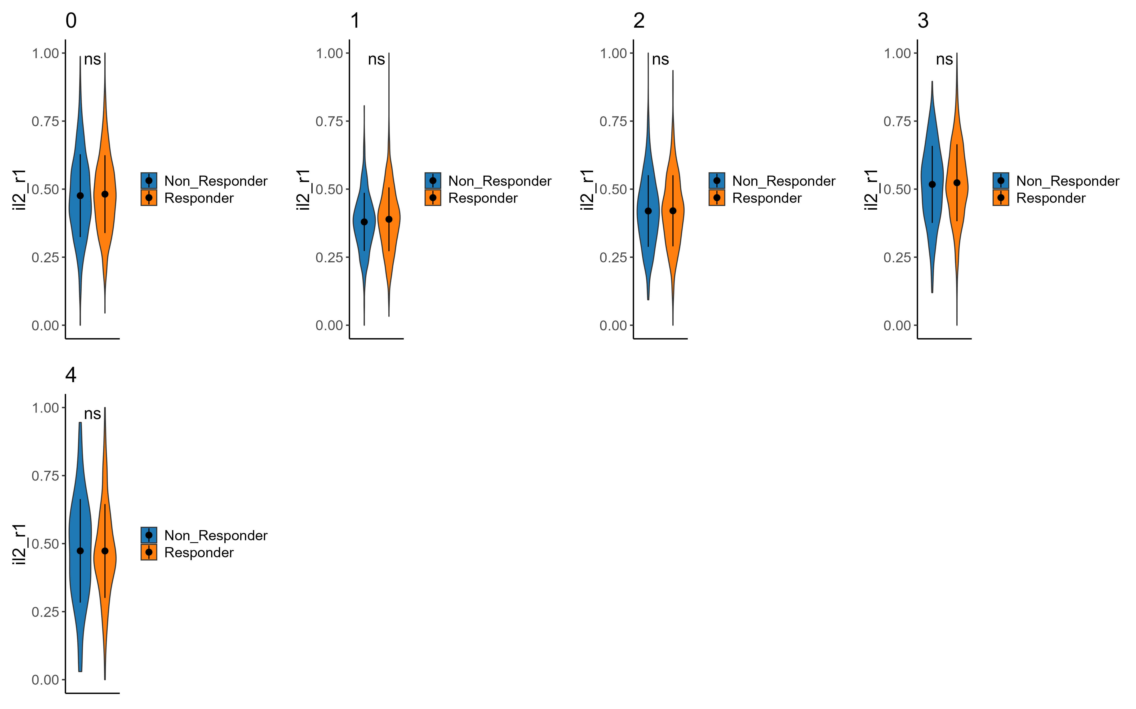
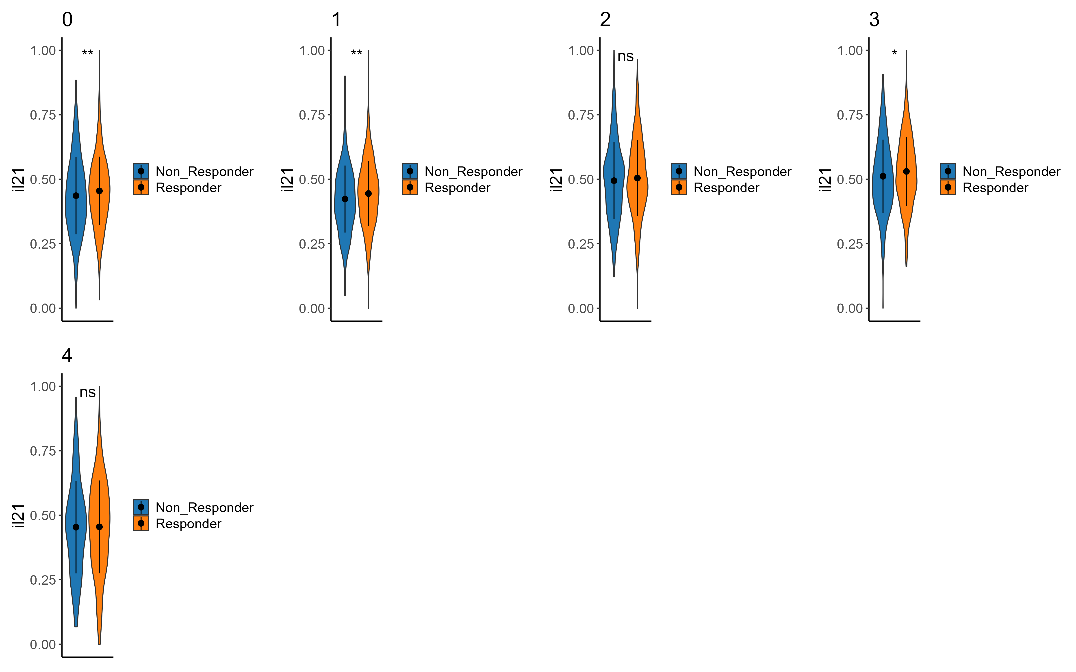
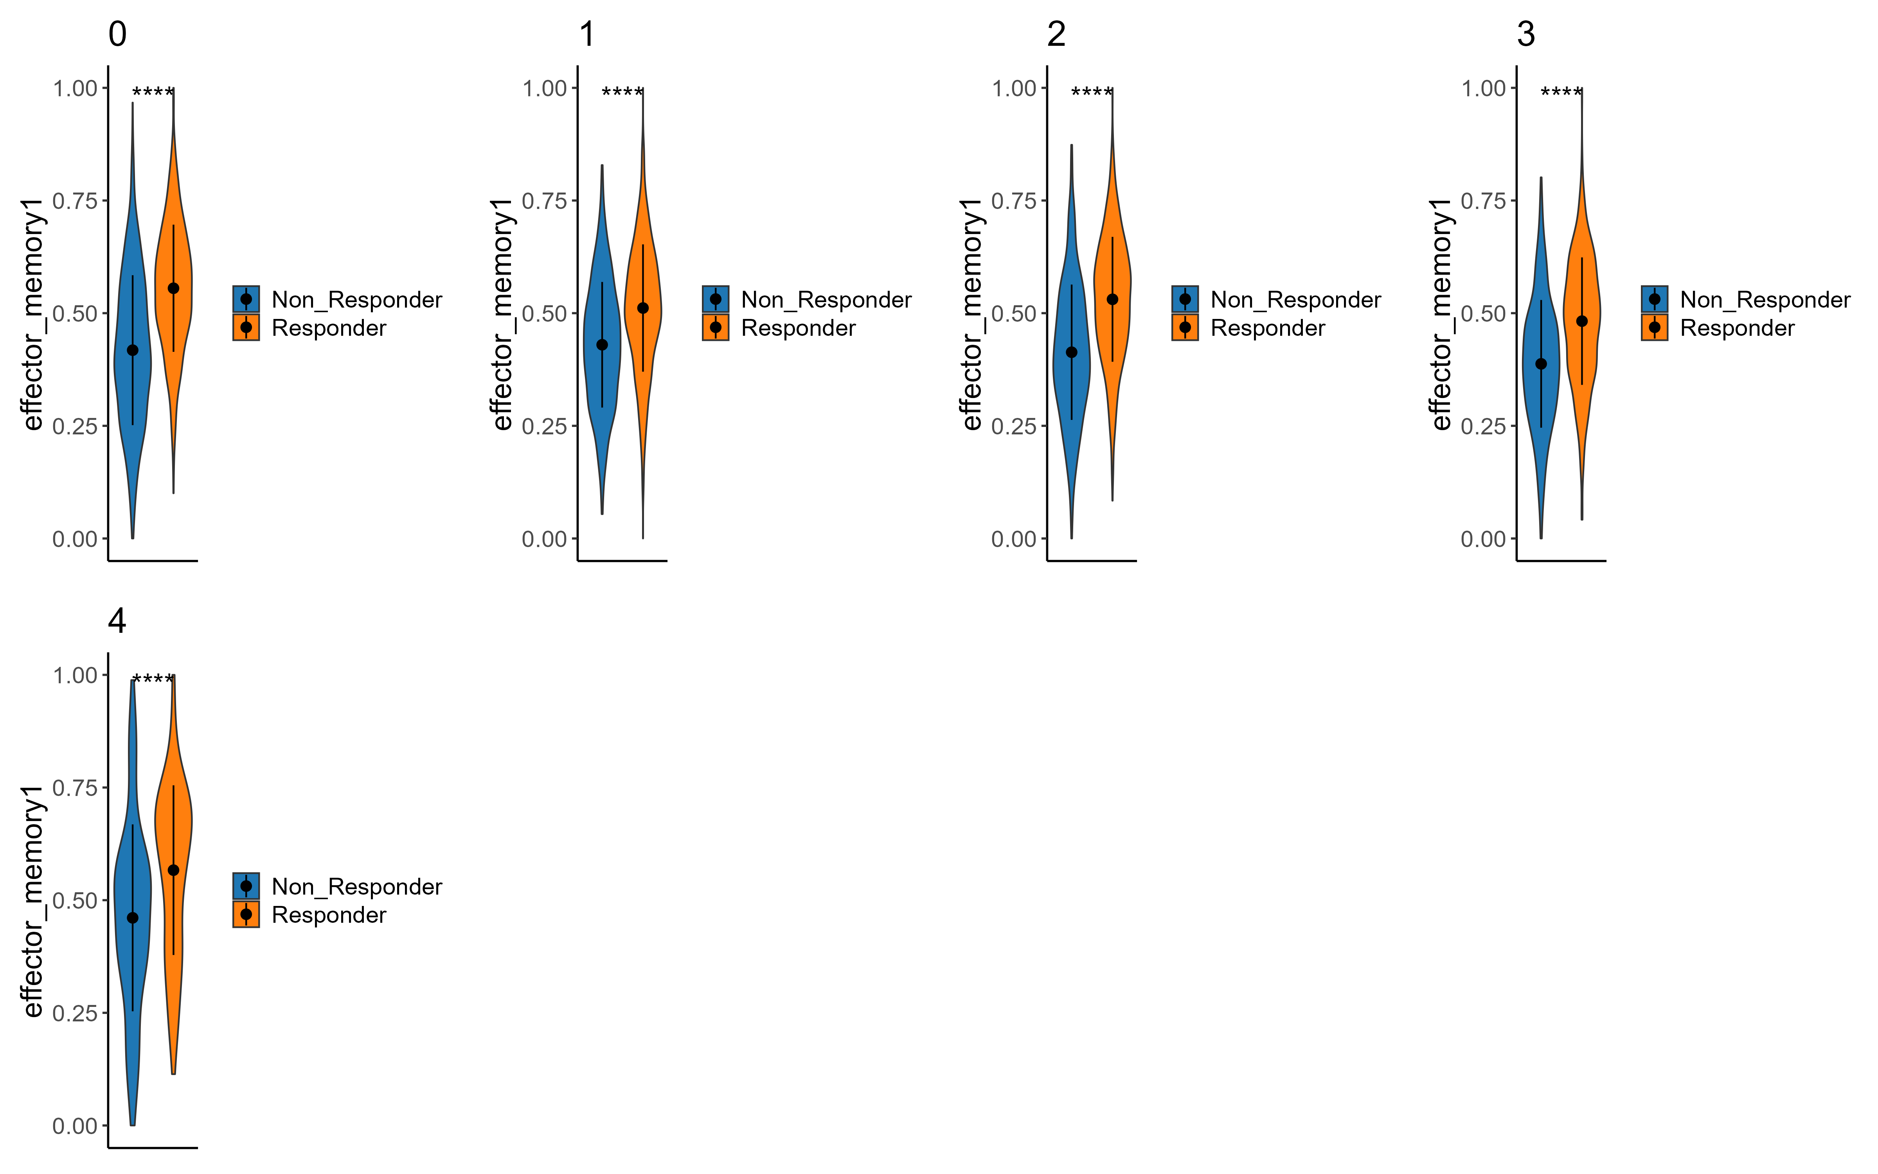


Signatures – cluster 2
il2r
il2
Effector memory
Persistance_upregulated
Cd8 memory

Slide 55
Signature summary
- il2 signature significant between responders & non in cluster 2 sub analysis, but not in cluster 1 - il2r not significant between responders & non in both clusters 1&2 - big difference in effector memory signature in both clusters
- cd8 memory & persistence signatures upregulated in responders vs non responders in cluster 2 much more than in cluster 1.

Slide 56




Signatures – cluster 0 - telomere length associated
downregulated signature
Upregulated signature
Notes:
Longer telomere = younger cell -> more persistance

Slide 57




Signatures – cluster 1 - telomere length associated
downregulated signature
Upregulated signature
Notes:
Longer telomere = younger cell -> more persistance

Slide 58




Signatures – cluster 2 - telomere length associated
downregulated signature
Upregulated signature
Notes:
Longer telomere = younger cell -> more persistance

Slide 59
Telomere signature summary
In cluster 0 we see higher expression of negatively correlated genes in responders than non-responders.
in clusters 1,2 we see lower expression of downregulated genes and higher expression of upregulated genes correlated with longer telomers.
Andreu-Sánchez, S., Aubert, G., Ripoll-Cladellas, A. et al. Genetic, parental and lifestyle factors influence telomere length. Commun Biol 5, 565 (2022).

Slide 60
פאנל פאקס ופאנל אלייזה(מה אנחנו הולכים לבדוק עכשיו)

Slide 61
jak inhibitors

Slide 62
Observations - summary
ILR7 higher in responders (strongly aligns with literature)
CD40LG higher in non responders(as opposed to paper)
GZMB, prf1, IFNG, GZMK, CD27, : higher in responders
effector/memory : KLF2, higher in responders
lower expression of ENTPD1 in responders (both in cd8 &cd4)
(TIM3 and ENTPD1 mark the exhausted-like state of CD8+ T cells)
N4 acts like responders in cluster 0, 1(a bit in 2 aswell) of all_cells(maybe interesting that he is not a responder ? )
- il2 signature significant between responders & non in cluster 2 sub analysis, but not in cluster 1 - il2r not significant between responders & non in both clusters 1&2
Longer telomers in responders in clusters 1,2 indicating naïve-like qualities.
DE between responders and non-respondesr in all_cells : SELL, CD27, GZMK, TRAV5
N4 acts like responders in cluster 0, 1(a bit in 2 aswell) of all_cells(maybe interesting that he is not a responder ? )

Slide 63
conclusions
upregulate effector marker
cd4\cd8 ratio ? persister cd4 traits ?

Slide 64
Next steps
Heatmaps of signatures

Slide 65



The team Contact: asafmadi@tauex.tau.ac.il

Slide 66
extras

Slide 67

CD69

Slide 68
observations
general : - lower expression of ENTPD1 in responders (both in cd8 &cd4) (TIM3 and ENTPD1 mark the exhausted-like state of CD8+ T cells) https://www.ncbi.nlm.nih.gov/pmc/articles/PMC6641984/ - N4 acts like responders in cluster 0, 1(a bit in 2 aswell) of all_cells(maybe interesting that he is not a responder ? ) - il2 signature significant between responders & non in cluster 2 sub analysis, but not in cluster 1 - il2r not significant between responders & non in coth clusters 1&2 -

